Slide 1
Seeing Change through to the Classroom
Effective Practice Indicators

Slide 2
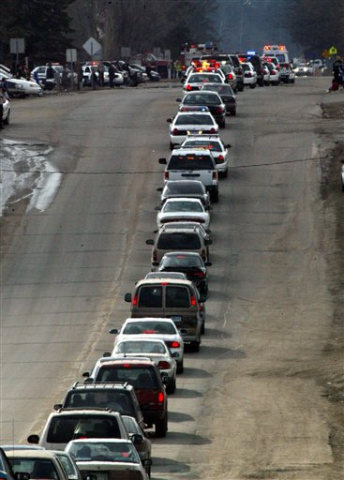
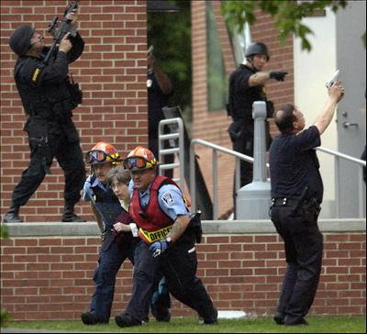
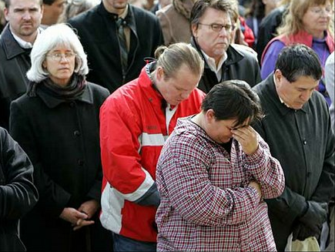
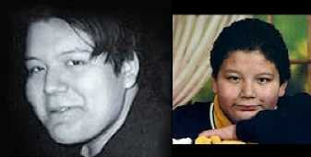

Slide 3


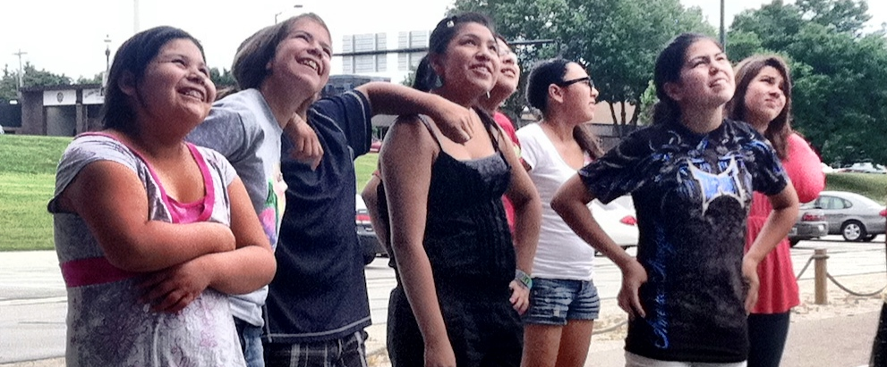
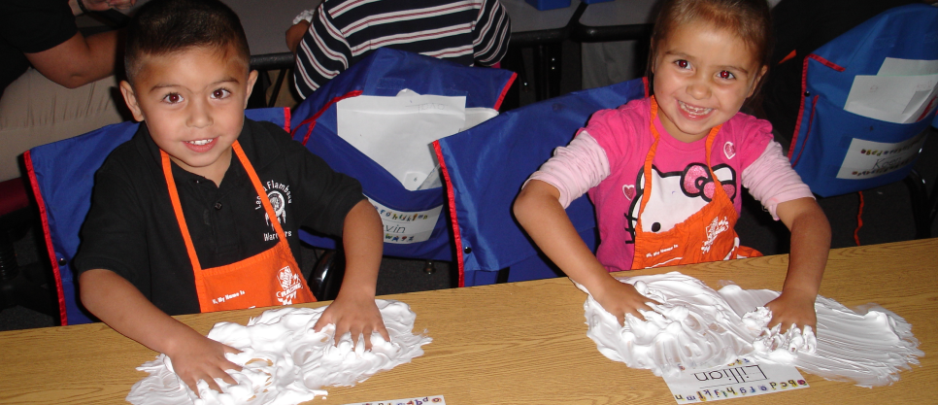

Slide 4


The Common Core benchmark (5.NF) for this concept reads as follows:
Add and subtract fractions with unlike denominators by replacing given fractions with equivalent fractions in such a way as to produce an equivalent sum of fractions with like denominators.

Slide 5
Effective Practice: Engage teachers in aligning instruction with standards and benchmarks
Effective Practice: Engage teachers in assessing and monitoring student mastery
Effective Practice: Engage teachers in differentiating and aligning learning activities.
Indicators

Slide 6


How much pizza?

Slide 7
A 5th grade teacher has opted to use the following problem to help her students explore the addition of unlike fractions:
My son and I had a pizza eating contest. He ate 1/2 of a jumbo pizza and I ate 1/4 of a pizza. How much pizza did we eat altogether?

Slide 8
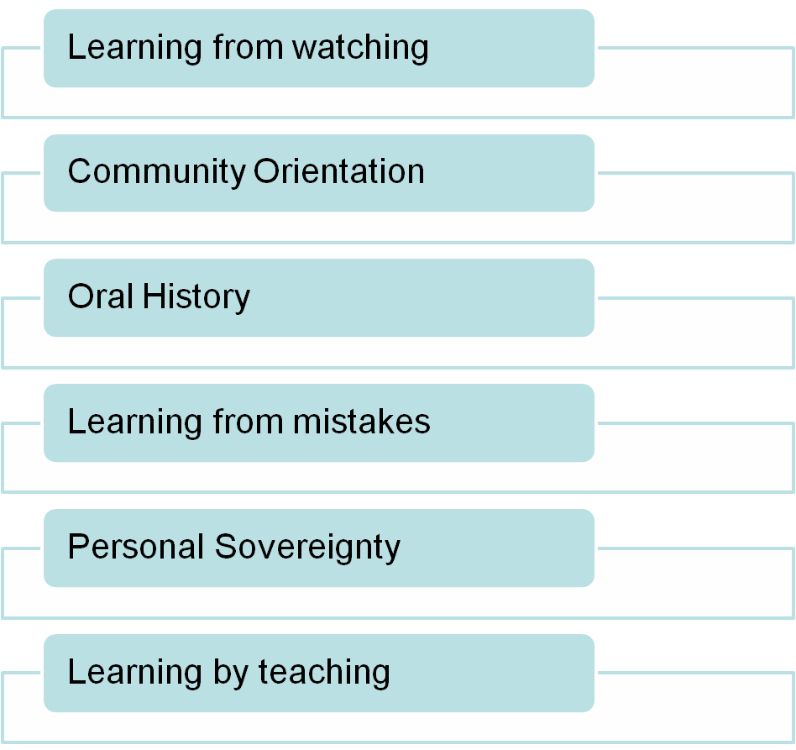
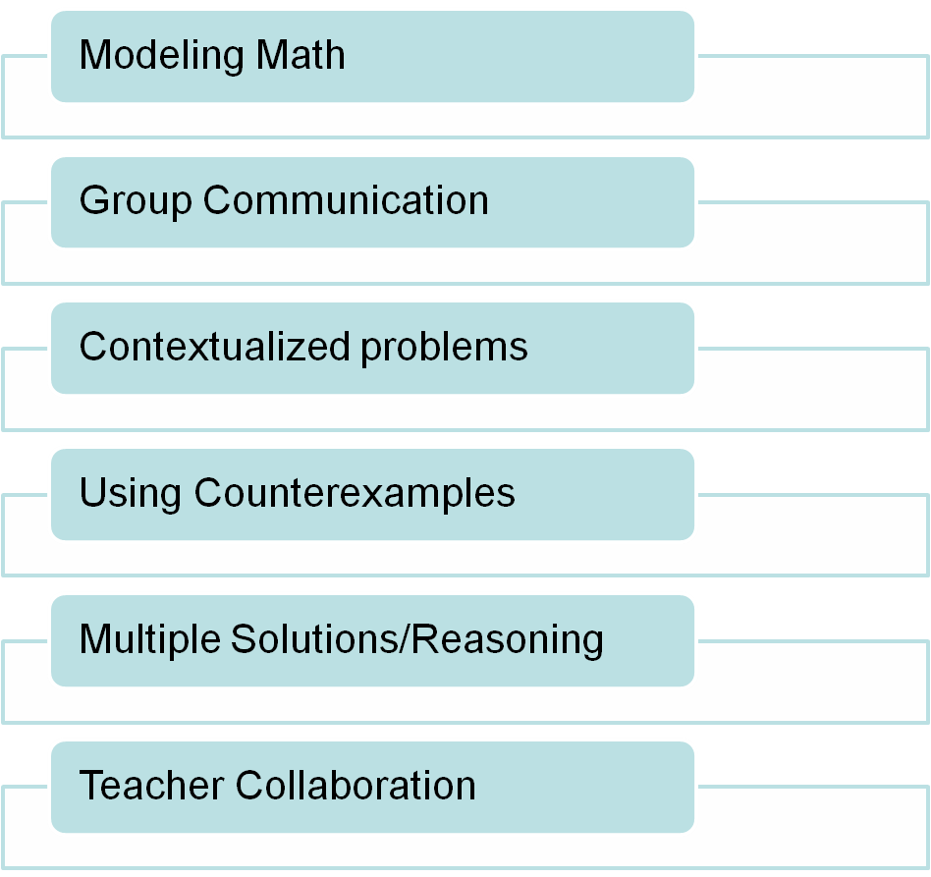
Commonality of Common Core
Ojibwe Pedagogy
Standards of Math Practice

Slide 9
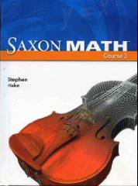
Lesson 76 in the teacher's manual calls for a review of numerators and denominators. It also requires the teacher to explain and define the term "unlike fractions." The teacher is then supposed to demonstrate the process for using multiples to create equivalent fractions, and finally have children practice this skill.

Slide 10
The following are student generated solutions

Slide 11

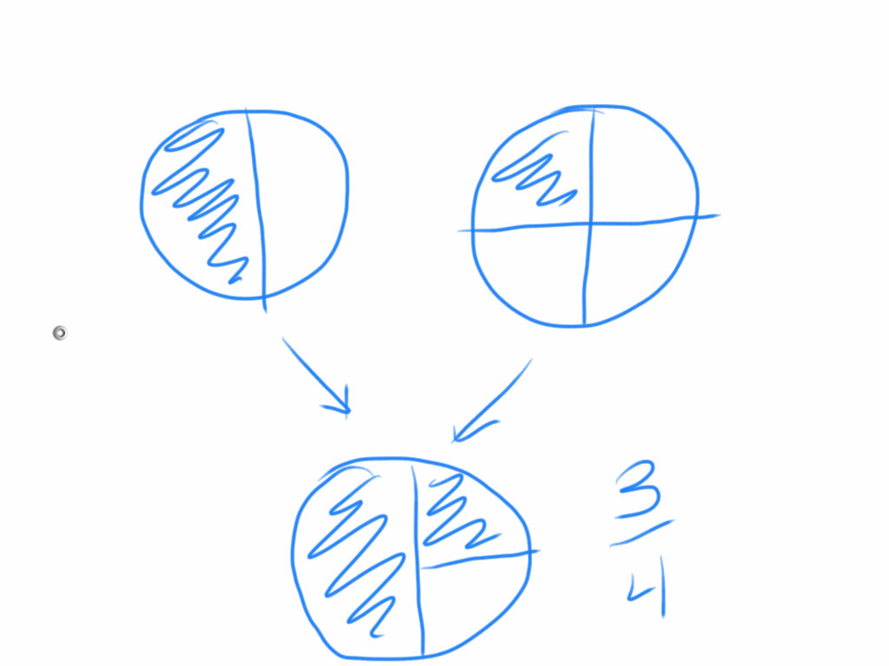

Slide 12
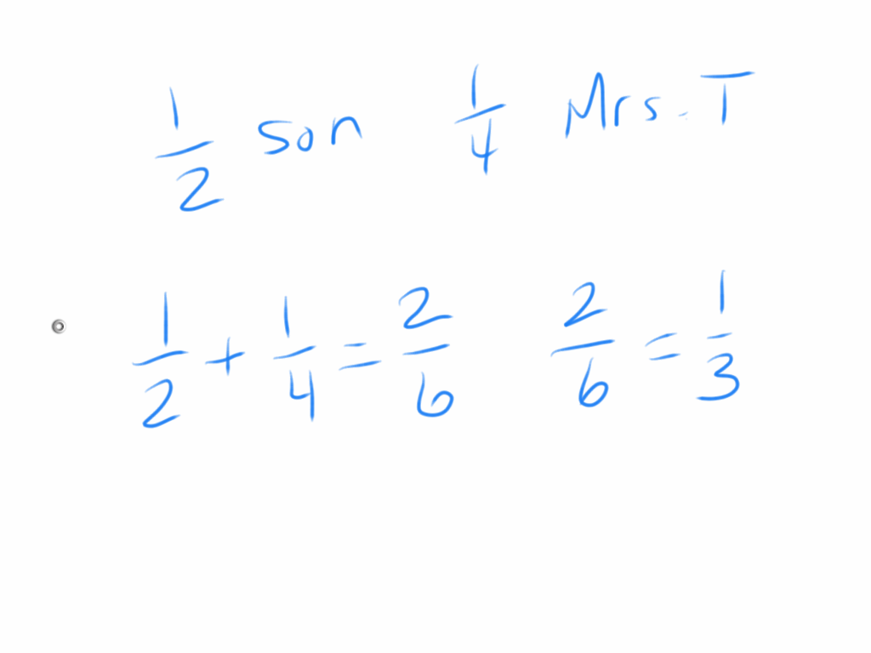

Slide 13
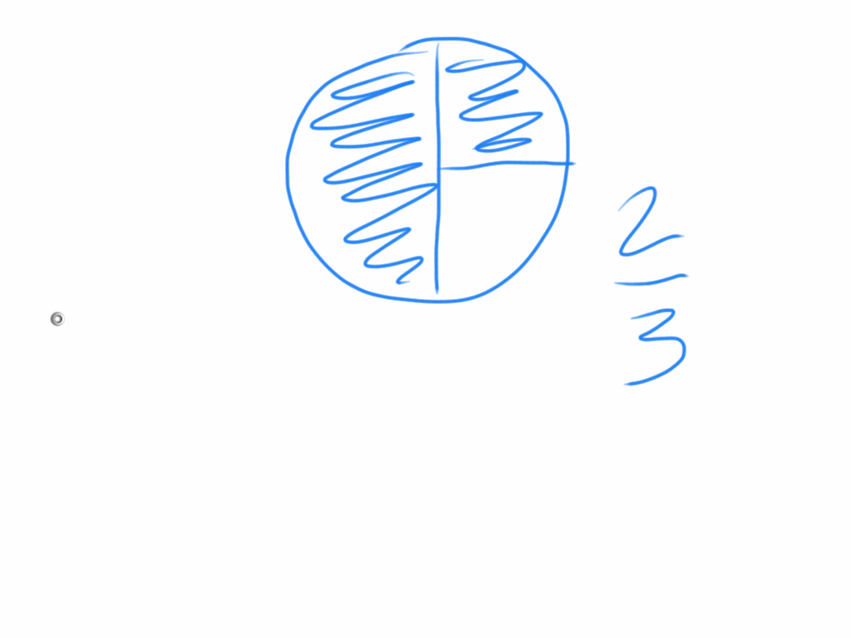

Slide 14
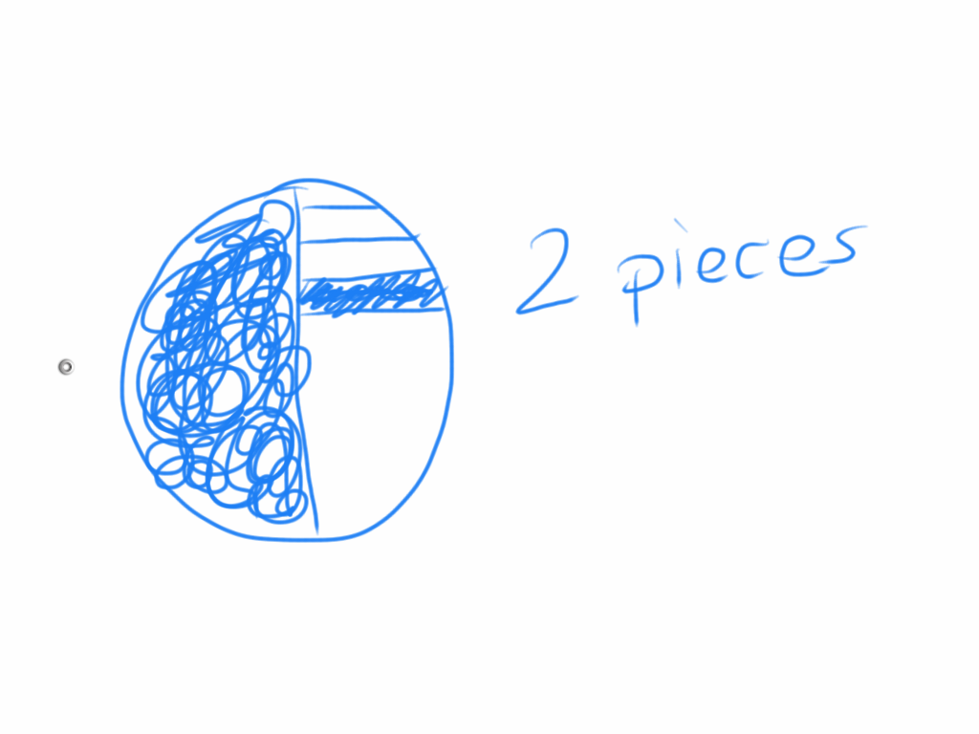

Slide 15
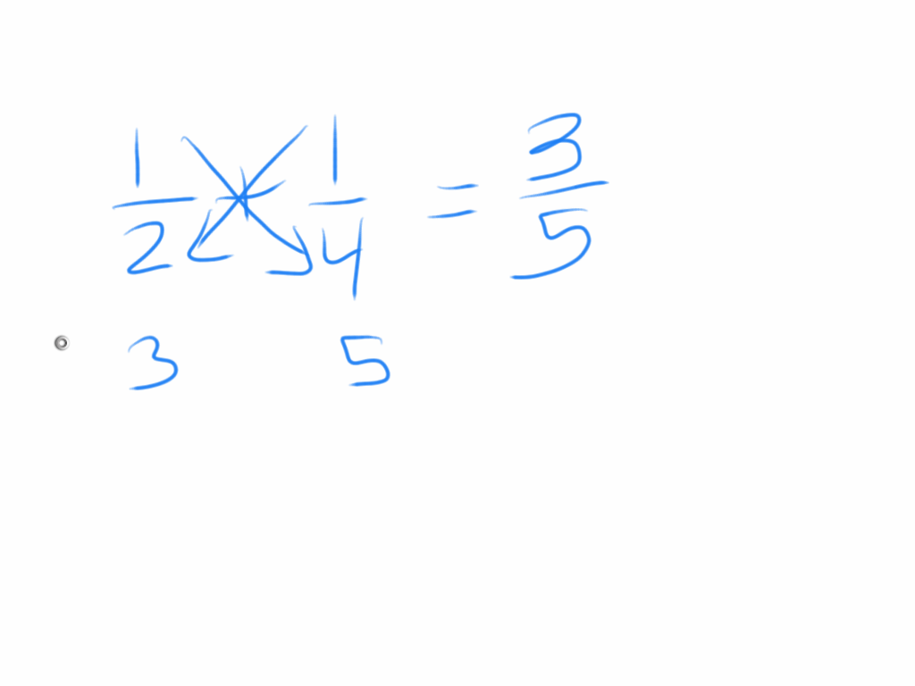

Slide 16
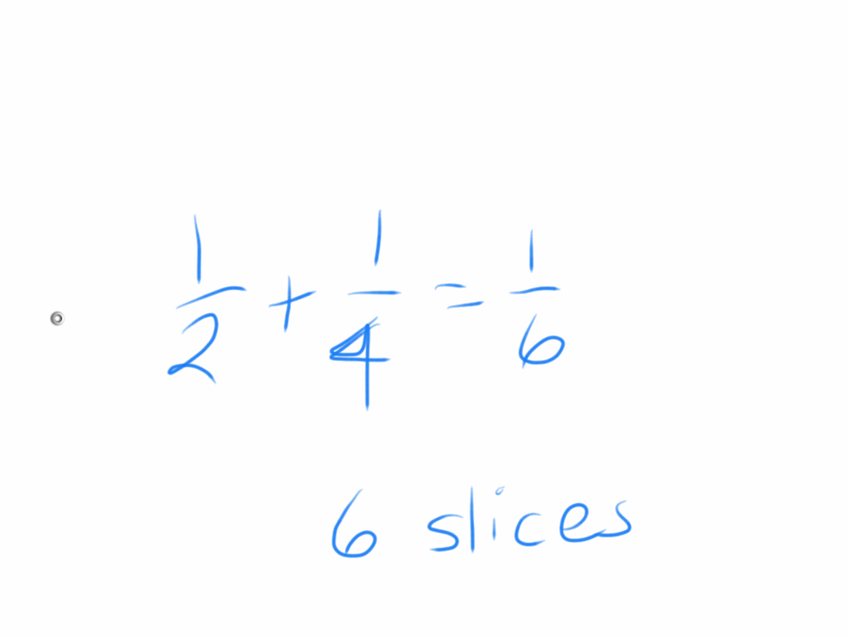

Slide 17
Effective Practice Indicators
Engage teachers in aligning instruction with standards and benchmarks
Lesson pre-conference to review specific learning objective(s)
Engage teachers in assessing and monitoring student mastery
Predict and search for student work to use during instruction
Engage teachers in differentiating and aligning learning activities
In debrief, would we change numbers, context, extension?

Slide 18
Task #1
Order student solutions from least proficient to most proficient (proximity to benchmark)
Effective Practice: Engage teachers in aligning instruction with standards and benchmarks

Slide 19

Discussion questions:
How does a teacher gauge benchmark proficiency informally?
How do you get teachers to self-reflect?
How do you measure "alignment?"

Slide 20
Task #2
Choose one example and write an open-ended (thought-provoking) question for the student to extend their thinking.
Effective Practice: Engage teachers in assessing and monitoring student mastery

Slide 21
Task #3
Teacher-directed Whole Group
Write 3 essential questions the teacher can use to adapt instruction for the various levels of understanding in her classroom
Effective Practice: Engage teachers in differentiating and aligning learning activities.

Slide 22
Task #4
Develop an action outline for the instructional planning team to examine and discuss for the remainder of the unit.
Effective Practice: Engage teachers in aligning learning activities.

Slide 23
Discussion questions:
What is the purpose of an instructional team?
How does your role influence the team?
How do we determine success of teams?

Slide 24
Principal Strategies for Improving Instruction
Deprivatize instruction
Question, question, question
Go outside box to engage
Create self-reflection

Slide 25
Question & Answer

