Slide 1
Personal Competencies Academy
Academic Development Institute
Center on Innovations in Learning

Slide 2
Day 1 Agenda
8:30 Registration and Coffee
9:00 Welcome and Introductions
9:15 Introduction to the Personal Competencies
10:30 Break
10:45 Introduction to the Personal Competencies, continued
12:00 Working Lunch - Case Study
1:00 How the Personal Competencies Interact
1:15 Personal Competencies and You
1:45 Personal Competencies and Your Students
2:15 Break
2:30 Case Study Gallery Walk and Discussion
3:30 Wrap Up and Instructions for Tomorrow
4:00 Adjourn

Slide 3
Professional Learning Objectives
All participants will be able to define and understand the four personal competencies and how they impact learning.
All participants will understand how the four personal competencies apply to their own lives.
All participants will be able to demonstrate how they will incorporate the four personal competencies in their work to benefit students.
Teachers will adapt a lesson plan to include the personal competencies.
Teachers will be able to independently construct lesson plans that include enhancement of the four personal competencies.

Slide 4
The Importance of the Personal Competencies
“Currently the U.S. education system draws from a rigorous and well-developed set of academic standards for learning which focus on what children should know and be able to do. However, success in the classroom and beyond relies on much more than mastery of these academic standards. If academic standards are what students need to learn, there are also skills and mindsets that prepare and support how students learn. Successful engagement in the classroom and in life relies on a set of cognitive and social-emotional skills and mindsets, which are not represented in academic standards.”
Source: Turnround for Children: http://www.turnaroundusa.org/what-we-do/tools/

Slide 5
The Importance of the Personal Competencies
“Currently the U.S. education system draws from a rigorous and well-developed set of academic standards for learning which focus on what children should know and be able to do. However, success in the classroom and beyond relies on much more than mastery of these academic standards. If academic standards are what students need to learn, there are also skills and mindsets that prepare and support how students learn. Successful engagement in the classroom and in life relies on a set of cognitive and social-emotional skills and mindsets, which are not represented in academic standards.”
Source: Turnround for Children: http://www.turnaroundusa.org/what-we-do/tools/
This training will focus on those “other” things that help students succeed.

Slide 6
Your Classroom Teaching Practices
Complete the Classroom Practices Survey on pages 5-8 of your packet. Please do not total your scores yet!

Slide 7
What are the Personal Competencies?
The four “propellants” of learning
Cognitive Competency
Metacognitive Competency
Motivational Competency
Social/Emotional Competency

Slide 8
What the Research Tells Us
Most Influential School/Environment Effects and Student Attributes (Wang, Haertel, & Walberg, 1993, 1997)
Classroom Management
Metacognitive Processes
Cognitive Processes
Home Environment/Support
Student-Teacher Social Interactions
Social/Behavioral Attributes
Motivational-Affective Attributes
Peer Group
Quality of Instruction—student engagement
School Culture
Classroom Climate
Classroom Instruction—clear and organized
Curriculum Design
Academic Interactions
Classroom Assessment

Slide 9
What the Research Tells Us
Most Influential School/Environment Effects and Student Attributes
(Wang, Haertel, & Walberg, 1993, 1997)
Classroom Management
Metacognitive Processes
Cognitive Processes
Home Environment/Support
Student-Teacher Social Interactions
Social-Behavioral Attributes
Motivational-Affective Attributes
Peer Group
Quality of Instruction—student engagement
School Culture
Classroom Climate
Classroom Instruction—clear and organized
Curriculum Design
Academic Interactions
Classroom Assessment
Four of the top 15 are the Personal Competencies.
Notes:
Using a variety of methods, Wang, et al. (1977) identified 28 categories of learning influence. Of the 11 most influential domains of variables, 8 involved social-emotional influences: classroom management, parental support, student- teacher interactions, social- behavioral attributes, motivational- effective attributes, the peer group, school culture, and classroom climate (Greenberg et al., 2003). Distant background influences (e.g., state, district, or school policies, organizational characteristics, curriculum, and instruction) were less influential. Wang et al. (1997) concluded that "the direct intervention in the psychological determinants of learning promise the most effective avenues for reform" (p. 210). Wang et al.’s research review targeted student learning characteristics (i.e., social, behavioral, motivational, affective, cognitive, and metacognitive) as the set of variables with the most potential for modification that could, in turn, significantly and positively effect student outcomes (DiPerna et al., 2002).

Slide 10
Competency Definitions Review
Competency | Cognitive Competency | Metacognitive Competency | Motivational Competency | Social/Emotional Competency
Definition | Prior knowledge that organizes the mind and provides associations to support new learning
Guiding Question | What are you learning?

Slide 11
Competency Definitions Review
Competency | Cognitive Competency | Metacognitive Competency | Motivational Competency | Social/Emotional Competency
Definition |  | Self-regulation of learning and use of learning strategies (problem solving, synthesis, creative thinking)
Guiding Question |  | How are you learning it?

Slide 12
Competency Definitions Review
Competency | Cognitive Competency | Metacognitive Competency | Motivational Competency | Social/Emotional Competency
Definition |  |  | Engagement and persistence in pursuit of goals (learning and life)
Guiding Question |  |  | Why are you learning it?

Slide 13
Competency Definitions Review
Competency | Cognitive Competency | Metacognitive Competency | Motivational Competency | Social/Emotional Competency
Definition |  |  |  | Sense of self-worth, regard for others, and emotional understanding and management to set goals and make responsible decisions
Guiding Question |  |  |  | What will it help you do that is important?

Slide 14
Competency Definitions Review
Competency | Cognitive Competency | Metacognitive Competency | Motivational Competency | Social/Emotional Competency
Definition | Prior knowledge that organizes the mind and provides associations to support new learning | Self-regulation of learning and use of learning strategies (problem solving, synthesis, creative thinking) | Engagement and persistence in pursuit of goals (learning and life) | Sense of self-worth, regard for others, and emotional understanding and management to set goals and make responsible decisions
Guiding Question | What are you learning? | How are you learning it? | Why are you learning it? | What will it help you do that is important?

Slide 15
Competency Definitions Overview
Learning Habits
Transformation of the personal competencies into patterns of behavior used in confronting new learning tasks
Relational Suasion
The teacher’s ability to influence a student’s learning and personal competency by virtue of the teacher’s personal knowledge of and interaction with the student and the student’s family

Slide 16
How do the Personal Competencies Interact?
There is natural overlap between the four personal competencies.
Think about:
How improved metacognition improves the outcomes in the cognitive domain, or
How social/emotional awareness may lead to higher motivation
Can you think of any other examples of how these competencies interact in your classroom?
Cognitive
Metacognitive
Motivational
Social/Emotional

Slide 17
How do the Personal Competencies Interact?
Cognitive
Metacognitive
The intersection of these competencies is where learning habits develop.
Motivational
Social/Emotional

Slide 18
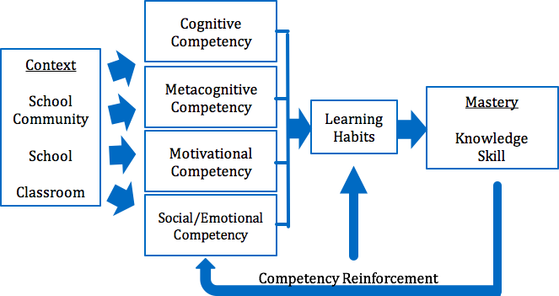
Personal Competency Framework
Redding, S. (2014). The Something Other: Personal competencies for learning and life. Philadelphia, PA: Temple University, Center on Innovations in Learning.

Slide 19
The Contexts for Competencies
The competencies are built within and across three contexts:
School Community
School
Classroom

Slide 20
Cognitive Competency
Definition: Prior knowledge which facilitates new learning; broad knowledge acquired in any context, accessible in memory to facilitate new learning; sufficient depth of understanding to expedite acquisition of new learning
Redding, S. (2016). Competencies and personalized learning. In M. Murphy, S. Redding, and J. Twyman (Eds.), Handbook on personalized learning for states, districts, and schools (pp. 3–18). Philadelphia, PA: Temple University, Center on Innovations in Learning.
What teachers need to know:
Standards
Curricula
Cognitive development
What teachers need to focus on:
Vocabulary
Writing tasks
Connections to prior learning

Slide 21
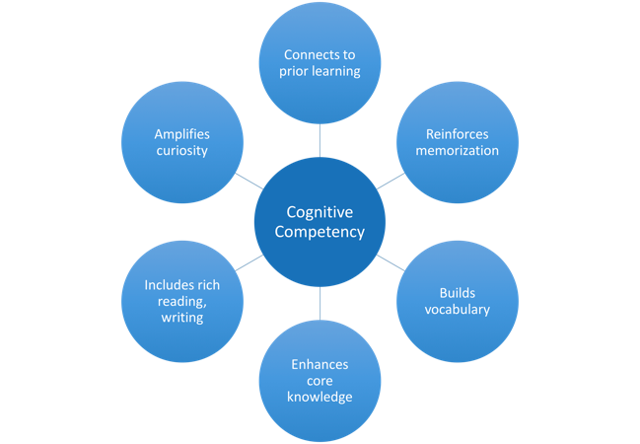

Slide 22
Cognitive Competency

Slide 23
Strategies for Cognitive Competency
Add up your total score for Part I of the survey you took this morning.
This section represents behaviors within the Cognitive Competency.

Slide 24
Strategies for Cognitive Competency
Thinking about the practices within the Cognitive Competency …
Which classroom practices do you already use that are related to cognitive competency?
What are some challenges you experience in implementing the cognitive competency?
What are your most effective strategies that you have used in your own classroom to support these practices related to cognitive competency?

Slide 25
Metacognitive Competency
Definition: Self-regulation of learning and use of learning strategies; “thinking about one’s thinking”
Redding, S. (2016). Competencies and personalized learning. In M. Murphy, S. Redding, and J. Twyman (Eds.), Handbook on personalized learning for states, districts, and schools (pp. 3–18). Philadelphia, PA: Temple University, Center on Innovations in Learning.
What teachers need to know:
Metacognition requires modeling, explicit instruction, and practice
What teachers need to focus on:
Reflection
Learning strategy selection
Critical thinking and reasoning

Slide 26
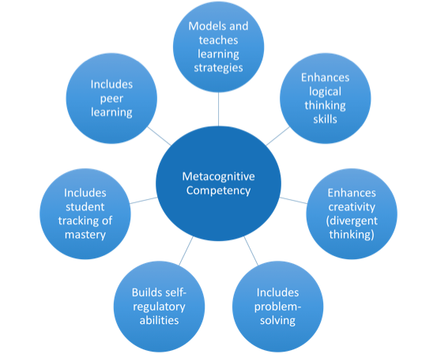

Slide 27
Metacognitive Competency
Video on annotation from a high school perspective
https://www.teachingchannel.org/videos/student-annotated-reading-strategy

Slide 28
Strategies for the Metacognitive Competency
Add up your total score for Part II of the survey you took this morning.
This section represents behaviors within the Metacognitive Competency.

Slide 29
Strategies for the Metacognitive Competency
Thinking about the practices within the Metacognitive Competency...
Which classroom practices do you already use that are related to metacognitive competency?
What are some challenges you experience in implementing the metacognitive competency?
What are your most effective strategies that you have used in your own classroom to support these practices related to metacognitive competency?

Slide 30
Motivational Competency
Definition: Engagement and persistence in pursuit of goals
Redding, S. (2016). Competencies and personalized learning. In M. Murphy, S. Redding, and J. Twyman (Eds.), Handbook on personalized learning for states, districts, and schools (pp. 3–18). Philadelphia, PA: Temple University, Center on Innovations in Learning.
What teachers need to know:
Fixed vs. growth mindset
Intrinsic vs. extrinsic motivation
Influence of home life
What teachers need to focus on:
Praising effort, not talent
Student agency, autonomy, interest/value, relatedness

Slide 31
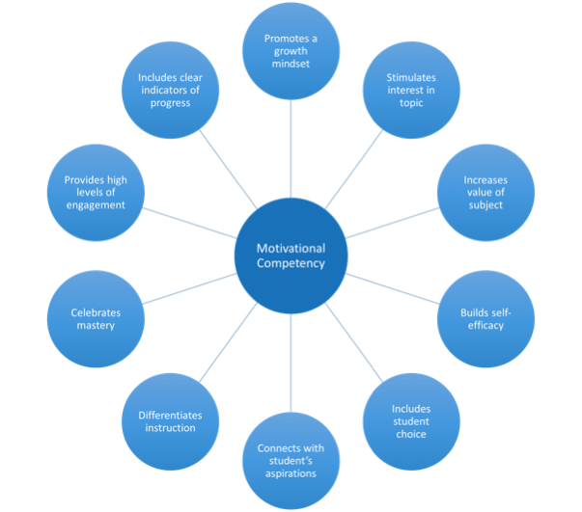

Slide 32
Motivational Competency
A video on persistence:
https://www.teachingchannel.org/videos/persist-through-challenges-perts

Slide 33
Strategies for the Motivational Competency
Add up your total score for Part III of the survey you took this morning.
This section represents behaviors within the Motivational Competency.

Slide 34
Strategies for the Motivational Competency
Thinking about the practices within the Motivational Competency...
Which classroom practices do you already use that are related to motivational competency?
What are some challenges you experience in implementing the motivational competency?
What are your most effective strategies that you have used in your own classroom to support these practices related to motivational competency?

Slide 35
Social/Emotional Competency
Definition: Sense of self-worth, regard for others, emotional understanding and management, ability to set positive goals and make responsible decisions
Redding, S. (2016). Competencies and personalized learning. In M. Murphy, S. Redding, and J. Twyman (Eds.), Handbook on personalized learning for states, districts, and schools (pp. 3–18). Philadelphia, PA: Temple University, Center on Innovations in Learning.
What teachers need to know:
Social/emotional learning requires modeling, explicit instruction, and practice
Teachers communicate that students belong in academic community
What teachers need to focus on:
Self-awareness/management
Social awareness
Relationship skills
Decision-making

Slide 36
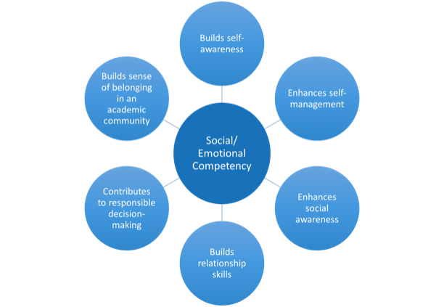

Slide 37
Social/Emotional Competency

Slide 38
Strategies for the Social/Emotional Competency
Add up your total score for Part IV of the survey you took this morning.
This section represents behaviors within the Social/Emotional Competency.

Slide 39
Strategies for the Social/Emotional Competency
Thinking about the practices within the Social/Emotional Competency...
Which classroom practices do you already use that are related to the social/emotional competency?
What are some challenges you experience in implementing the social/emotional competency?
What are your most effective strategies that you have used in your own classroom to support these practices related to the social/emotional competency?

Slide 40
Classroom Teaching Practices Survey Findings
Now compare the totals you reached on each of the sections.
Cognitive Competency (Part I) | Metacognitive Competency (Part II) | Motivational Competency (Part III) | Social/Emotional Competency (Part IV)

Slide 41
Classroom Teaching Practices Survey Findings
Now compare the totals you reached on each of the sections.
Go to www.pollev.com/amandaklein183 OR text AMANDAKLEIN183 to 22333 to join our survey session.
Did any of your results surprise you?

Slide 42
Personal Competencies and Your Students
Case Study
Think of the one student who frustrated you the most, who you felt you couldn’t reach.
Use the prompts on page 19 of your participant’s guide to reflect on how you engaged with this student.

Slide 43
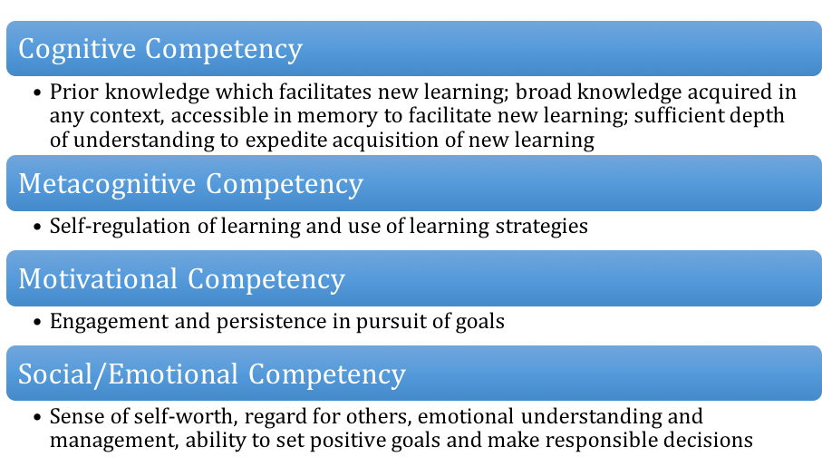
Competency Definitions Review
In use, these competencies turn into learning habits, behaviors used to tackle new learning tasks.

Slide 44
The Importance of the Personal Competencies Revisited
“If academic standards are what students need to learn, there are also skills and mindsets that prepare and support how students learn. Successful engagement in the classroom and in life relies on a set of cognitive and social-emotional skills and mindsets, which are not represented in academic standards.”
Source: Turnround for Children: http://www.turnaroundusa.org/what-we-do/tools/

Slide 45
The Importance of the Personal Competencies Revisited
Personal Competencies = “The Something Other”
Cognitive
Metacognitive
=
Motivational
Social/Emotional

Slide 46
Personal Competencies and You
We’ve all seen it - a child throwing a tantrum in a store.
The parent (maybe you!) is embarrassed, other shoppers are horrified, and a solution is needed right away!
What skills or behaviors does the parent need to properly address this situation?
How do those fit into the four competencies?

Slide 47
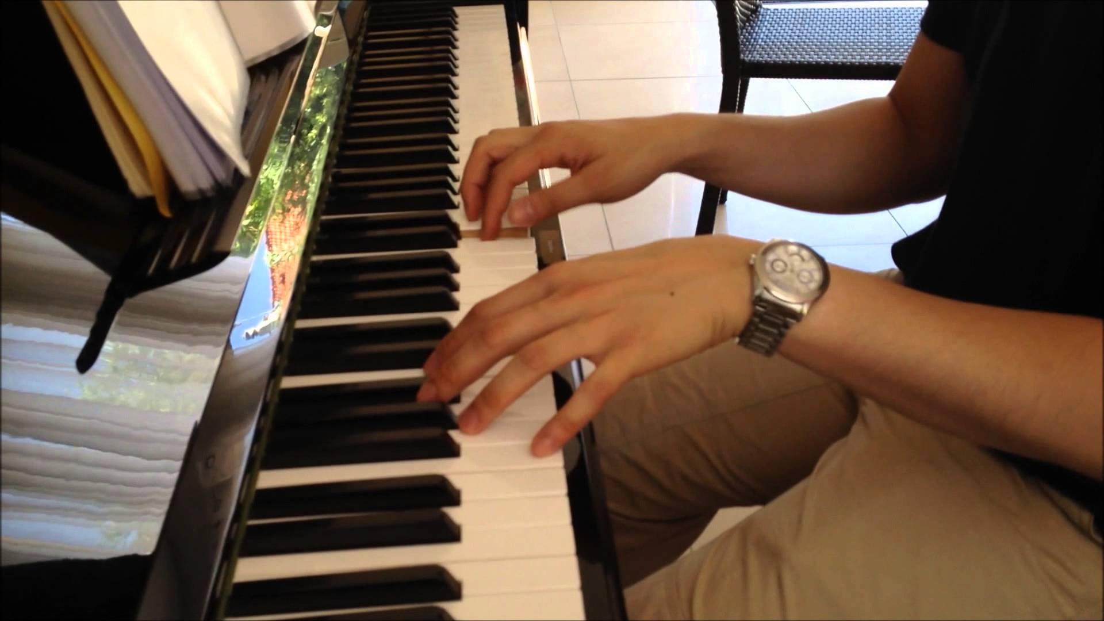
Personal Competencies and You
Think of a hobby that you have outside of work. How have you developed this interest/skill?
On page 18 of your participant’s guide, use the note paper to jot down your thoughts.
Odds are, you’ve used the personal competencies while learning this skill!

Slide 48
Personal Competencies and You
How can you connect your own hobby to the 4 competencies?
How did you build your knowledge/skill, and how do you continue to learn?
How do you reflect on and manage your learning/skills?
How do you stay motivated to continue learning? How do you deal with barriers (e.g., time demands, limited access to information) to your learning?
How do you build relationships, show empathy, and/or make responsible decisions within this area?
What are some similarities/differences among your table group members?

Slide 49
Personal Competencies and Your Students
How can you help students develop their personal competencies, and ultimately the learning habits they need to be successful?
Modeling of competencies in the classroom
Explicit teaching of how to use the competencies
Building relationships with students and families
These are the components of Relational Suasion.
Redding, S. (2016). Competencies and personalized learning. Philadelphia, PA: Temple University, Center on Innovations in Learning.

Slide 50
Relational Suasion and the Personal Competencies
Please read Jeffrey’s Story on pages 21-22 of your Participant’s Guide.

Slide 51
Relational Suasion and the Personal Competencies
Jeffrey’s Story
How did Ms. Johnson teach or reinforce the cognitive and metacognitive competencies within her classroom?
What about Ms. Johnson’s assignment enhanced Jeffrey’s motivational competency?
In what ways did Jeffrey’s social/emotional competency improve through his engagement with others?
How did Jeffrey exhibit a pattern of behavior in tackling Ms. Johnson’s assignment that might be useful to future learning?

Slide 52
Relational Suasion and the Personal Competencies
Relational Suasion - the teacher’s ability to influence a student’s learning and personal competencies by virtue of their personal knowledge of, and interaction with the student and the student’s family.
“Students develop personal competencies in part through instruction. They also acquire personal competencies through the modeling, encouragement, and caring exhibited by teachers and other people they respect.”
Redding, S. (2014). Personal competencies in personalized learning. Philadelphia, PA: Temple University, Center on Innovations in Learning.

Slide 53
Personal Competencies and Your Students
Teachers are responsible for:
What their students learn (cognitive competency),
Their ability (metacognitive competency) and desire (motivational competency) to learn, and
How students feel and interact with others while learning (social/emotional competency).
Building relationships with students and families help them meet these responsibilities.
Redding, S. (2013). Through the Student’s Eyes. Philadelphia, PA: Temple University, Center on Innovations in Learning.
Redding, S. (2014). Personal competencies in personalized learning. Philadelphia, PA: Temple University, Center on Innovations in Learning.

Slide 54
Personal Competencies and Your Students
Case Study
Think of the one student who frustrated you the most, who you felt you couldn’t reach.
How could you better incorporate (or have incorporated) the personal competencies into your interactions with that student (using your relational suasion) to improve your relationship and their outcomes?

Slide 55
To Prepare for Tomorrow
Bring in a lesson plan that you are comfortable sharing and critiquing.
This lesson could be your tried and true favorite, one that did not go as well as you would have liked, or a new one that you are developing.
Pick a lesson for which it would be useful to receive feedback.
You do NOT need to use a lesson plan that already exemplifies the personal competencies!

Slide 56
Day 2 Agenda
8:30 Welcome back and review of previous day
8:45 Introduction of Enhanced Lesson Design (ELD)
9:45 Break
10:00 Adapt lesson plan with ELD
11:30 Lunch
12:30 Reflecting on the ELD Process
1:30 Classroom Culture, School Culture, and School Community
2:30 Break
2:45 Wrap-Up and Evaluation
3:30 Adjourn

Slide 57
Let’s See What You’ve Learned
Which competency does this strategy enhance?
Review prior learning, connecting to new topics

Slide 58
Let’s See What You’ve Learned
Which competency does this strategy enhance?
Review prior learning, connecting to new topics
COGNITIVE

Slide 59
Let’s See What You’ve Learned
Which competency does this strategy enhance?
Establish classroom norms for personal responsibility, cooperation and concern for others

Slide 60
Let’s See What You’ve Learned
Which competency does this strategy enhance?
Establish classroom norms for personal responsibility, cooperation and concern for others
SOCIAL/EMOTIONAL

Slide 61
Let’s See What You’ve Learned
Which competency does this strategy enhance?
Review prior learning, connecting to new topics

Slide 62
Let’s See What You’ve Learned
Which competency does this strategy enhance?
Review prior learning, connecting to new topics
COGNITIVE

Slide 63
Let’s See What You’ve Learned
Which competency does this strategy enhance?
Connect learning tasks to the student’s personal aspirations

Slide 64
Let’s See What You’ve Learned
Which competency does this strategy enhance?
Connect learning tasks to the student’s personal aspirations
MOTIVATIONAL

Slide 65
Let’s See What You’ve Learned
Which competency does this strategy enhance?
Think out loud to show how a learning task is approached and pursued

Slide 66
Let’s See What You’ve Learned
Which competency does this strategy enhance?
Think out loud to show how a learning task is approached and pursued
METACOGNITIVE

Slide 67
Let’s See What You’ve Learned
Which competency does this strategy enhance?
Model responsible behavior, caring, optimism, and positive verbal interactions

Slide 68
Let’s See What You’ve Learned
Which competency does this strategy enhance?
Model responsible behavior, caring, optimism, and positive verbal interactions
SOCIAL/EMOTIONAL

Slide 69
Let’s See What You’ve Learned
Which competency does this strategy enhance?
Stretch the student’s interests to find value in new topics (acquired relevance)

Slide 70
Let’s See What You’ve Learned
Which competency does this strategy enhance?
Stretch the student’s interests to find value in new topics (acquired relevance)
MOTIVATIONAL

Slide 71
What You Already Know About Lesson Planning
Every great lesson plan should include the following elements:
A clearly stated learning objective that includes why it is worth learning and how it will be assessed
Modeling to explain and show in small steps how to work/think for success
Guided practice to increase student application in small steps
Checks for understanding (formative assessment)
Adjustment of instruction, as necessary, through re-teaching or student pairs helping each other
Continue to informally assess and adjust instruction until most students can independently master the content.
Schmoker, M. (2013). The lost art of teaching soundly structured lessons. Retrieved from http://www.edweek.org/tm/articles/2013/06/04/fp_schmoker_lessons.html

Slide 72
Where We’re Headed
Now that you understand the four competencies, we are going to apply what you have learned. Our activities will include three different steps:
Looking at some sample lessons as a group
Reflecting on how well these sample lesson plans incorporate and enhance the personal competencies, with practice adapting these samples to better incorporate the competencies
Adapting your own lesson plan to further foster students’ personal competencies through “Enhanced Lesson Design”

Slide 73
Incorporating Personal Competencies into Your Lessons
“It may take several lessons, spread across days or topics to adequately address [personal] competencies. As personal competencies are ever evolving, none is ever ‘achieved,’ but each is strengthened within the intentional design of the teacher’s instruction.”
Teachers are not expected to address all 4 competencies within a single lesson!
Twyman, J., & Redding, S. (2015). Personal competencies/personalized learning: Lesson plan reflection guide.

Slide 74
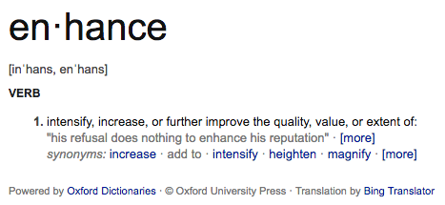
Incorporating Personal Competencies into Your Lessons: Enhanced Lesson Design (ELD)

Slide 75
Incorporating Personal Competencies into Your Lessons: Enhanced Lesson Design (ELD)
The process of refining and/or adding instructional elements to enhance the Personal Competencies within an already developed lesson
How can you incorporate the strategies we’ve been discussing into a lesson plan you already have designed, without changing its purpose?

Slide 76
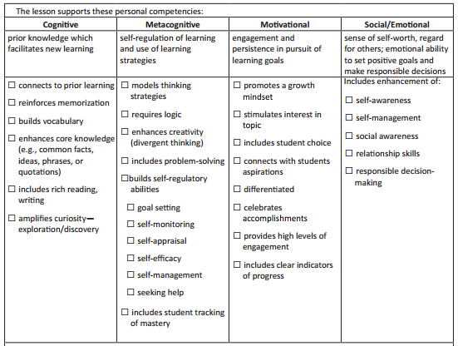
Let’s Look at a Sample...
Let’s look at an existing lesson plan to assess how well the competencies are represented.
Using the checklist, how well does the lesson plan address the four competencies?
Notes:
Then begin: “Before I look at the competencies, let me make sure this lesson plan on the 3 branches of government has some of the keys we discussed earlier.” Flip back to earlier slide number ___. “Yes, it has clear objectives, don’t see any direct mention of modeling, but maybe the teacher models what students are expected to do when they do role playing activity? She definitely has guided practice and formative assessment through the use of the Exit Ticket.”

Slide 77
Let’s Look at a Sample...
Let’s look at an existing lesson plan to assess how well the competencies are represented.
Using the checklist, how well does the lesson plan address the four competencies?
✔
✘
✘
✘
✔
✔
✘
✔
✔
✔
✔
✔
✘
✔
✘
✘
✘
✘
✔
✘
✘
✘
✔
✘
✘

Slide 78
Let’s Look at a Sample...
It is clear that this lesson’s strengths are in the Cognitive and Social/Emotional Competencies.
How can we better incorporate elements of the Metacognitive and Motivational Competencies into this lesson?
Metacognitive Indicator/Strategy | How Can You Strengthen the Competency?
Models thinking strategies | Teacher could model what it might be like to be a member of each branch -- what their perspective might be or how they might approach their work.
Requires logic
Enhances creativity (divergent thinking)
Includes problem-solving | The scenario could be about a relevant problem that the different branches are working to solve.
Builds self-regulatory abilities | The task could be structured like a real political exchange, so that students must follow the rules for when to contribute and when to listen.
Includes student tracking of mastery

Slide 79
Let’s Look at a Sample...
It is clear that this lesson’s strengths are in the Cognitive and Social/Emotional Competencies.
How can we better incorporate elements of the Metacognitive and Motivational Competencies into this lesson?
Metacognitive Indicator/Strategy | How Can You Strengthen the Competency?
Models thinking strategies | Teacher could model what it might be like to be a member of each branch -- what their perspective might be or how they might approach their work.
Requires logic
Enhances creativity (divergent thinking)
Includes problem-solving | The scenario could be about a relevant problem that the different branches are working to solve.
Builds self-regulatory abilities | The task could be structured like a real political exchange, so that students must follow the rules for when to contribute and when to listen.
Includes student tracking of mastery

Slide 80
Let’s Look at a Sample...
It is clear that this lesson’s strengths are in the Cognitive and Social/Emotional Competencies.
How can we better incorporate elements of the Metacognitive and Motivational Competencies into this lesson?
Motivational Indicator/Strategy | How Can You Strengthen the Competency?
Promotes a growth mindset
Stimulates interest in topic
Includes student choice | Students could self-select into roles.
Connects with students’ aspirations
Differentiated | Student prompts could differ based on reading level or informal assessment.
Celebrates accomplishments | The teacher could lead a reflection of the role play to shout out particularly strong student contributions and which branch may have won.
Provides high levels of engagement
Includes clear indicators of progress

Slide 81
Let’s Look at a Sample...
It is clear that this lesson’s strengths are in the Cognitive and Social/Emotional Competencies.
How can we better incorporate elements of the Metacognitive and Motivational Competencies into this lesson?
Motivational Indicator/Strategy | How Can You Strengthen the Competency?
Promotes a growth mindset
Stimulates interest in topic
Includes student choice | Students could self-select into roles.
Connects with students’ aspirations
Differentiated | Student prompts could differ based on reading level or informal assessment.
Celebrates accomplishments | The teacher could lead a reflection of the role play to shout out particularly strong student contributions and which branch may have won.
Provides high levels of engagement
Includes clear indicators of progress

Slide 82
Now It’s Your Turn
With your table partners, look through the sample lesson on pages 26-27 of your Participant’s Guide. Think about the following questions as you look at the lesson. Complete the Enhanced Lesson Design: Sample Lesson tables for each competency on pages 28-31.
How well does it stack up against the Personal Competencies Checklist?
Which competencies does this teacher need to enhance?
What are some ways that they can improve their lessons to better incorporate the four competencies?

Slide 83
Incorporating Personal Competencies into Your Lessons
Now look at the lesson you brought today. How well does your own lesson incorporate the personal competencies?
Complete the Enhanced Lesson Design: Your Lesson tables for each competency on pages 33-36.

Slide 84
Incorporating Personal Competencies into Your Lessons
Now that you’ve assessed and improved your own lesson, think about the enhancements that you made:
How well did your own lesson originally incorporate the personal competencies?
Was there overlap with your survey results from yesterday?
How did you highlight the value of the competencies in your lesson?

Slide 85
Share Your Own Lessons
Any volunteers to share their lesson overview and ELD process?
Notes:
Grade level? Content area? Talk through: Objectives (summary)? Activities? Strengths? Weaknesses? Changes made?

Slide 86
Reflecting on the ELD Process
As teachers, you design lessons all the time, but this training gave you a new lens to look through while planning.
At your tables, talk about how this process has been for you.
What was the most intuitive part of the process?
What was the most confusing or challenging part of the process?
How did the ELD process help you think through the four competencies?
How will you continue to use ELD during the school year?

Slide 87
Incorporating the Competencies into All Contexts
Remember that the competencies are enhanced across three different contexts, not just the classroom.
While your primary focus as teachers is what happens in your own classroom, it is critical to consider your influence on the school and school community at large.
School Community
School
Classroom

Slide 88
Incorporating the Competencies into All Contexts

Slide 89
Incorporating the Competencies into All Contexts
Ways to build the competencies into the school culture:
Discuss elements of the competencies in school-wide rituals and routines
Celebrating effort and mastery on the morning announcements
Provide suggestions in the school newsletter
Include in bulletin boards, student work displays, and the school website
Create daily routines across the school, such as Morning Meetings
Ensure that all school staff and volunteers are trained in the competencies
Offer professional development for staff and volunteers
Encourage universal techniques for praise to promote a growth mindset

Slide 90
Incorporating the Competencies into All Contexts
Why Families Need the Competencies
Families want to know about and improve their children’s academic progress;
They may not know the proper way to praise their child (effort, not innate qualities);
They may not know that the work done in the classroom can be enhanced at home -- academic or otherwise.

Slide 91
Incorporating the Competencies into All Contexts
Why Families Need the Competencies
Families want to know about and improve their children’s academic progress;
They may not know the proper way to praise their child (effort, not innate qualities);
They may not know that the work done in the classroom can be enhanced at home -- academic or otherwise.
How to Teach the Competencies to Families
Host family workshops to share this information and strategies to use at home;
Incorporate into parent-teacher conferences, Back to School Night, and other school-wide events;
Utilize the School Community Council or other parent groups as ambassadors for this effort.

Slide 92
Revisiting Our Professional Learning Objectives
All participants will be able to define and understand the four personal competencies and how they impact learning.
All participants will understand how the four personal competencies apply to their own lives.
All participants will be able to demonstrate how they will incorporate the four personal competencies in their work to benefit students.
Teachers will adapt a lesson plan to include the personal competencies.
Teachers will be able to independently construct lesson plans that include enhancement of the four personal competencies.

Slide 93
Next Steps
What are some ways you can continue this work throughout the school year?
Talk to your colleagues who also attended this training and see how you can collectively include the competencies in your instruction and management practices.
Contact the Muscogee (Creek) Nation’s Educational Specialist at your school (Larissa or Tammy) with questions or to share ideas.
Check out the Center on Innovations in Learning for more resources: www.centeril.org

Slide 94
Wrap Up
Please complete your Professional Learning Evaluation so that we know how we can continue to improve this Academy.
Thank you for your feedback and participation!

