Slide 1
Change in Korea
Principal Leadership Academy
November 2012

Slide 2
Your Perceptions of Korean Schools
1.
2.
3.
4.
5.

Slide 3
Innovation & Turnaround in a Korean School

Slide 4
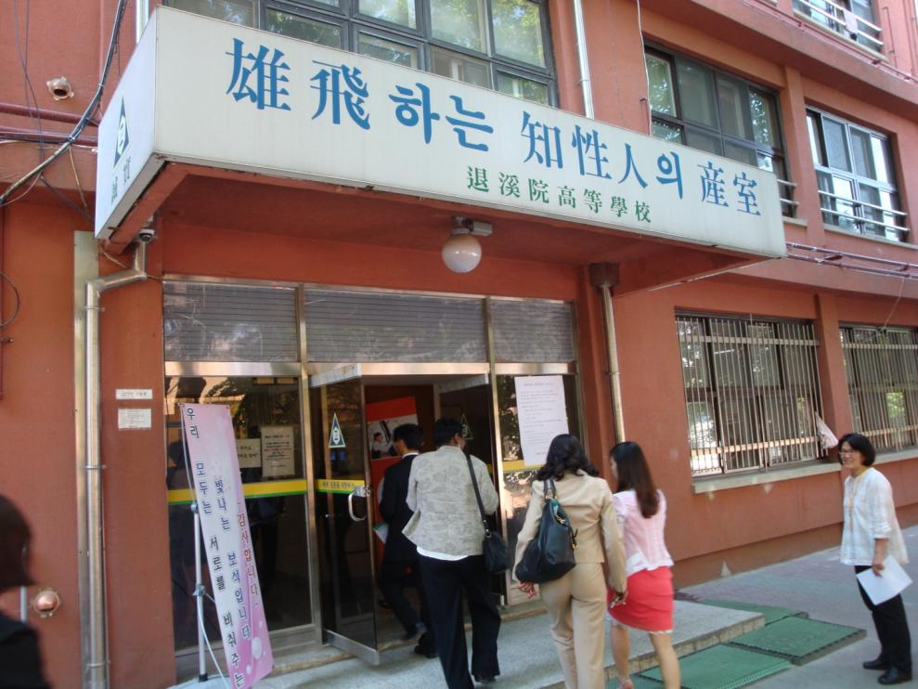
Toegyewon High School Near Seoul, Korea

Slide 6
School Neighborhood

Slide 7
Meeting with Principal

Slide 8
Their Turnaround Story

Slide 9
Visiting Classrooms

Slide 24
PE Class

Slide 28
Instrumental Music Class

Slide 30
Vocal Music Class

Slide 32
Your Observations
1.
2.
3.

Slide 33
How this school turned around
Strong leadership by principal
Teacher instructional teams plan instruction
Instruction is aligned to standards
Teachers directly teach
Teachers interact
Student groups and individual assignments for mastery, including homework
“Happy school” ingredients
Activity classes
Faculty advocate for each student
High energy in classes

Slide 34
Your Change Leadership
How can you be a change agent?
What tools can assist you in changing school culture?
Where are your leverage points?

