Slide 1
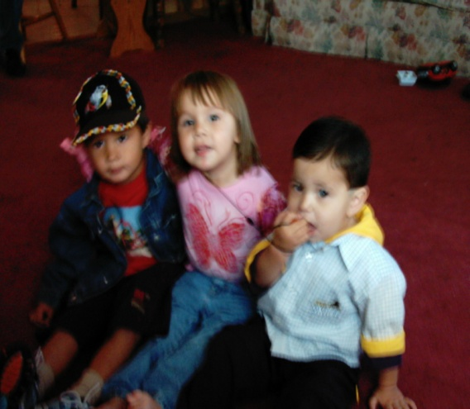
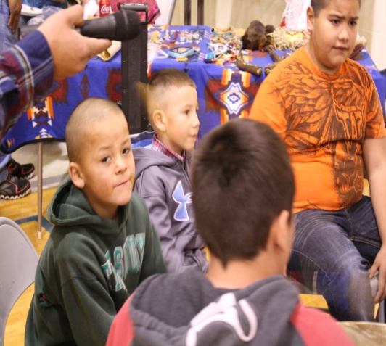
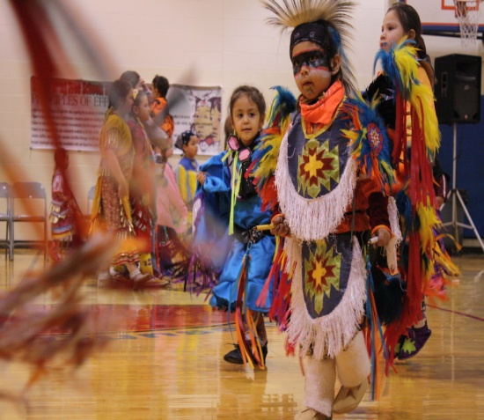
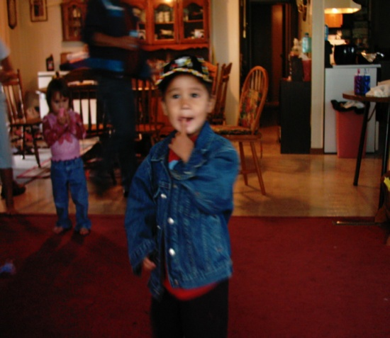
Principal Leadership Academy
Dunseith Day School
Projects:
Renewing for Future Generations
and
Common Core Transition

Slide 2
The Future, Why?
Our children, parents, and community have only a handful of tribal members who know the tribal languages that were handed down generation after generation. Our children’s future need to include their language. Families speak only bits and pieces of the language and we are confusing the children by not teaching them the proper way to use their own language.
We now learn and teach the Ojibwa language thanks to the PLAN.

Slide 3
The Plan is working:
Our own resources
Other resources
The lesson plans
Word or phrase of the week
Language Endorsements
Everyone is involved
NWEA Data
THE STUDENTS LOVE IT!!!!!!

