Slide 1
Expectations: Knocking Down Barriers to Success
Lauren Morando Rhim, RunningHorse Livingston,
& Bernadette Anderson
Presenters
Notes:
They say that mathematics is a universal language.
If this is true, then the aptitude of an individual to construct an understanding of math concepts is not influenced by class, race, or gender.

Slide 2
Session Purpose:
To expose barriers to change and identify strategies to knock them down.

Slide 3
Levels of Barriers
C
Central Office
School
Classroom

Slide 4
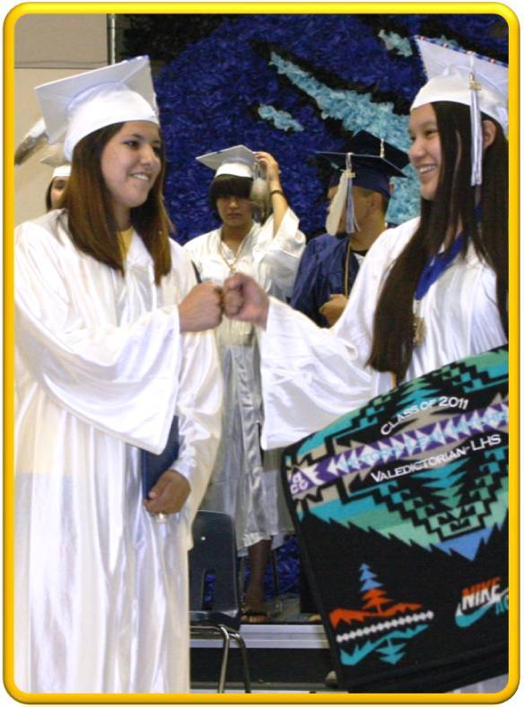
LET’S TALK
What do Native American students need most to motivate them toward school learning and persistence in education?

Slide 5
LET’S TALK
What factors influence performance of schools enrolling Native American Students?

Slide 6
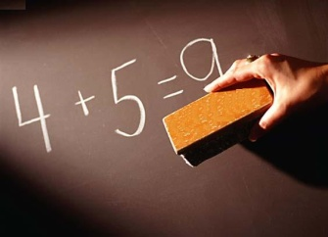
Variables Impacting Student Success
Quality of the Curriculum
Quality of the Instruction
Quality of the School Environment
Quality of the Student’s Home Environment
Schools control 3 out of 4 critical variables that determine student success in mathematics. Fennel, 2002

Slide 7

LET’S DISCUSS
What are the specific barriers which may stand in the way as change begins to occur?

Slide 8
LET’S THINK
Select a previously mentioned barrier and answer the questions with your partner:
Why will dramatic change be hard to address for the specific barrier?
How do we knock the barrier down for the sake of the students?

Slide 9
LET’S SHARE
One partner share with group a solution for a barrier.

Slide 10
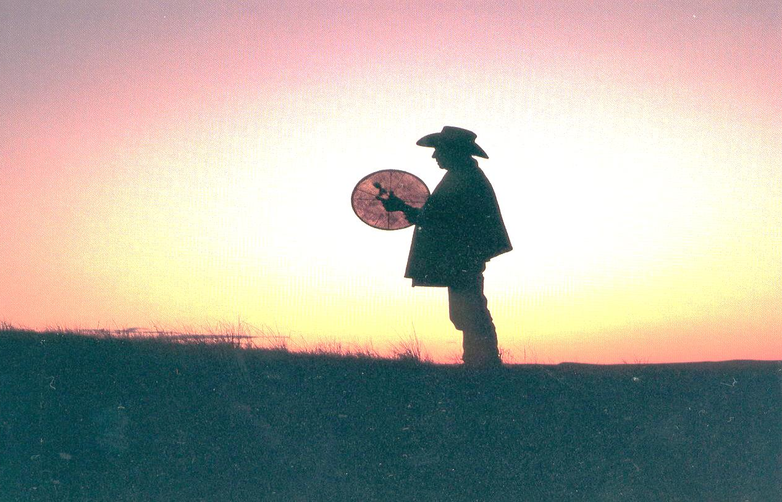
NEXT STEPS
KEEP IT MOVING FORWARD
Notes:
The order of things too, in Native cultures, can be different.
Native people are said to be holistic thinkers; that the connections they see in the environment and people are non-linear.
This goes against the very logical/sequential system of teaching and learning in dominant society.
What does this mean?

