Slide 1
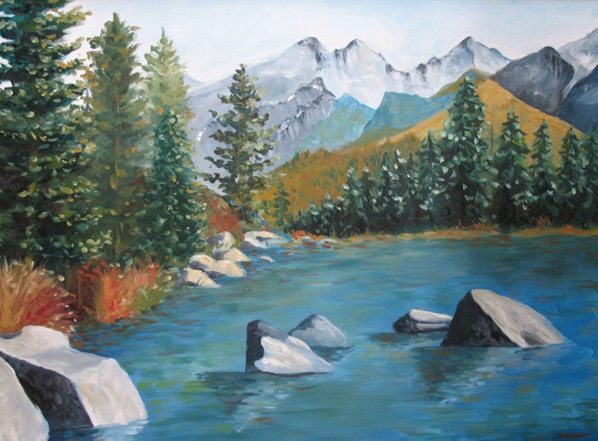
Managing Change
Principal Leadership Academy
November 2012

Slide 2
Fox and Hedgehog

Slide 3
Change Leaders Sweat the Details
Many leaders pride themselves on setting high-level direction: I’ll set the vision and stay out of the details. It’s true that a compelling vision is critical. But it’s not enough. Big-picture, hands-off leadership isn’t likely to work in a change situation, because the hardest part of change—the paralyzing part—is precisely in the details. (p.53)
Heath, C. & Heath, D. (2010). Switch: How to change things when change is hard. New York, NY: Broadway Books.

Slide 4
Professional Development
Teams
Principal

Slide 5
Effective Practices
Establish a team structure with specific duties and time for instructional planning
Focus the principal’s role on building leadership capacity, achieving learning goals, and improving instruction
Align classroom observations with evaluation criteria and professional development

Slide 6
Teams
Effective Practice: Establish a team structure with specific duties and time for instructional planning

Slide 7
Teams
A team structure for schools is officially incorporated into district/school policy.
All teams have written statements of purpose and by-laws for their operation.
All teams operate with work plans for the year and specific work products to produce.

Slide 8
Teams
All teams prepare agendas for their meetings.
All teams maintain official minutes of their meetings.
The principal maintains a file of the agendas, work products, and minutes of all teams.

Slide 9
Teams
A Leadership Team consisting of the principal, teachers who lead the Instructional Teams, and other key professional staff meets regularly (twice a month or more for an hour each meeting).
The Leadership Team serves as a conduit of communication to the faculty and staff.
The Leadership Team shares in decisions of real substance pertaining to curriculum, instruction, and professional development.

Slide 10
Teams
The school’s Leadership Team regularly looks at school performance data and aggregated classroom observation data and uses that data to make decisions about school improvement and professional development needs.
Teachers are organized into grade-level, grade-level cluster, or subject-area Instructional Teams.
Instructional Teams meet for blocks of time (4 to 6 hour blocks, once a month; whole days before and after the school year) sufficient to develop and refine units of instruction and review student learning data.

Slide 11
Table Discussion
In 1 minute, describe the team structure in your school and the time teams are given for their work.
After everyone has shared, take 3 minutes to discuss.
Report out.

Slide 12
Table Discussion
From all the Team indicators we have reviewed, which two does your school need the most work on? Why? 1 minute for your sharing.
After everyone has shared, take 3 minutes to discuss.
Report out.

Slide 13
Principal
Effective Practice: Focus the principal’s role on building leadership capacity, achieving learning goals, and improving instruction

Slide 14
The Principal
The principal makes sure everyone understands the school’s mission, clear goals (short term and long term), and their roles in meeting the goals.
The principal models and communicates the expectation of improved student learning through commitment, discipline, and careful implementation of sound practices.
The principal participates actively with the school’s teams.

Slide 15
The Principal
The principal keeps a focus on instructional improvement and student learning outcomes.
The principal monitors curriculum and classroom instruction regularly.
The principal spends at least 50% of his/her time working directly with teachers to improve instruction, including classroom observations.

Slide 16
The Principal
The principal challenges and monitors unsound teaching practices and supports the correction of them.
The principal celebrates individual, team, and school successes, especially related to student learning outcomes.
The principal offers frequent opportunities for staff and parents to voice constructive critique of the school’s progress and suggestions for improvement.

Slide 17
Table Discussion
Pick one Principal indicator on which you are especially strong. In 1 minute, tell the group what you do and how you know this is your strength?
After everyone has shared, take 3 minutes to discuss.
Report out.

Slide 18
Table Discussion
From all the Principal indicators we have reviewed, which two do you need the most work on? Why? 1 minute for your sharing.
After everyone has shared, take 3 minutes to discuss.
Report out.

Slide 19
Professional Development
Effective Practice: Align classroom observations with evaluation criteria and professional development

Slide 20
Professional Development
The principal compiles reports from classroom observations, showing aggregate areas of strength and areas that need improvement without revealing the identity of individual teachers.
The Leadership Team reviews the principal’s summary reports of classroom observations and takes them into account in planning professional development.
Professional development for teachers includes observations by the principal related to indicators of effective teaching and classroom management.

Slide 21
Professional Development
Professional development for teachers includes observations by peers related to indicators of effective teaching and classroom management.
Professional development for teachers includes self-assessment related to indicators of effective teaching and classroom management.
Teachers are required to make individual professional development plans based on classroom observations.

Slide 22
Professional Development
Professional development of individual teachers includes an emphasis on indicators of effective teaching.
Professional development for the whole faculty includes assessment of strengths and areas in need of improvement from classroom observations of indicators of effective teaching.
The principal plans opportunities for teachers to share their strengths with other teachers.

Slide 23
Table Discussion
1. Pick one Professional Development indicator on which your school is really strong.
2. In 1 minute, tell the group why your school is strong on this indicator, what it looks like in your school, and how you know it is strong.
3. After everyone has shared their strong indicator, discuss as a group for 3 minutes.

Slide 24
Table Discussion
From all the Professional Development indicators we have reviewed, which two does your school need the most work on? Why? 1 minute for your sharing.
After everyone has shared, take 3 minutes to discuss.
Report out.

Slide 25
Final Thoughts
Vision matters.
What is yours? Is this a shared vision for your school community? How do you know?
Details matter.
Indicators are the details.
Teams are essential.
You can’t do it alone.
Capacity matters.
Your students deserve teachers who are competent, committed, and caring. You are key in your teachers’ professional development.
Team work
is professional development.
Teachers learn from each other.
You make that happen.

