Slide 1
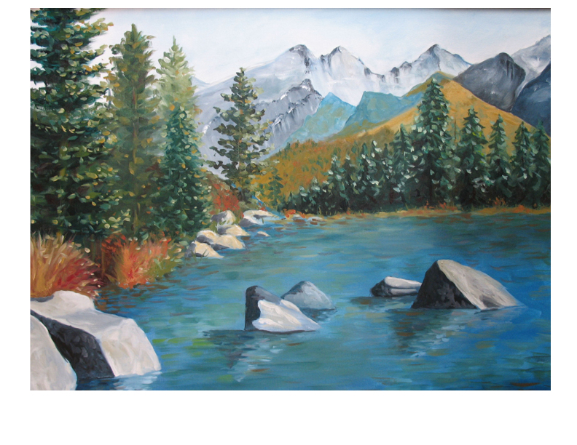
Mentor-Principals February Webinar
Principal Leadership Academy

Slide 2
Agenda: Progress Reports
Welcome
Snapshot Progress Reports
Each Principal gives a 3 minute report of PLA progress with:
Rapid Improvement Leader Plan
Leadership Team work with Native Star
Project 1: Engaging People: Culture and Language
Project 2: Common Core (or substitute topic)

Slide 3
Agenda: Looking Ahead
A Look Ahead to March (10 minutes)
March 15: Complete Culture and Language Project; enter report in Project Management Tool
Continue implementation of Project 2 (Common Core or substitute topic); weekly log in Project Management Tool
Site Visits: Who is scheduled for February? Schedule set in Project Management Tool?
Mid-Year Training: Dates and Location

Slide 4
Agenda: Seeing Change Through to the Classroom
What has changed in classroom instruction related to the Leadership Team’s plans with instructional indicators? (3 minutes each principal)
Instructional planning by teacher teams
Teacher lesson plans
Multiple modes of instruction
Teacher-student interaction
Classroom management

Slide 5
Agenda: Discussion and Reminders
Discussion of Principal reports (Seeing Change Through to the Classroom) and common themes (10 minutes)
Reminder to enter reflections about this webinar in Project Management Tool
Confirm March webinar time and date
Confirm dates and location of Mid-Year Training

