Slide 1
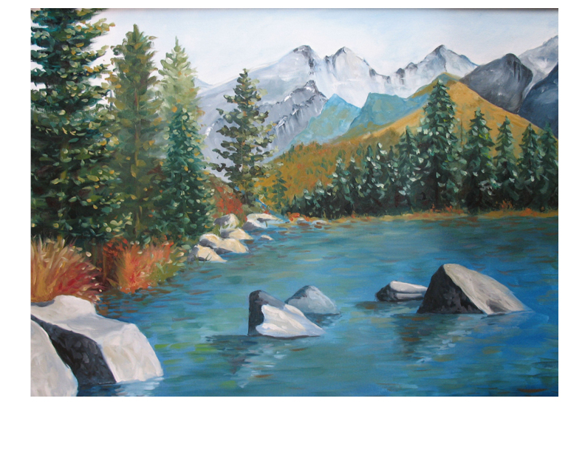
Mentor-Principals
May Webinar
Principal Leadership Academy

Slide 2
Agenda: Progress Reports
Welcome
Snapshot Progress Reports
  Each Principal gives a 3 minute report of PLA progress with:
    Rapid Improvement Leader Plan
    Leadership Team work with Native Star
    Project 2: Common Core (or substitute topic)

Slide 3
Agenda: Final Reports
High Quality Documentation (10 minutes)
  May 15: All PLA work completed and documented in Project Management Tool, Rapid Improvement Leader Tool, Native Star
  On May 16, ADI will generate reports from the online tools to prepare a portfolio for each Principal. The Research Team will score the portfolio to determine each Principal’s eligibility for Certification.

Slide 4
Agenda: Ready for Next Year?
What changes are you planning for next school year? (3 minutes each principal)
  Resource re-allocation (budget, staff, materials)
  Leadership Team
  Instruction
  Engaging people

Slide 5
Agenda: Discussion and Reminders
Discussion of Principal reports (Ready for Next Year?) and common themes (10 minutes)
Reminder to enter reflections about this webinar in Project Management Tool
Summative Meeting
  Confirm location and dates for Summative Meeting
  Prepare PPT for 3-minute presentation on Project 1: Culture and Language
  Prepare PPT for 3-minute presentation on Project 2: Common Core (or substitute topic)

