Slide 1
Native Star
School Improvement
Electronic Reporting

Slide 2
Native Star’s Two Purposes
1.
Process for school improvement
2.
Convenient way to submit reports

Slide 3
School Improvement
Picture a principal and lead teachers sitting around a table. This is a Leadership Team. Now listen as they discuss “indicators of effective practice” and make plans to improve the professional practice of everyone in the school. Now hear the students cheering in the hallway.
This is Native Star.

Slide 4
What is Indistar?
Good question. Indistar is the school improvement system that is in 25 states and thousands of schools.
Native Star is BIE’s version of Indistar, customized for Native American schools.
Want to know more? Go to www.indistar.org
Watch the YouTube video. See the Powerpoints. See lots of other information.

Slide 5
The Essentials

Slide 6
The Team Comes First
Native Star shows effective practice, with research briefs and videos
Native Star guides the school’s Leadership Team
Native Star structures the Leadership Team’s plan to improve practice
Native Star encourages the Team to celebrate its success

Slide 7
Leadership Team Meetings
Process Manager and Principal prepare agenda, worksheets in Native Star
Twice a month, about 90 minutes each
Team works on indicators
Process Manager (or Principal) documents the Team’s work in Native Star

Slide 8
Two Ways for Meetings
Some Teams project Native Star on a screen and enter the work during the meeting
Some Teams work from the worksheets and the Process Manager enters the work later into Native Star
See which way works for you

Slide 9
The System

Slide 10
Login to Native Star
Each school has a login for the Principal and Process Manager.
The Process Manager is someone appointed by the Principal to assist with Native Star.
A Guest Login is displayed on school dashboard. It is for Leadership Team members, teachers, parents, school board, tribal councils.

Slide 11
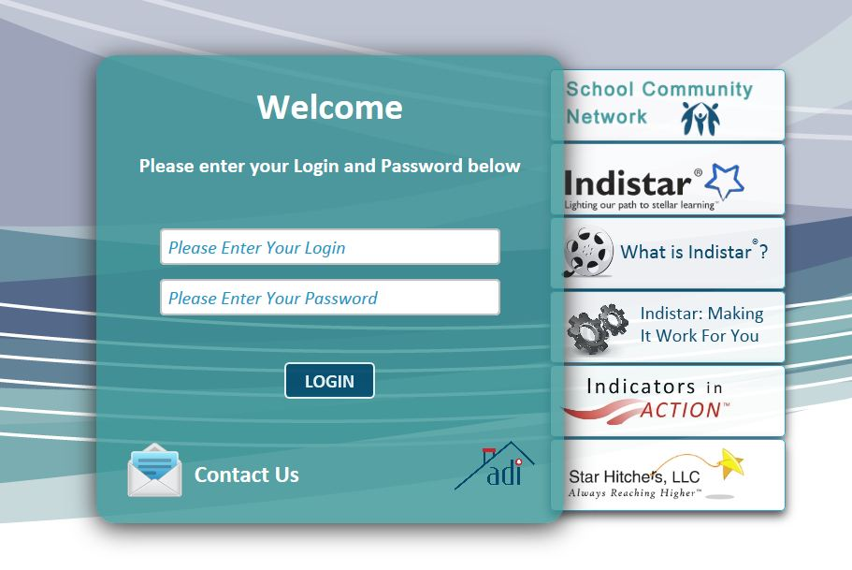
Where to Login
From BIE website – http://www.bie.edu/
From Indistar website – www.indistar.org

Slide 12
School Dashboard

Slide 13
School Main Menu

Slide 14
Reporting through Native Star

Slide 15
Forms to Complete Tab

Slide 16
Forms to Complete Tab
Read the descriptions
Submit for review if required
Fill out the forms that apply to your school

Slide 17
Required Reports Tab

Slide 18
Required Reports Tab
Native Star SIP Benchmark Reports
Just submit by the date. The system creates the report
Other Reports
Fill them out in Forms to Complete and then just hit submit here

Slide 19
Instructions See Docs and Links Tab

Slide 20
Document Upload See Filing Cabinet

Slide 21
Upload to File Cabinet
Upload other BIE forms and documents here, as per instructions
Some documents will need to be downloaded from Forms to Complete, filled in, saved to your computer, and then uploaded into the File Cabinet

Slide 22
www.indistar.org

Slide 23
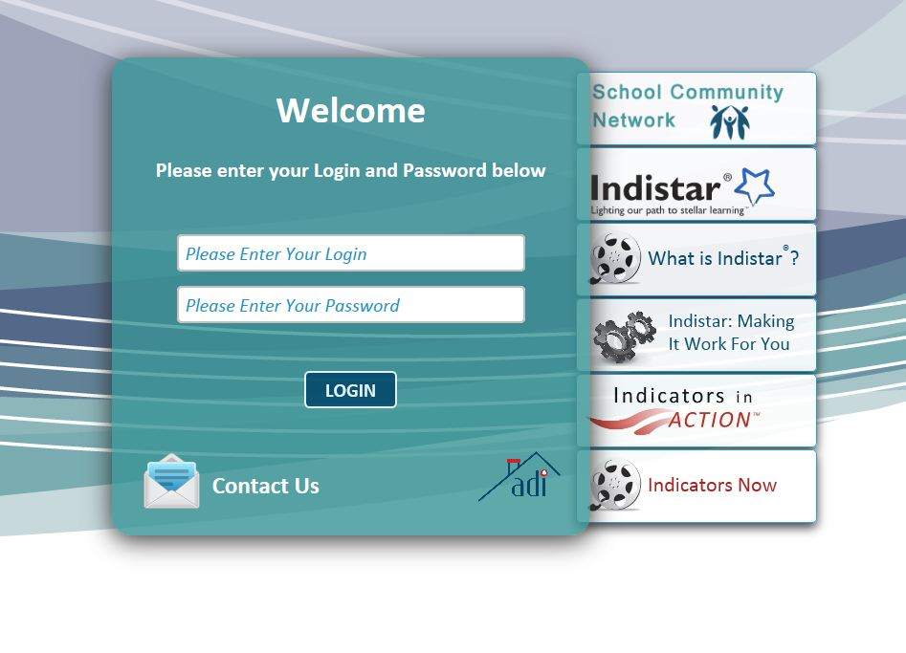
Indistar Login

Slide 24
Indicators in Action

Slide 29
Indicators Now

Slide 31
Need Help?
See the link at bottom of each page
Indistar@adi.org
Contact your Native Star Specialist
Or email to this address: psheley@adi.org

Slide 32
What is Essential
One thing: A Leadership Team that meets regularly, works on the indicators, and keeps improving professional practice for the sake of the students in the school.
Your school’s destiny is in your hands.
Take charge!

