Slide 1
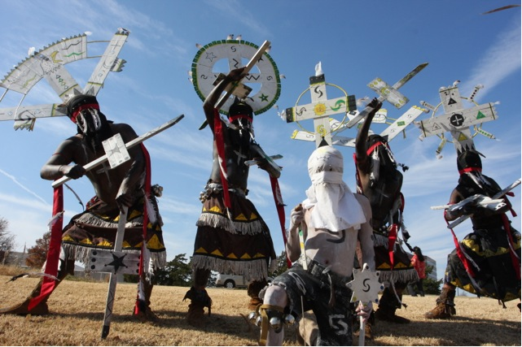
Culture and Language
Riverside Indian School
Tony L. Dearman

Slide 2
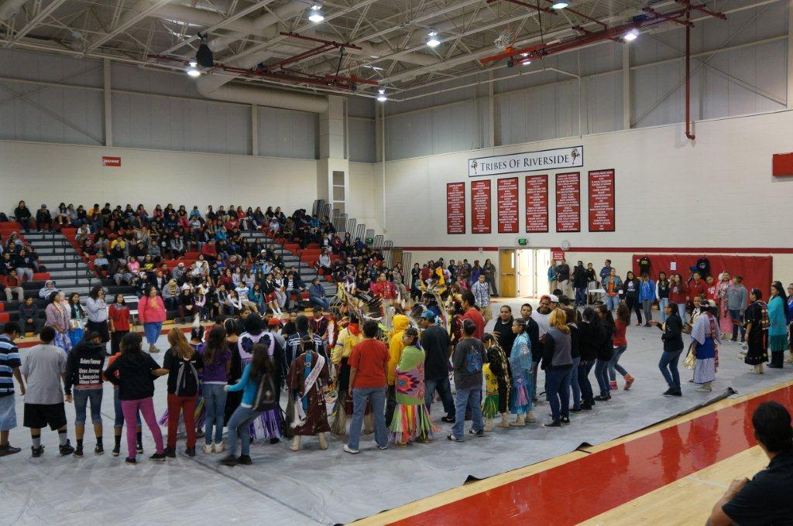
Riverside Indian School
Grades 4 – 12
204 employees (10 Non-Indian)
520 Residential Students and approximately 40 – 50 day students for a total of 560 – 570 students
Student enrollment of 75 – 80 different tribes
Students are from 20 – 25 different states

Slide 3
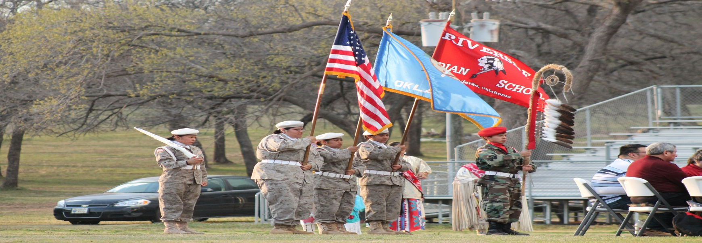
Culture and Language Objectives
Project Objective 1: The school includes tribal elders, speakers, and leaders in planning and providing school events that feature Native American culture, customs, and values.
Project Objective 2: The Leadership Team plans ways to infuse tribal customs and values into the school’s operating procedures, rituals, and activities.
Project Objective 3: The principals and other school leaders demonstrate an understanding of tribal culture, customs, and values and model a respect for them.

Slide 4
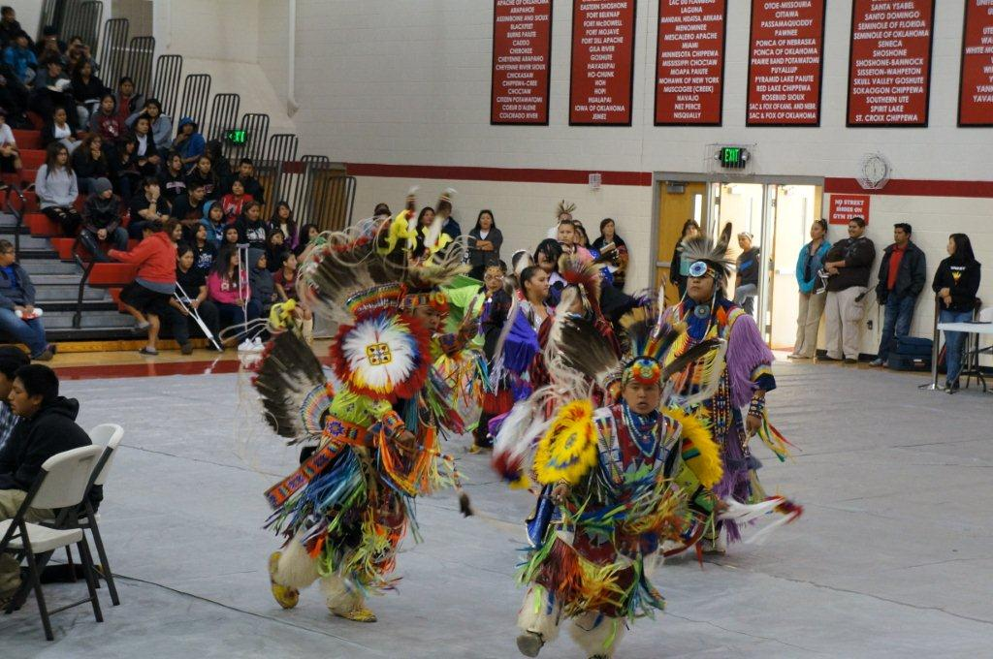
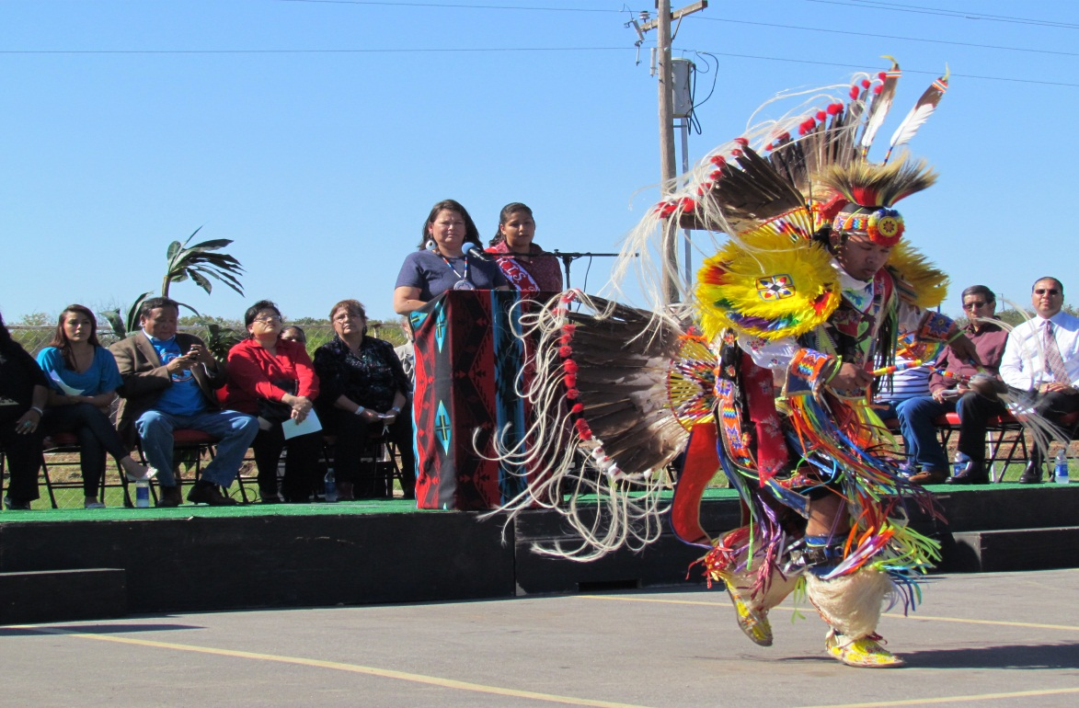
Culture and Language Activities
Classroom Observations
Indian Club Events
Apache Club
Native American Color Guard
Riverside Drum Group
School Board Meetings
Riverside Alumni
Zuni Dance Group
Pueblo Dance Group
Hand Games
Leadership Meetings

