Slide 1
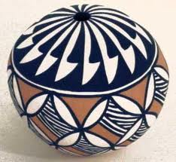
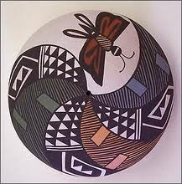
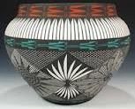
Language and Culture
Sky City Community School
By: Yvonne M. Haven, Acting Principal
Infusing Acoma Culture and Traditions into the 21st Century

Slide 2
The physical appearance of the school reflects the tribal culture.
Oral History of Baskets lesson for 7-8th grade (Baskets displayed)
The appointed 2013 Acoma Tribal Officials, their roles and their Indian names. (Pictures displayed)
Canes and Pueblo Government lesson (drawings displayed)
Traditional clothing presentation.
Paper dolls of the Huuchaniis.
Indian Puppets (displayed on walls)
Clan class walk (Banners displayed)
Storybook and Native Roots performance by Emmett “Shkeme” Garcia
Tribes Projects (displayed in lobby)
Shkeme: Storybook and Native Roots Performance

Slide 3
The Leadership Team plans ways to infuse tribal customs and values in the school’s operating procedures, rituals and activities.
The Commanche Dance
School-wide Initiatives
-Acoma Language classes built into the Master schedule
Morning Blessing cited in all classes every morning
-Greetings in Keres within the school
-LST planned Native American Week
-Native American Dress Day
and class performances
-Tribes project presentation by classes

Slide 4
Parent Education programs include Native American and tribal history, customs, values and languages.
Parent Involvement in our cultural activities
Parent Education Programs
Parents were active participants in this project and helped the students to get their regalia together. The 4th grade class performed buffalo and deer dances for the Senior Citizens at the Acoma Senior Citizen Center.
Singing of Christmas songs in Keres in the community to various programs.
Keres Parent Night Carnival
Acoma Keresan Language Policy Project Committee at Acoma Community Library.
Community members prayed each morning during Native American Week.

