Slide 1
The Something Other Personal Competencies Academy Center on Innovations in Learning Academic Development Institute

Slide 2
Welcome and Introductions
Notes:
-Introduce self and other trainers (if applicable), thank host (if applicable) and thank participants for the opportunity to be share ideas with them
Warm Up Purpose:
To provide an opportunity for the participants to introduce themselves
To add levity
To give the participants a way to easily remember names
Warm Up Directions:
Ask for each person to think of a positive attribute which begins with the same first letter in their first name, such as: Sincere Sarah, Motivating Mary, Sharing Sharon, Timely Tony, etc. Then ask attendees to introduce themselves. If the group is large, each person can introduce to two other people. In either case, explain briefly what the descriptive word means.
Housekeeping
Review the following housekeeping items:
Attendance (Sign-In documentation)
Engage enthusiastically
Name Tags or Table Tents
Share location of restrooms
Confirm each person has an agenda and presentation handouts
Share protocol for asking questions
Parking Lot poster for other comments

Slide 3
Learning Together
We will:
Define and discuss the four personal competencies and how they impact learning and life.
Apply the four personal competencies to our own lives.
Apply the four personal competencies in our roles to benefit students.
Notes:
Materials Needed: None
Instructions for Facilitator: None
Sample Script: “By the end of this Academy, you all will be able to:
Define and discuss the four personal competencies and how they impact learning and life.
Apply the four personal competencies to our own lives.
Apply the four personal competencies in our roles to benefit students.
On Day 2, teachers (and other educators) will adapt one of their lesson plans to include the personal competencies. As they progress through the next school year, they will also be able to independently construct lesson plans that include the four competencies.
Next slide has two clicks, stop first after one.

Slide 4
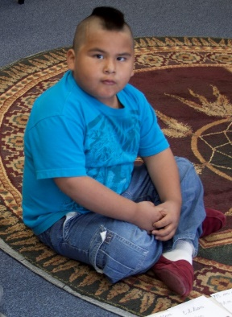
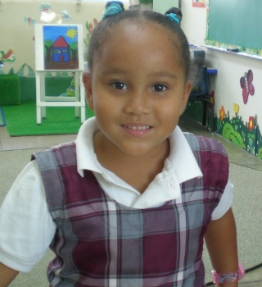
The Something Other
Our mission is for all children to become self-directed learners, avid readers, and responsible citizens, respecting themselves and those around them.
Notes:
Think of a Child: Think of a child that you know. He or she could be a student, your own child, niece or nephew, or a neighbor.
Picture this child in your mind. Write the name of the child on a sticky note.
What do you want this child to possess to ensure the best opportunity for success in life?
Let’s hear a few examples of what you want most for a child you know that will propel him or her through school and life.
Now click to second slide.
For many years, we said our mission is for all children to become self-directed learners, avid readers, and responsible citizens, respecting themselves and those around them. That is how we addressed the “something other.” Is this something that you would want for the child you had in mind?
Why do we call these things “the something other”?
(Next slide has three clicks. Pause after first and ask for thoughts.)

Slide 5
Other Things
“Currently the U.S. education system draws from a rigorous and well-developed set of academic standards for learning which focus on what children should know and be able to do. However, success in the classroom and beyond relies on much more than mastery of these academic standards. If academic standards are what students need to learn, there are also skills and mindsets that prepare and support how students learn. Successful engagement in the classroom and in life relies on a set of cognitive and social-emotional skills and mindsets, which are not represented in academic standards.”
This Academy will focus on those “other” things that help students succeed.
Notes:
Materials Needed: None
Instructions for Facilitator: Give a few seconds for them to read the quote, then go to second click.
Sample Script: “This is a quote that provides a basis or rationale for some of the things we will talk about today. It is from Turnaround for Children, an organization working to provide tools to schools to help their students develop the skills and mindsets they need to be successful learners.”
Slide Text: “Currently the U.S. education system draws from a rigorous and well-developed set of academic standards for learning which focus on what children should know and be able to do. However, success in the classroom and beyond relies on much more than mastery of these academic standards. If academic standards are what students need to learn, there are also skills and mindsets that prepare and support how students learn. Successful engagement in the classroom and in life relies on a set of cognitive and social-emotional skills and mindsets, which are not represented in academic standards.”
[Click on second slide.]
Sample Script: “This quote sums up why the personal competencies are relevant and critical to student learning and academic success.
This Academy will focus on those “other” things that help students succeed.
[Click again.]
The little green guy with one eye is to remind us of the “something other.”
The next slide has 8 clicks. After first click, ask participants: “What single factor do you think has the greatest effect on student learning?”
Allow time to discuss. Then go to second click. Take each click one at a time to make your points.

Slide 6
What the Research Tells Us
1. Classroom Management
2. Metacognitive Processes
3. Cognitive Processes
4. Home Environment/Support
5. Student-Teacher Social Interactions
6. Social/Behavioral Attributes
7. Motivational-Affective Attributes
8. Peer Group
9. Quality of Instruction—student engagement
10. School Culture
11. Classroom Climate
12. Classroom Instruction—clear and organized
13. Curriculum Design
14. Academic Interactions
15. Classroom Assessment
Four of the top 15 are the Personal Competencies.
Most Influential School/Environment Effects and Student Attributes
(Wang, Haertel, & Walberg)
Notes:
We have some exciting research and new ideas to share with you!!
These 15 items are from a meta-analysis of what affects student learning, in rank order by their effect size.
Does anything jump out at you?
Brief discussion with your neighbor. Then share out some observations about the list.
Classroom management: includes teachers preparation to orchestrate the classroom, withitness, focus
Click again a few times to show the 4 Personal Competencies.
We now have a name for the “something other.” They are called personal competencies.
Why are they called “personal competencies”?
Note: Classroom management and home environment are both environmental; the personal competencies are what the student possesses.
Brief discussion.
Personal Competencies are not “fixed”; they grow with nurturing from parents, teachers, and others. And with effort from the students themselves.

Slide 7
The “Propellants” of Learning
Something Other = Personal Competencies
What I Know (Cognitive Competency)
How I Learn (Metacognitve Competency)
Why I Learn (Motivational Competency)
Who I Am (Social/Emotional Competency)
Notes:
We say that the Personal Competencies are what “propel” learning. They make it go!
The What, How, Why, and Who help us remember what each of these propellants does.
[The next slide has multiple clicks. First click will draw the table. Second click will give the first definition. Third click will give the simple phrase that goes with the definition. Each column will fill in order.]

Slide 8
Personal Competencies in a Nutshell
Competency | Cognitive | Metacognitive | Motivational | Social/ Emotional
Definition
What I know.
How I learn.
Why I learn.
Who I am.
Prior knowledge that facilitates new learning
Self-regulation of learning and use of learning strategies
Engagement and persistence in pursuit of goals (learning and life)
Self-worth, regard for others, emotional understanding and management; setting goals and making responsible decisions
Something Other“
Notes:
Discuss: Explain how what I already know affects what I am able to learn.
Click to see How I Learn.
Discuss: What does it mean to self-regulate learning? To use learning strategies?
Click to see Why I learn.
Discuss: Is motivation to learn ever a problem? How?
Click to see Who I am.
Discuss: Does a student’s emotional well-being affect his or her learning in school? What about social skills, getting along with others? How?

Slide 9
How Do They Interact?
The 4 Personal Competencies interact.
They affect each other.
What would be an example?
Notes:
Materials Needed: None
Instructions for Facilitator: None
Sample Script: “This graphic illustrates that the competencies overlap and influence each other. Take for example a student who develops increased metacognitive competency by developing a new self-regulated learning strategy (e.g., a good note-taking strategy); use of this strategy would presumably lead to deeper comprehension of texts, and therefore increased core knowledge and cognitive competency. A student who has developed a growth mindset (motivational competency) and believes that working hard can lead to success in the classroom may also develop a strong sense of belonging in the academic community (social/emotional competency). Other examples?”

Slide 10
The Learning Habits
The intersection of these competencies is where learning habits develop.
Notes:
Facilitator: Refer to the four circles and point out when they interact that learning habits develop.

Slide 11
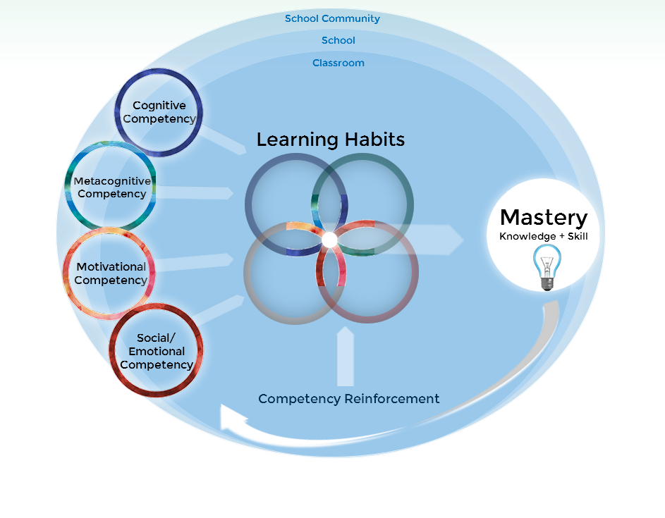
The Framework
Redding, S. (2014). The Something Other: Personal competencies for learning and life. Philadelphia, PA: Temple University, Center on Innovations in Learning.
Notes:
Materials Needed: None
Instructions for Facilitator: None
Sample Script: “Here we have our personal competency framework which basically pulls together the concepts we have discussed. The competencies are built within the three contexts, and together these competencies result in students’ learning habits, which in turn contribute to students’ knowledge, skill, and mastery.”
Activity:
Pass out the Reflection Activity. Ask participants to jot down some thoughts. Tell them we will revisit.
OK, we have covered some big ideas already. Let’s take a 10 minute break and then get back to it!

Slide 12
BREAK

Slide 13
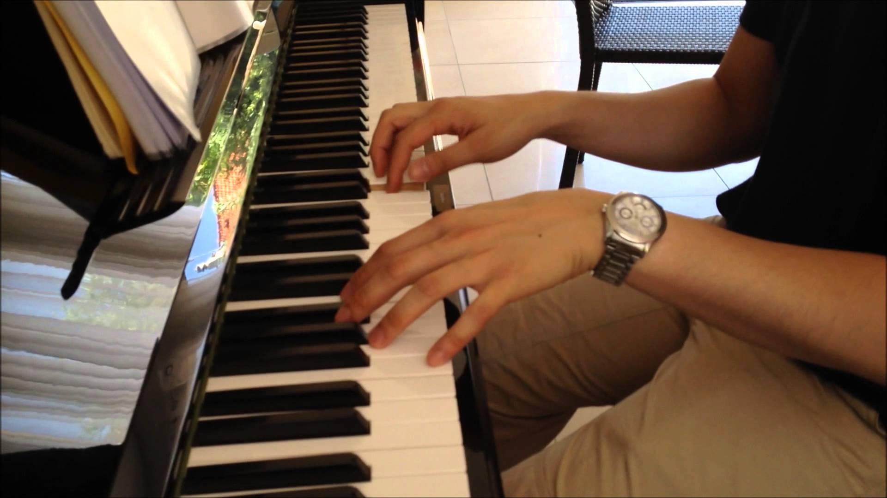
Personal Competencies and You
Think of something you are good at doing. How did you developed this skill?
In your participant’s guide, use the note paper to jot down your thoughts.
Odds are, you’ve used the personal competencies while learning this skill!
Notes:
Materials Needed:
Activity in Participant’s Guide
Activity #24
Instructions for Facilitator: Presenter provides personal example of a hobby from their own life and describes how he or she uses the competencies for learning in this hobby. Participants will have 5 minutes to do a quick write about their own hobby. Then, they will discuss their hobbies with their table groups.
Sample Script: “Let’s apply the competencies another way. Your participant’s materials has a sheet (page 11) with some guiding questions about how we use the competencies in our own lives.”

Slide 14
Personal Competencies and You
How can you connect your own skill to the competencies?
Did something you already knew help in what you had to learn?
What strategies did you use in learning, how did you learn?
Why did you learn this? Ever consider giving up? Why or why not?
Did you interact with other people in your learning?
Does this hobby help define who you are?
Notes:
Materials Needed:
Activity on page 11 of the Participant’s Guide
Activity #25: Adjust time as needed.
Instructions for Facilitator: Discuss the questions with the participants. Have them take five minutes to think on their own, five minutes to discuss at their tables, and 10 minutes as a whole group.
Sample Script: “On page 11 of your packet we have a brief activity. Select a favorite hobby/activity you have and describe how you connect your hobby to the 4 competencies using these questions as a guide. You will have five minutes individually to reflect and then share with your tables some of the connections you made.”
Slide Text:
How can you connect your own hobby to the 4 competencies?
How did you build your knowledge/skill, and how do you continue to learn?
How do you reflect on and manage your learning/skills?
How do you stay motivated to continue learning? How do you deal with barriers (e.g., time demands, limited access to information) to your learning?
How do you build relationships, show empathy, and/or make responsible decisions within this area?
What are some similarities/differences among your table group members?

Slide 15
Where Students’ PCs Grow
Family and
Community
School
Classroom
Notes:
Materials Needed: None
Instructions for Facilitator: None
Sample Script: “Personal competencies are not just confined to the classroom, but are built within the school itself (staff and students), as well as the school community. A ‘school community’ consists of the people intimately associated with a school—students, their families, teachers, administrators, school staff, and volunteers—bound together by their common interest in the students served by the school” (Redding, 2011).
Slide Text: The competencies are built within and across three contexts.
Now we will look at strategies at home, with students, and in the classroom that contribute to their personal competencies.

Slide 16
What I Know (Cognitive Competency)
Definition: Prior knowledge which facilitates new learning; broad knowledge acquired in any context, accessible in memory to facilitate new learning; sufficient depth of understanding to expedite acquisition of new learning; fed by curiosity and disciplined study.
Redding, S. (2016). Competencies and personalized learning. In M. Murphy, S. Redding, and J. Twyman (Eds.), Handbook on personalized learning for states, districts, and schools (pp. 3–18). Philadelphia, PA: Temple University, Center on Innovations in Learning.
Notes:
Materials Needed: None
Instructions for Facilitator: None
Sample Script: “The first competency, Cognitive Competency, represents the prior knowledge that students possess that allows them to engage in new learning (for example, this could be core knowledge such as facts, ideas, etc.). That knowledge has to be accessible and of sufficient depth to enable new learning.
To promote cognitive competency, teachers need to be aware of children’s cognitive development, as well as of course academic standards and curricula to foster mastery of those standards. What this looks like in practice is teachers providing plenty of opportunities for students to build their knowledge/cognitive competency through activities such as vocabulary-building, helping students connect what they are learning to what they already know, and ample writing/reading opportunities, for example.”
Slide Text:
Definition: Prior knowledge which facilitates new learning; broad knowledge acquired in any context, accessible in memory to facilitate new learning; sufficient depth of understanding to expedite acquisition of new learning
(Redding, S. (2016). Competencies and personalized learning. In M. Murphy, S. Redding, and J. Twyman (Eds.), Handbook on personalized learning for states, districts, and schools (pp. 3–18). Philadelphia, PA: Temple University, Center on Innovations in Learning.)

Slide 17
What I Know (Cognitive Competency)
In other words:
Cognitive competency is the reservoir of prior learning that enables the learner to access webs of association and understanding to efficiently acquire new learning.

Slide 18
Basic Components of Cognitive Competency in School Learning

Slide 19
Cognitive Competency – What I know Strategies for Teachers
Review prior learning and connect it with newly introduced topics.
Encourage each student’s natural inclination to be curious by providing pathways of exploration and discovery.
Use writing assignments to encourage the association and integration of new learning with known concepts.
Assign rich reading and apply the reading in written work and discussion.
Include vocabulary development (general and specific to subject) as learning objectives.
Expect that specific knowledge is memorized and teach memorization techniques.
Notes:
Materials Needed: None
Instructions for Facilitator: None
Sample Script: “Students have to build their cognitive competency, their broad knowledge that is accessible and leads to depth of understanding, in order to achieve academic standards, such as Common Core, or state standards. This competency is probably the one that is the most obvious to educators.
This slide represents strategies within cognitive competency; these strategies can be used to develop this competency. For example, teachers may select literature designed to amplify curiosity about a particular issue, or they may ask students to brainstorm everything they know about a particular topic, before having them read a non-literary text. These strategies are some of the many ways that teachers may foster cognitive competency. In a little while, we will brainstorm a list of additional strategies for how to implement these ideas.”
ACTIVITY #6: Modeling learning about Cognitive Competency
Connects to prior learning- Pass out brain teaser, tell them it is timed for 2 minutes, and then ask for winner at time. Ask what prior knowledge did you have to know to complete task?
Reinforces memorization- Draw attention to the name plates and ask how the card reinforces memorization?
Builds vocabulary- Take twelve words with definitions (one word per laminated handout) and ask participants in groups of thee to think about how many ideas they can come up with how this poster builds vocabulary and put each idea on sticky pad. How could it be used? Let each group report out. Take all sticky pad ideas and put on chart paper with Cognitive Competency as the title.

Slide 20
Cognitive Competency (What I know) In Your Role
How do you contribute to a young person’s Cognitive Competency:
As a parent?
As a counselor?
As a youth group leader?
As a school administrator?
Other?
Notes:
Let’s discuss. Throw out ideas for each of these roles.
[Facilitator records on chart paper.]

Slide 21
Cognitive Competency
Notes:
Materials Needed:
Link to video on slide
Instructions for Facilitator: Introduce the video, and then click Play right from the slide. Show the video on informal, or “low-stakes” writing to guide ideas, from a middle and high school perspective. After the video, flip back to previous slide and allow for comments.
Sample Script: “Here we have a short video that provides an example of how teachers can develop students’ cognitive competency.” Watch to see where the teacher uses the student exercise to enhance prior knowledge. How might this help the students learn (achieve the learning objective?)
Activity #7: Framing the observation.
Tell participants to listen, look, and think about cognitive competency?
Tell participants to discuss with one peer once video ends. Did they see any of the previous points? If so what?
Label: Cognitive Competency Video Reflections
Chart paper to collect ideas from reporting out on videos.
Then before transitioning to the new slide ask for more thoughts if none then move on. This will give time for questions or clarification. See script below.
After video, “We thought this video captured many of the areas of cognitive competency, such as engaging students’ prior knowledge, and providing a rich writing experience for students. Any other thoughts?”
Slide Text: Link to video (https://www.youtube.com/watch?v=OsIqpMLNW3M)

Slide 22
Cognitive Competency
Summary Thoughts
Prior knowledge can come from many contexts not just a lesson taught yesterday.
Knowledge has to exist in memory and be readily accessible
There must be sufficient depth of understanding of prior knowledge to build new learning.
There are many strategies to enhance cognitive competency.
Something Other“:
Notes:
[Give participants a chance to write notes on their Reflection sheets.]

Slide 23
How I Learn (Metacognitive)
Definition: Self-regulation of learning and use of learning strategies; thinking about one’s thinking; tools for problem solving; consists of both self-appraisal (knowing what I know) and self-management
Redding, S. (2016). Personal Competency: A framework for building students’ capacity to learn. Philadelphia, PA: Temple University, Center on Innovations in Learning.
Notes:
Materials Needed: None
Instructions for Facilitator: None
Sample Script: “Metacognitive competency involves the ability to consider one’s thinking, and monitoring/reflecting on learning, the effectiveness of learning strategies used, as well as critical thinking and reasoning. Students must be explicitly taught to be “metacognitive,” through explicit instruction that includes modeling and plenty of guided practice.”
Slide Text:
Definition: Self-regulation of learning and use of learning strategies; “thinking about one’s thinking”; a tool for problem solving; consists of both self-appraisal (knowing what I know) and self-management
(Redding, S. (2016). Competencies and personalized learning. In M. Murphy, S. Redding, and J. Twyman (Eds.), Handbook on personalized learning for states, districts, and schools (pp. 3–18). Philadelphia, PA: Temple University, Center on Innovations in Learning.)

Slide 24
How I Learn (Metacognitive)
In other words:
Students develop metacognitive competency by understanding that they have control over their learning and responsibility for it and by knowing procedures that lead to mastery, strategies to employ, and methods for testing their own progress.

Slide 25
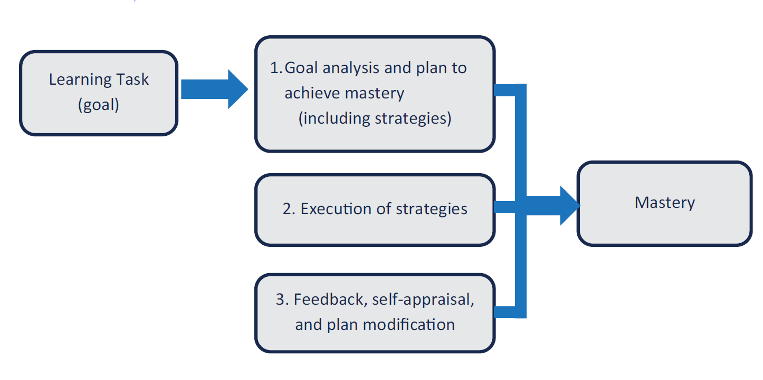
Basic Components of Metacognitive Competency in School Learning

Slide 26
Metacognitive Competency (How I learn) – Strategies for Teachers
Show how to chart and graph assignment and completion and objective mastery.
Include self-checks and peer-checks as part of assignment completion.
Think out loud to show, by example, how a learning task is approached and pursued.
Include documentation of learning processes and strategies employed in the completion of an assignment.
Teach the process of goal setting and planning, monitoring progress, and adapting basked on feedback.
Teach specific learning strategies and techniques, such as active listening, note-taking, strategic reading, organization of content, access to resources, research, questioning, memorization (mnemonics), outlining, practice, analytical thinking, self-monitoring, and test preparation.
Notes:
Materials Needed: None
Instructions for Facilitator: None
Sample Script: “This slide shows some of the indicators that represent metacognitive competency, which can lead to strategies that teachers use to foster this competency. For example, a teacher may build their students’ ability to regulate their learning by having them respond to comprehension prompts during reading informational texts. We will talk more about strategies for the competency in a bit.”
Facilitator: Briefly define each and reference page number xx which breaks down self-regulatory abilities.
Activity #10: Model the first three and then group work.
Models and teaches learning strategies- demonstrate the KWL chart (use resource book and pass around so each can review and discuss how a teacher’s uses a KWL chart to teach strategies for thinking.
Enhances logical thinking skills: Use thinking games. Think out loud on how I would enhance logical skills. Use the verbal example of “if I go to the beach what am I going to take?” Go around the room and take turns making sure each repeats what the others have said. Then ask what else can I do? Scribe responses.
Enhances creativity (divergent thinking): Use a graphic organizer on a chart paper and ask the group to brainstorm how do you get ready for a trip? In the middle of the circle write TRIP. What do I need to do? Who do I need to talk to? Where do I want to go? How do I find out where I want to go? Chart responses by drawing a line out to the responses then point to the fact that a big picture emerges of what needs to happen and then determine what will be first then so on. Reference the handout as a resource of looking for ideas.
Now participants turn. Assign each group to write ideas on sticky pads (medium size) ideas for each of the four. Tell them to use technology if they have it to generate ideas if needed. With the honor system of no calls or texts pointing to the fact they are modeling their own learning and should reflect their student expectations.
Ask what can you do or how do you support kids to …
4. Includes problem-solving
5. Builds self-regulatory abilities
6. Includes student tracking of mastery
7. Includes peer learning.
Ask one person to report out ideas. Put ideas on chart paper with the other ideas.

Slide 27
Metacognitive Competency (How I Learn) - In Your Role
How do you contribute to a young person’s Metacognitive Competency:
As a parent?
As a counselor?
As a youth group leader?
As a school administrator?
Other?
Notes:
Give them time to discuss.

Slide 28
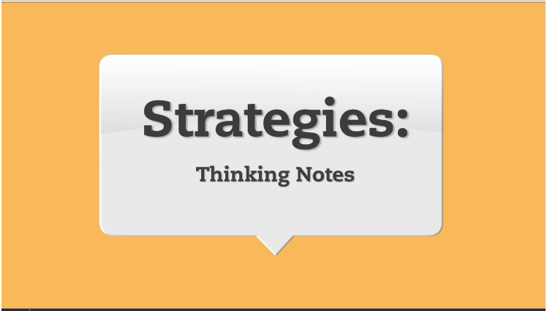
Metacognitive Competency
https://www.teachingchannel.org/videos/student-annotated-reading-strategy
Notes:
Materials Needed: Video link on slide
Instructions for Facilitator: Click link on the slide to open the video in a new window and show the video. After the video, flip back to previous slide to get participant responses on other ways metacognitive competency was fostered within the video.
Sample Script: “This video demonstrates a learning strategy that builds older students’ ability to self-regulate their understanding during reading, and engage in deeper levels of learning. Students would likely need plenty of explicit instruction and practice to become proficient with the strategy. Other thoughts?” In what ways do 'thinking notes' require students to track their response to a text and engage in more thoughtful reading?
How would this exercise build the students’ metacognitive competency?
How would this help the students future learning?
Slide Text: https://www.teachingchannel.org/videos/student-annotated-reading-strategy
Activity #11: Framing the observation.
Point to three posters:
We can only listen with open ears.
We can only see with open eyes.
We can only think with open minds.
Tell participants to listen, look, and think about metacognitive competency?
Tell participants to discuss with one peer once video ends. Did they see any of the 7 previous points? If so what?
Label: Metacognitive Competency Video Reflections
Chart paper to collect ideas from reporting out on videos.
Then before transitioning to the new slide ask for more thoughts if none then move on. This will give time for questions or clarification.

Slide 29
Metacognitive Competency
Summary Thoughts
Learners can self-regulate their learning
Thinking about your thinking can be modeled
Learning strategies can be taught
There are tools for problem solving that can be taught
Students can learn how to self-appraise (self-check) and self-manage (track their mastery)
Something Other“:

Slide 30
Working Lunch Exercise
Think of the one student or child who challenged you the most, who you felt you couldn’t reach.
Use the prompts on page 10 of your participant’s materials to reflect on how you engaged with this student.
Notes:
Materials Needed:
Case Study Exercise on page 10 of the Participant’s Materials
Instructions for Facilitator: None
Activity #21:
Sample Script: “Please complete this exercise on page 10 of your packet during lunch.”
Slide Text:
Think of the one student who frustrated you the most, who you felt you couldn’t reach.
Use the prompts on page 10 of your participant’s materials to reflect on how you engaged with this student.
- 60 MINUTE LUNCH BREAK -

Slide 31
Why I Learn (Motivational)
Definition: Engagement and persistence in pursuit of goals; self-efficacy (belief in ability to complete tasks and achieve goals); willingness to engage in an activity based on value and expectation of success
Redding, S. (2016). Personal Competency: A framework for building students’ capacity to learn. Philadelphia, PA: Temple University, Center on Innovations in Learning.
Notes:
Slide Number: 18
Materials Needed: None
Instructions for Facilitator: None
Sample Script: “Motivational competency involves promoting student engagement and persistence in pursuing their goals for learning. In order for students to pursue learning goals, teachers need to promote a growth rather than fixed ability mindset, in which they praise effort rather than “talent.” For example, saying “You solved that math problem? You must be really smart in math!” reinforces a fixed mindset and leaves no room for growth. Instead saying “You solved that math problem? You must have worked really hard and long on it to solve it!” Parents need to be aware of this concept as well, so that they can talk with their child in ways that promote a growth mindset. We also want to build intrinsic motivation for learning by providing students with opportunities to be autonomous, as well as activities that stimulate interest, value and relatedness.”
Slide Text:
Definition: Engagement and persistence in pursuit of goals
(Redding, S. (2016). Competencies and personalized learning. In M. Murphy, S. Redding, and J. Twyman (Eds.), Handbook on personalized learning for states, districts, and schools (pp. 3–18). Philadelphia, PA: Temple University, Center on Innovations in Learning.)

Slide 32
Why I Learn (Motivational)
In other words:
Apart from the student’s cognitive and metacognitive competency in grappling with and mastering the task, the student must simply want to engage and persist. Motivation is the wanting to.

Slide 33
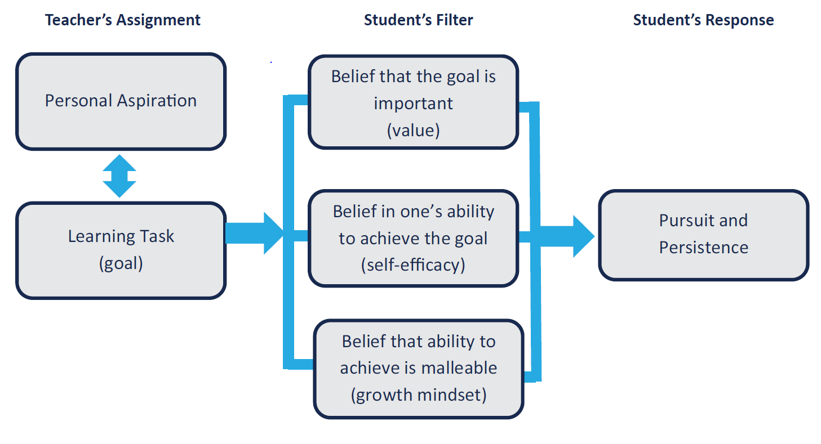
Basic Components of Motivational Competency in School Learning

Slide 34
Motivational Competency (Why I learn) – Strategies for Teachers
Promote a growth mindset by attributing learning success to effort and self-regulation, reinforcing the idea that both actual ability and self-efficacy are malleable and grow with practice, and insist upon (and reward) persistence to mastery.
Connect learning tasks to student’s personal aspirations.
Differentiate assignments to provide the right balance of challenge and attainability.
Help students “find the fun” in learning rather than simply making tasks fun.
Stretch the student’s interests for find value in new topics.
Celebrate mastery.
Help parents understand their influence on their children’s mindset, sense of agency, and motivation to learn, especially in their verbal attributions.
Notes:
Slide Number: 19
Materials Needed: None
Instructions for Facilitator: None
Sample Script: “This slide represents some of the indicators that show how teachers may foster motivational competency. For example, a teacher can celebrate student mastery through recognition of certain students’ exceptional growth at the end of a difficult unit.
Facilitator: Briefly define each.
Activity #14: Model the first two and then group work on what can you do.
Promotes a growth mindset. Use handout 10 Growth Mindset statements to illustrate how to share this students.
Stimulates interest in topic. Preview a couple of books asking what do they think it may be about. Use book What to do with an idea.
Next pair up participants with chart paper and have then assign two. (3 and 4, 5 and 6, 7 and 8, and 9 and 10)
Have them write ideas then illustrate ideas with a drawing to report out.
3. Increases value of subject
Builds self-efficacy (Psychologist Albert Bandura has defined self-efficacy as one's belief in one's ability to succeed in specific situations or accomplish a task. One's sense of self-efficacy can play a major role in how one approaches goals, tasks, and challenges.)
Includes student choice
Connects with student’s aspirations
Differentiates instruction
Celebrates mastery
Provides high levels of engagement
Includes clear indicators of progress
Post charts.

Slide 35
Motivational Competency (Why I Learn) - In Your Role
How do you contribute to a young person’s Motivational Competency:
As a parent?
As a counselor?
As a youth group leader?
As a school administrator?
Other?
Notes:
Give them a chance to discuss.

Slide 36
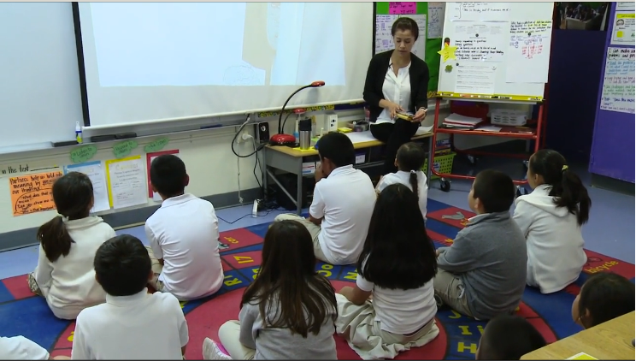
Motivational Competency
https://www.teachingchannel.org/videos/persist-through-challenges-perts
Notes:
Slide Number: 20
Materials Needed: Video link on slide
Instructions for Facilitator: This video will not automatically play within the slide. Before the presentation, open the link in a new window so it is ready for when this section comes up. Show the video. After the video, flip back to previous slide to get participant responses on other ways motivational competency was fostered within the video.
Sample Script: “This video demonstrates an important component of motivational competency, instilling in students a growth mindset so that they develop the skills to persist through academic challenges. Other thoughts on how the teacher in the video builds her students’ motivational competency? How does Ms. Montoy-Wilson help her students become excited about challenges?
Why is it important for students to articulate their thinking about challenging work?
How does Ms. Montoy-Wilson ensure that her students are struggling productively?
Slide Text: A video on persistence: https://www.teachingchannel.org/videos/persist-through-challenges-perts
Activity #15: Framing the observation.
Point to three posters:
We can only listen with open ears.
We can only see with open eyes.
We can only think with open minds.
Tell participants to listen, look, and think about motivation competency?
Tell participants to discuss with one peer once video ends. Did they see any of the 10 previous points? If so what?
Label: Motivation Competency Video Reflections
Chart paper to collect ideas from reporting out on videos.
Then before transitioning to the new slide ask for more thoughts if none then move on. This will give time for questions or clarification.

Slide 37
Motivational Competency
Summary Thoughts
Praise effort rather than “smartness” (growth mindset)
Students will persist with goals they believe they have the ability to achieve
Students will persist with goals that have value to them
Adults differentiate tasks for students to meet the “sweet spot” between challenge and attainability
Something Other“:

Slide 38
Who I Am (Social/Emotional)
Definition: Sense of self-worth, regard for others, emotional understanding and management, ability to set positive goals and make responsible decisions
Redding, S. (2016). Competencies and personalized learning. In M. Murphy, S. Redding, and J. Twyman (Eds.), Handbook on personalized learning for states, districts, and schools (pp. 3–18). Philadelphia, PA: Temple University, Center on Innovations in Learning.
Notes:
Materials Needed: None
Instructions for Facilitator: None
Sample Script: “As teachers we also of course need to promote students’ social/emotional competency, which involves their sense of self-efficacy in learning, regard for others, management of emotions, responsible decision-making, and ability to set positive goals. We also need to be sure to let students know through our words and actions that they BELONG in an academic environment by building opportunities for autonomy within the classroom and showing respect for students’ opinions.
Where appropriate, teachers can explicitly incorporate social-emotional goals into their instructional programs, and provide modeling and student practice.”
Slide Text:
Definition: Sense of self-worth, regard for others, emotional understanding and management, ability to set positive goals and make responsible decisions
(Redding, S. (2016). Competencies and personalized learning. In M. Murphy, S. Redding, and J. Twyman (Eds.), Handbook on personalized learning for states, districts, and schools (pp. 3–18). Philadelphia, PA: Temple University, Center on Innovations in Learning.)

Slide 39
Who I Am (Social/Emotional)
In other words:
Learning, especially school learning, is both a personal and social activity. As with other competencies, social/emotional competency is malleable, subject to enhancement through instruction as well as through the example set by teachers and peers and through the school’s and classroom’s norms for relationships among teachers and students.

Slide 40
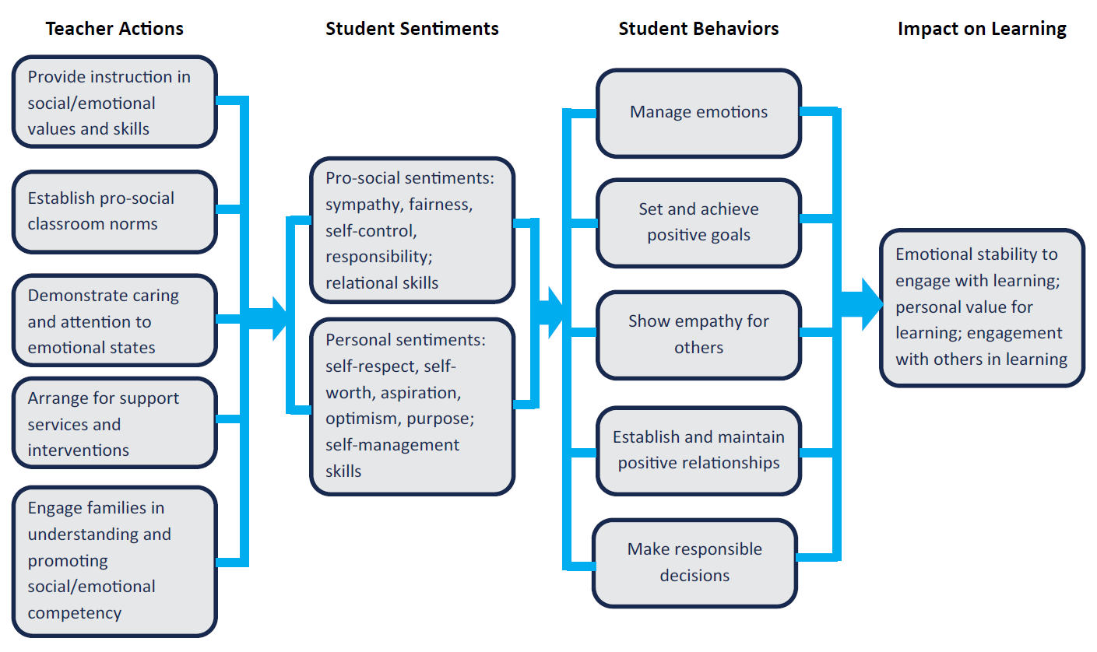
Basic Components of Social/Emotional Competency in School Learning

Slide 41
Social/Emotional Competency – Strategies for Teachers
Teach and reinforce positive social skills and relationships.
Model responsible behavior, caring, optimism, and positive verbal interactions.
Establish classroom norms for personal responsibility, cooperation, and concern for others.
Be attentive to students’ emotional states and guide students in managing their emotions.
Help students set constructive goals for learning and social relationships and know how to pursue and achieve the goal.
Teach students to understand the consequences of their decisions and to take responsibility for them.
Use cooperative learning methods.
Encourage questioning, seeking help from others, and offering help to others..
Work closely with parents to promote social/emotional competency at home.
Notes:
Materials Needed: None
Instructions for Facilitator: None
Sample Script: “This slide represents some of the strategies that teachers can use to build their students’ social/emotional competency. We will see from the video that group work and problem-based learning may serve to develop students’ skills in this area. In a little while, we will further discuss strategies that can help teachers implement these ideas.”
Activity #18: Review each one then model examples.
Builds self-awareness- do as a large group listing ideas on chart
Enhances self-management- use handout Personal qualities not measured by test pointing out how one can enhance each one listed in the visual.
Enhances social awareness- use poem the Golden Rule as a guide and share how using poems can be a powerful tool. Add how students could write their own poem.
Then create three groups assigning each group one of the remaining three. Have them chart responses and then post with the other charts. Drawing attention to how a room of ideas is being created.
Builds relationship skills
Contributes to responsible decision making
Builds sense of belonging in an academic community

Slide 42
Social/Emotional Competency (Who I am) - In Your Role
How do you contribute to a young person’s Social/Emotional Competency:
As a parent?
As a counselor?
As a youth group leader?
As a school administrator?
Other?
Notes:
Give a chance to discuss.

Slide 43
Social/Emotional Competency
https://www.youtube.com/watch?v=DqNn9qWoO1M
Notes:
Materials Needed: Link to video
Instructions for Facilitator: Click Play on the slide to show the video. After the video, flip back to previous slide to get participant responses on other ways metacognitive competency was fostered within the video.
Sample Script: Here we have a short video that provides an overview of the Social/Emotional Competency from a group called CASEL (Collaborative for Academic, Social and Emotional Learning). Is there anything they are describing about social emotional learning that would enhance young people that you work with?
Do the values of social emotional learning that they portray match your own understanding of how young people should value themselves and others? How?
What are ways that you know already to develop this competency in young people? Did you learn this from family, school, workplace, or social life?
Do you believe that you could enhance social emotional competency at the same time that you are working toward specific learning goals? How?
Slide Text: https://www.youtube.com/watch?v=DqNn9qWoO1M
Activity #19: Framing the observation.
Point to three posters:
We can only listen with open ears.
We can only see with open eyes.
We can only think with open minds.
Tell participants to listen, look, and think about social/emotional competency?
Tell participants to discuss with one peer once video ends. Did they see any of the 6 previous points? If so what?
Label: Social/Emotional Competency Video Reflections
Chart paper to collect ideas from reporting out on videos.
Then before transitioning to the new slide ask for more thoughts if none then move on. This will give time for questions or clarification.

Slide 44
Social/Emotional Competency
Summary Thoughts
Teachers and others can communicate that students belong
Students can build relationship skills with practice
Teachers and adults can model good social/emotional skills
Students can be taught to set positive goals and make responsible decisions
Students can be taught to respect themselves and respect others
Something Other“:

Slide 45
Break

Slide 46
Definitions Review
Cognitive Competency
Prior knowledge which facilitates new learning; broad knowledge acquired in any context, accessible in memory to facilitate new learning; sufficient depth of understanding to expedite acquisition of new learning
Metacognitive Competency
Self-regulation of learning and use of learning strategies; thinking about one’s thinking; tools for problem solving; consists of both self-appraisal (knowing what I know) and self-management
Notes:
Materials Needed: None
Instructions for Facilitator: None
Sample Script: “So students’ continuing development of personal competencies evolve into Learning Habits, which are the behaviors they use to handle new learning tasks.”

Slide 47
Definitions Review
Motivational Competency
Engagement and persistence in pursuit of goals; self-efficacy (belief in ability to complete tasks and achieve goals); willingness to engage in an activity based on value and expectation of success
Social/Emotional Competency
Sense of self-worth, regard for others, emotional understanding and management, ability to set positive goals and make responsible decisions
In use, these competencies become learning habits, behaviors used to tackle new learning skills.

Slide 48
Personal Competencies = “The Something Other”
=
Notes:
Materials Needed: None
Instructions for Facilitator: None
Sample Script: “Helping students develop their personal competencies, a.k.a. ‘the something other,’ helps them develop the learning habits that allow them to reach academic standards but also become lifelong learners.”
Activity #23: Because you care poem
Ask someone to volunteer to read. Draw the connection between the line “we give them something else” and now we have defined the something other.

Slide 49
How We Help Students Develop Personal Competencies . . .
. . . and Build Learning Habits
Modeling competencies
Explicitly teaching the competencies
Building relationships with students and families
That’s how we use Relational Suasion!
Notes:
This slide is a segue to Relational Suasion. These are ways to help students develop personal competencies and build strong learning habits.

Slide 50
Relational Suasion
Relational Suasion - the teacher’s (or other respected adult’s) ability to influence a student’s learning and personal competencies by virtue of their personal knowledge of, and interaction with the student and the student’s family.
Students develop personal competencies in part through instruction. They also acquire personal competencies through the modeling, encouragement, and caring exhibited by teachers and other people they respect.”
Redding, S. (2014). Personal competencies in personalized learning. Philadelphia, PA: Temple University, Center on Innovations in Learning.
Notes:
Materials Needed: None
Instructions for Facilitator: None
Slide Text: Relational Suasion - the teacher’s (or other respected adult’s) ability to influence a student’s learning and personal competencies by virtue of their personal knowledge of, and interaction with the student and the student’s family. “Students develop personal competencies in part through instruction. They also acquire personal competencies through the modeling, encouragement, and caring exhibited by teachers and other people they respect.”
Redding, S. (2014). Personal competencies in personalized learning. Philadelphia, PA: Temple University, Center on Innovations in Learning.

Slide 51
Influencing Jeffrey
Please read Jeffrey’s Story in your Participant’s Guide.
Notes:
Materials Needed: Jeffrey’s story on page 20-21 of the Participant’s materials
Instructions for Facilitator: Give participants 10 minutes to read Jeffrey’s Story independently.
Activity #26:
Sample Script: “We have a brief vignette about a not-so engaged and excited young man named Jeffrey. We are going to read Jeffrey’s Story individually and then discuss it together.”
Slide Text:
Please read Jeffrey’s Story on page 20-21 of your Participant’s materials.

Slide 52
Relational Suasion and the Personal Competencies
Jeffrey’s Story
How did Ms. Johnson teach or reinforce the cognitive and metacognitive competencies within her classroom?
What about Ms. Johnson’s assignment enhanced Jeffrey’s motivational competency?
In what ways did Jeffrey’s social/emotional competency improve through his engagement with others?
How did Jeffrey exhibit a pattern of behavior in tackling Ms. Johnson’s assignment that might be useful to future learning?
Notes:
Materials Needed: Jeffrey’s Story Text on page 20-21 of the Participant’s materials.
Continue Activity #26
Instructions for Facilitator: Facilitate a whole-group discussion using the questions on the slide.
Sample Script: “Ms. Johnson used a good deal of what we call relational suasion through her enhancement of each of the personal competencies within her instruction. She used modeling of strategies and provided encouragement; and she demonstrated caring by making sure she had personal knowledge of her students and their families.”
Sample Script:
“Let’s talk about how Ms. Johnson taught or reinforced the cognitive and metacognitive competencies. Any ideas?” Continue with each question, discussing as a whole group.
Slide Text: Jeffrey’s Story
How did Ms. Johnson teach or reinforce the cognitive and metacognitive competencies within her classroom?
What about Ms. Johnson’s assignment enhanced Jeffrey’s motivational competency?
In what ways did Jeffrey’s social/emotional competency improve through his engagement with others?
How did Jeffrey exhibit a pattern of behavior in tackling Ms. Johnson’s assignment that might be useful to future learning?

Slide 53
Personal Competencies and Your Students
Case Study
Think of the one student or child who challenged you the most, who you felt you couldn’t reach.
How could you better incorporate (or have incorporated) the personal competencies into your interactions with that student (using your relational suasion) to improve your relationship and his or her outcomes?
Notes:
Materials Needed:
Case Study Worksheet on page 17 of the Participant’s materials.
Chart Paper
Markers
Activity #27: modify time as needed
Instructions for Facilitator: Have a piece of chart paper for each of the different types of students on the handout -- behavioral issues, quiet/disengaged, academically underperforming (struggling), academically underperforming (gifted), etc. Each piece of chart paper can have 4 boxes, for each of the competencies. Have the teachers form groups are around each piece of chart paper and enter strategies in the four squares (15 minutes). Have each group leader hold up their chart paper and explain what they would do with this student across the four competencies.
Sample Script: “Refer back to the case study you completed at lunch on page 17 of your Participant’s Guide. We are going to do an activity to get you all moving and to share your ideas with the group. We have four pieces of chart paper around the room that represent different types of students who may be difficult to engage -- behavioral issues, quiet/disengaged, academically underperforming (struggling), academically underperforming (gifted). On each piece of chart paper, there is a box for each of the competencies. We are going to form groups around the four pieces of chart paper so you can fill out the strategies you have used or would suggest using to engage these types of students, using the personal competencies. After you have finished writing, take a look at what other participants have written to get some ideas.”
Slide Text: Case Study
Think of the one student who frustrated you the most, who you felt you couldn’t reach.
How could you better incorporate (or have incorporated) the personal competencies into your interactions with that student (using your relational suasion) to improve your relationship and their outcomes?

Slide 54
What We Learned Together
Did we:
Define and discuss the four personal competencies and how they impact learning and life?
Apply the four personal competencies to our own lives?
Apply the four personal competencies in our roles to benefit students?
Notes:
Materials Needed: None
Instructions for Facilitator: None
Sample Script: “Okay, we have covered a lot today. We won’t give you a quiz, but we hope that you have come away with the ability to define and understand how the personal competencies impact learning, and why they are important to teachers. In a broader sense, we also hope that you developed an understanding of how these competencies are applied generally in life.”
Activity #30: Taking it home 3-2-1 Learning handout
Ask participants to think of 3 things learned, 2 things to share, and one thing to do in the next week in reflection of the two day training. Tell them to keep and ask if anyone wants to share.
Slide Text:
All participants will be able to define and understand the four personal competencies and how they impact learning.
All participants will understand how the four personal competencies apply to our own lives.
All participants will be able to demonstrate how they will incorporate the four personal competencies in their work to benefit students.

Slide 55
Teachers - Preparing for Tomorrow
Bring in a lesson plan that you are comfortable sharing and critiquing.
This lesson could be your tried and true favorite, one that did not go as well as you would have liked, or a new one that you are developing.
Pick a lesson for which it would be useful to receive feedback.
You do NOT need to use a lesson plan that already exemplifies the personal competencies!
Notes:
Materials Needed: None
Instructions for Facilitator: None
Activity #28: Revisit Reflection Activity and ask them to jot anything new down. Ask for questions.
Make note if they do not have one they can bring a generic one as well. Give out door prizes.
Sample Script: “Please look through your lesson plans at home and bring one in for the session tomorrow. Digital or paper copies are fine, whichever works better for you. You don’t need one that exemplifies the competencies, but rather pick one, could be your favorite or one you want to improve, that you would like feedback on.”
Slide Text: Bring in a lesson plan that you are comfortable sharing and critiquing.
This lesson could be your tried and true favorite, one that did not go as well as you would have liked, or a new one that you are developing.
Pick a lesson for which it would be useful to receive feedback.
You do NOT need to use a lesson plan that already exemplifies the personal competencies!

Slide 56
Wrap Up
Please complete your Professional Learning Evaluation Day 1 so that we know how we can continue to improve this Academy.
Thank you for your feedback and participation!
Notes:
Materials Needed: Evaluation forms in packet – look for Day 1
Instructions for Facilitator: Have participants complete Academy evaluation. Evaluations are in the participant’s materials and should be printed separately so they can turn them in. There is a set for Day 1 and for Day 2, in case there are some who only attend the first day. Collect all surveys at the end of the session. Also refer them to the glossary of terms in their Participant’s Materials.
Sample Script: “Just wanted to point out that there is a glossary of terms in your Participant’s Materials just for your reference. We also have an evaluation form for you to fill out –Look for Day 1. Please fill out and turn in to one of us. We will be holding this training with a number of other teacher groups and would love your feedback on how you think it went. It will help inform not only our future presentations but also how we can help support you after this Academy.”
Activity #31: Point out the poem Don’t Quit. Thank everyone for their attendance and give away a couple of door prizes. Thank the host and return the control of the session back to the host.
Slide Text:
Please complete your Professional Learning Evaluation so that we know how we can continue to improve this Academy. Thank you for your feedback and participation!

Slide 57
Welcome and Introductions (Day 2)
Notes:
Welcome back, and greet and introduce anyone new.
Housekeeping
Review the following housekeeping items:
Attendance (Sign-In documentation)
Engage enthusiastically
Name Tags or Table Tents
Share location of restrooms
Confirm each person has an agenda and presentation handouts
Share protocol for asking questions
Parking Lot poster for other comments

Slide 58
What We Will Learn Together
We will:
Adapt a lesson plan to include the personal competencies.
Learn to construct lesson plans that include enhancement of the four personal competencies.

Slide 59
Definitions Review
Cognitive Competency
Prior knowledge which facilitates new learning; broad knowledge acquired in any context, accessible in memory to facilitate new learning; sufficient depth of understanding to expedite acquisition of new learning
Metacognitive Competency
Self-regulation of learning and use of learning strategies; thinking about one’s thinking; tools for problem solving; consists of both self-appraisal (knowing what I know) and self-management
Notes:
Materials Needed: None
Instructions for Facilitator: None
Sample Script: “To review from yesterday, we talked about the 4 personal competencies that together result in student learning habits that allow them to tackle new learning tasks.“

Slide 60
Definitions Review
Motivational Competency
Engagement and persistence in pursuit of goals; self-efficacy (belief in ability to complete tasks and achieve goals); willingness to engage in an activity based on value and expectation of success
Social/Emotional Competency
Sense of self-worth, regard for others, emotional understanding and management, ability to set positive goals and make responsible decisions
In use, these competencies become learning habits, behaviors used to tackle new learning skills.
Notes:
FOLLOWING SLIDES ARE Q & A.
CLICK 1 = Q
CLICK 2 = A

Slide 61
Let’s See What You’ve Learned
Which competency does this strategy enhance?
Review prior learning, connecting to new topics
COGNITIVE

Slide 62
Let’s See What You’ve Learned
Which competency does this strategy enhance?
Establish classroom norms for personal responsibility, cooperation and concern for others
Social/Emotional

Slide 63
Let’s See What You’ve Learned
Which competency does this strategy enhance?
Review prior learning, connecting to new topics
COGNITIVE

Slide 64
Let’s See What You’ve Learned
Which competency does this strategy enhance?
Connect learning tasks to the student’s personal aspirations
MOTIVATIONAL

Slide 65
Let’s See What You’ve Learned
Which competency does this strategy enhance?
Think out loud to show how a learning task is approached and pursued
METACOGNITIVE

Slide 66
Let’s See What You’ve Learned
Which competency does this strategy enhance?
Model responsible behavior, caring, optimism, and positive verbal interactions
SOCIAL/EMOTIONAL

Slide 67
Let’s See What You’ve Learned
Which competency does this strategy enhance?
Stretch the student’s interests to find value in new topics (acquired relevance)
MOTIVATIONAL

Slide 68
Personal Competencies = “The Something Other”
Cognitive
Metacognitive
=
Motivational
Social/Emotional
Notes:
Materials Needed: None
Instructions for Facilitator: None
Activity #28: Revisit yesterday’s work on chart paper around the room, ask them to review their own reflection sheet and ask for any questions from yesterday.
Sample Script: “Any questions/clarifications/ reflections from yesterday on the competencies? These competencies are the “Something Other” that teachers can directly influence through their classroom practices and use of relational suasion. Building relationships with students and their families helps teachers develop these critical competencies that result in learning habits that allow students to be successful in the classroom and life.”
Slide Text: Personal Competencies = The “Something Other”

Slide 69
Lesson Planning
Notes:
Materials Needed: None
Instructions for Facilitator: None
Sample Script: “Before we start working personal competencies into your lesson plans, wanted to first review the things generally that make up good, sound lesson plans. These are just the basics. Your lesson plans also may have teaching/learning activities, connection to standards, resources needed to implement the lesson, etc.”
Every great lesson plan should include the following elements:
A clearly stated learning objective that includes: Students will be able to…
The teacher then decides the best method of delivering the content.
Continue to informally assess and adjust instruction until most students can independently master the content. Schmoker, M. (2013). The lost art of teaching soundly structured lessons. Retrieved from http://www.edweek.org/tm/articles/2013/06/04/fp_schmoker_lessons.html

Slide 70
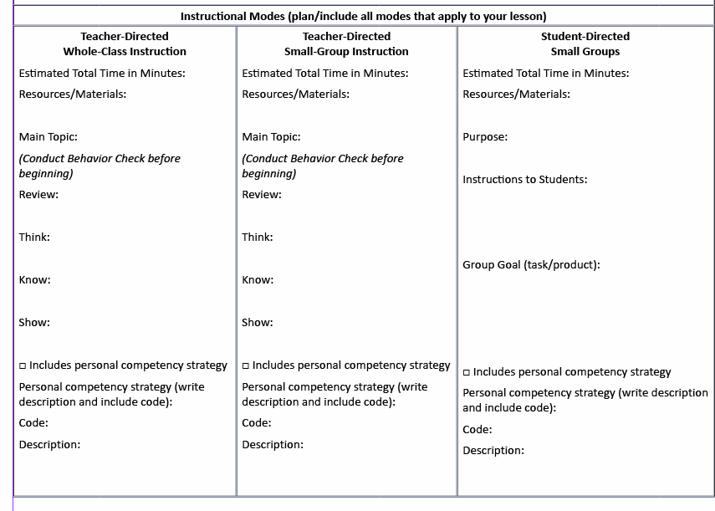
Lesson Planning
Notes:
For Whole class or small group instruction, the parts of the lesson are the same. A quick behavior check to make sure everyone is ready to learn. Review to provide students with a clear evaluation of their progress. Think is the time to introduce the new lesson, activate prior knowledge, stimulate student cognition relative to the topic. Know is when the teacher directly teaches the new skill or concept. Show is the time for students to demonstrate what they have learned. The teacher can do a quick summary of the main points and can ask questions to see how much students have learned. Schmoker, M. (2013). The lost art of teaching soundly structured lessons. Retrieved from http://www.edweek.org/tm/articles/2013/06/04/fp_schmoker_lessons.html

Slide 71
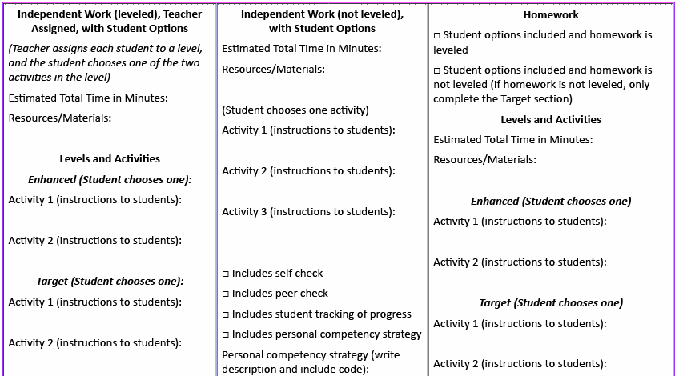
Lesson Planning
Notes:
Remember that student may complete their Independent Work at different rates. Also, the learning activities do not have to be completed in a day. You may give assignments that will take most students several days to complete. Students will learn to manage their time to get things done, and that is a great lesson in responsibility for learning. Clear directions, and concise procedures for accomplishing tasks will lay the ground and set the classroom for on-task learners.
Homework is ta primary point of interface between the school and the home, and parents are best able to support the school’s purpose for homework when they understand what is expected of students and their role in monitoring their children’s homework.

Slide 72
Enhanced Lesson Design
Now that you understand the four competencies, we are going to apply what you have learned. Our activities will include three different steps:
Looking at some sample lessons as a group
Reflecting on how well these sample lesson plans incorporate and enhance the personal competencies, with practice adapting these samples to better incorporate the competencies
Adapting your own lesson plan to further foster students’ personal competencies through “Enhanced Lesson Design”
Notes:
Materials Needed: None
Instructions for Facilitator: None
Sample Script: “In alignment with good practice, we are going to first model how to determine to what extent lesson plans reflect the personal competencies, and how a lesson can be adapted to better address them. Then we will give you some guided practice on a sample lesson. Then we will have you reflect on how your lesson plan enhances students’ personal competencies and how you might better incorporate them.
Slide Text:
Where We’re Headed
Now that you understand the four competencies, we are going to apply what you have learned. Our activities will include three different steps:
Looking at some sample lessons as a group
Reflecting on how well these sample lesson plans incorporate and enhance the personal competencies, with practice adapting these samples to better incorporate the competencies
Adapting your own lesson plan to further foster students’ personal competencies through “Enhanced Lesson Design”

Slide 73
Incorporating PCs into Your Lessons
“It may take several lessons, spread across days or topics to adequately address [personal] competencies. As personal competencies are ever evolving, none is ever ‘achieved,’ but each is strengthened within the intentional design of the teacher’s instruction.”
Teachers are not expected to address all 4 competencies within a single lesson!
Twyman, J., & Redding, S. (2015). Personal competencies/personalized learning: Lesson plan reflection guide.

Slide 74
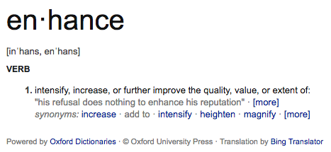
Incorporating PCs into Your Lessons: Enhanced Lesson Design (ELD)

Slide 75
Incorporating PCs into Your Lessons: Enhanced Lesson Design (ELD)
The process of refining and/or adding instructional elements to enhance the Personal Competencies within an already developed lesson
How can you incorporate the strategies we’ve been discussing into a lesson plan you already have designed, without changing its purpose?

Slide 76
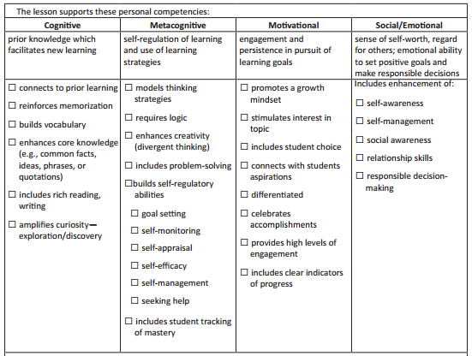
Enhanced Lesson Design
Notes:
Materials Needed:
Sample lesson on page 17 of the Participant’s materials
Instructions for Facilitator: Explain that this lesson can be found in the participant guide on page 17. Give two to three minutes for participants to read over lesson.
Sample Script:
Then begin: “Before I look at the competencies, let me make sure this lesson plan on the 3 branches of government has some of the keys we discussed earlier.” “Yes, it has clear objectives, don’t see any direct mention of modeling, but maybe the teacher models what students are expected to do when they do role playing activity? She definitely has guided practice and formative assessment through the use of the Exit Ticket.” Using the checklist, how well does the lesson plan address the four competencies?

Slide 77
Enhanced Lesson Design
✔
✘
✘
✘
✔
✘
✔
✔
✔
✔
✔
✔
✘
✘
✘
✔
✘
✘
✔
✘
✘
✘
✔
✘
✘
Notes:
Materials Needed:
Sample lesson on page 17 of the Participant’s materials
Instructions for Facilitator: Use the script below to model the process of evaluating a lesson for the use of personal competencies. This slide has the checklist marked off, so explain that you would check them off as you go along and that we used this checklist because it fits nicely on the slide!
Sample Script: “Now let’s look at the personal competencies.
Cognitive: I don’t see any mention of connecting to prior learning, or memorization, but it could be she does this as part of her Do Now explanation, and just didn’t explicitly say so. The lesson doesn’t address memorization, but this might not be appropriate for the lesson, or may come in a subsequent lesson. She definitely builds vocabulary (check box) through the explanations and reinforcements, and clearly the lesson will enhance core knowledge (check box). She doesn’t make mention of independent reading, but does have an independent writing assignment that requires inferential thinking (check box). Don’t see how the lesson would amplify curiosity or exploration.”
Metacognitive: “Hmm. The only thing I see here is that she definitely enhances creativity/divergent thinking by using the role playing exercise.
Motivational: “I think she definitely stimulates interest in the topic through the role playing, and this activity also provides high levels of engagement.
Social/Emotional: “While she doesn’t explicitly state she is trying to do this, I think the group work with the role playing and sharing out can contribute to almost all of these areas because students must work together collaboratively, and through this process students develop self-awareness, management, social awareness, and relationship skills.”
Remember that these are general guidelines and are subjective. Everyone might interpret the use of the personal competencies a little differently.

Slide 78
Enhanced Lesson Design
Metacognitive Indicator/Strategy | How Can You Strengthen the Competency?
Models thinking strategies | Teacher could model what it might be like to be a member of each branch -- what their perspective might be or how they might approach their work.
Requires logic
Enhances creativity (divergent thinking)
Includes problem-solving | The scenario could be about a relevant problem that the different branches are working to solve.
Builds self-regulatory abilities | The task could be structured like a real political exchange, so that students must follow the rules for when to contribute and when to listen.
Includes student tracking of mastery
Notes:
Materials Needed:
Sample lesson on page 17 of the Participant’s materials.
Instructions for Facilitator: Use the script below to model the process of evaluating a lesson for the use of personal competencies. Break audience into groups to address the review of sample for the other three competencies- Metacognitive, Motivational, Social Emotional
Sample Script: “This lesson has does a pretty good job of addressing the Cognitive and Social/Emotional competencies. There may be some things that could be tweaked to improve the metacognitive/motivational competencies as well.” Flip to next slide.
This chart is a modified version of what you will use to evaluate other lessons, as well as your own. From the checklist slide, we know that the teacher already addressed some of these indicators/strategies, but let’s think about how we could strengthen the competency.”
How can we better incorporate elements of the Metacognitive and Motivational Competencies into this lesson?

Slide 79
Enhanced Lesson Design
Metacognitive Indicator/Strategy | How Can You Strengthen the Competency?
Models thinking strategies | Teacher could model what it might be like to be a member of each branch -- what their perspective might be or how they might approach their work.
Requires logic
Enhances creativity (divergent thinking)
Includes problem-solving | The scenario could be about a relevant problem that the different branches are working to solve. tosolv
Builds self-regulatory abilities | The task could be structured like a real political exchange, so that students must follow the rules for when to contribute and when to listen.l
Includes student tracking of mastery
Notes:
Materials Needed:
Sample lesson on page 17 of the Participant’s materials
Lesson plan checklist and worksheet
Instructions for Facilitator: Use the script below to model how to think about improving this lesson within the Metacognitive and Motivational Competencies.
Sample Script: “To build metacognitive competency, the teacher could model how what it could be like to be a member of each branch, maybe describing what their perspective might be or how they might approach their work. The teacher could also tweak the lesson to include a scenario involving some type of relevant problem that branches are working to solve. To increase students’ ability to self-regulate their learning, the task could be structured like a real political exchange, so that students must follow rules for when to contribute and when to listen. Actually this activity braids the metacognitive and motivational competencies together, since it builds not only students’ self-regulatory abilities, but also stimulates their interests and provides high levels of engagement.”

Slide 80
Enhanced Lesson Design
Motivational Indicator/Strategy | How Can You Strengthen the Competency?
Promotes a growth mindset | Teacher could model what it might be like to be a member of each branch -- what their perspective might be or how they might approach their work.
Stimulates interest in topic
Includes student choice
Connects with students’ aspirations | The scenario could be about a relevant problem that the different branches are working to solve.
Differentiated | The task could be structured like a real political exchange, so that students must follow the rules for when to contribute and when to listen.
Celebrates accomplishments
Provides high levels of engagement
Includes clear indicators of progress
Notes:
Materials Needed:
Sample lesson on page 17 of the Participant’s materials
Lesson plan checklist and worksheet
Instructions for Facilitator: Use the script below to model how to think about improving this lesson within the Metacognitive and Motivational Competencies.
Sample Script: “Like the metacognitive chart, this chart is a modified version of what you will use to evaluate other lessons, as well as your own. From the checklist slide, we know that the teacher already addressed some of these indicators/strategies, but let’s think about how we could strengthen the competency.”
How can we better incorporate elements of the Motivational Competencies into this lesson?

Slide 81
Enhanced Lesson Design
Motivational Indicator/Strategy | How Can You Strengthen the Competency?
Promotes a growth mindset | Teacher could model what it might be like to be a member of each branch -- what their perspective might be or how they might approach their work.
Stimulates interest in topic
Includes student choice | Students could self-select into roles.
Connects with students’ aspirations | The scenario could be about a relevant problem that the different branches are working to solve.
Differentiated | Student prompts could differ based on reading level or informal assessment.
Celebrates accomplishments | The teacher could lead a reflection of the role play to shout out particularly strong student contributions and which branch may have won.
Provides high levels of engagement
Includes clear indicators of progress
Notes:
Materials Needed:
Sample lesson on page 17 of the Participant’s materials
Lesson plan checklist and worksheet
Instructions for Facilitator: Use the script below to model how to think about improving this lesson within the Metacognitive and Motivational Competencies.
Sample Script: “To further build students’ motivational competency, the teacher could adjust the lesson to allow students to self-select their roles within the role-playing activity. The writing prompts that students complete could be differentiated based on informal assessment or reading level; this activity could also serve to braid together the motivational with cognitive competencies because differentiation serves to better build students’ core knowledge. To celebrate accomplishments, the teacher could lead a role play reflection to shout out particularly strong student contributions, and finish with an analysis of which branch might have ‘won.’”
- 15 MINUTE BREAK -

Slide 82
BREAK

Slide 83
Enhanced Lesson Design
Your Turn: Sample Lesson Plan
How well does it stack up against the Personal Competencies Checklist?
Which competencies does this teacher need to enhance?
What are some ways that they can improve their lessons to better incorporate the four competencies?
Notes:
Materials Needed:
Sample lesson plan on pages 18-19 of the participant’s materials
Complete Enhanced Lesson Design: Sample Lesson on pages 28-31 of participant’s guide
Instructions for Facilitator: Have participants work together in pairs or with their table groups to apply what they learned during the modeling session to a new sample lesson. They will use the Enhanced Lesson Design Sample Lesson which has one page for each competency. They will check off which indicators/strategies are used in the lesson for each competency (left column), then indicate HOW the lesson reinforces each indicator/strategy they selected (middle column), and finally provide suggestions as to how the competency might be improved (right column).
Sample Script: “Pair up with your neighbor or work with your table group to give the ELD process a try on a new lesson. This is an elementary math lesson, unlike the last one, which was a secondary social studies lesson. See how the competencies might be the same or different across age groups or subject areas. Everything you need is on pages 18-19 of your Participant’s materials. You will fill in the 4 competency tables, by first checking off which indicators/strategies are used in the lesson (left column of table), then describe briefly HOW the lesson reinforces that indicator/strategy (middle column), and finally provide suggestions as to how the competency might be improved (right column).”
Slide Text: With your table partners, look through the sample lesson on pages 18-19 of your Participant’s Guide. Think about the following questions as you look at
How well does it stack up against the Personal Competencies Checklist?
Which competencies does this teacher need to enhance?
What are some ways that they can improve their lessons to better incorporate the four competencies?

Slide 84
Enhanced Lesson Design
Your Turn: Your Lesson Plan
How well does your own lesson incorporate the personal competencies?
Take a look at how the competencies are addressed within your lesson(s).
What did you find out? Any overlap with your survey results from yesterday?
How can you better incorporate elements of the competencies into your lesson?
Notes:
Materials Needed:
Teachers’ own lesson plans (or extra samples if they are not prepared)
Enhanced Lesson Plan: Your Lesson from pages 25-28 of participant’s guide
Instructions for Facilitator: The participants should use the worksheet on pages 25-28 in their participant’s guide to write down their thoughts about their own lessons.
Sample Script: “Take out the lesson plan that you brought with you. You are going to have a bit of time to go through the same process on a lesson that is meaningful to you. Everything you need for this can be found on pages 25-28.”
Slide Text: Look at the lesson you brought today. How well does your own lesson incorporate the personal competencies?
Take a look at how the competencies are addressed within your lesson(s).
What did you find out? Any overlap with your survey results from yesterday?
How can you better incorporate elements of the competencies into your lesson?
Instruct participants to complete the Enhanced Lesson Design: Your Lesson tables for each competency on pages 25-28

Slide 85
Enhanced Lesson Design
How might the personal competencies further apply to your teaching behaviors?
While teaching whole-group?
While working with a small group?
While working one on one?
While assigning students enrichment activities to extend learning?
While providing peer-led activities?
Notes:
Materials Needed:
List of indicators/strategies on page 29 of the Participant’s materials
Instructions for Facilitator: Reference the list of strategies that were developed during yesterday’s gallery walk activity, as well as the list of indicators/strategies in the guides.
Sample Script: “We have talked about the Personal Competencies in terms of examples or stories and also in terms of instructional technique. Now we need to bring those together to think about actual teaching behaviors. Of course, the competencies are strongly evident in how teachers approach and interact with their students. Let’s think about how the competencies might affect behaviors of the teacher in different settings.”
Slide Text: Now your lesson plan is all set -- but how do the PC apply to your own teaching behaviors? You have incorporated the personal competencies into your lesson plans by building in some additional strategies that address them.
While teaching whole-group?
While working with a small group?
While working one on one?
While leading an activity?

Slide 86
Enhanced Lesson Design
Sharing Out Lesson Designs
Notes:
Materials Needed: None
Instructions for Facilitator: Participants should share out a brief description of their lesson design (stating the objective of the lesson and if it is whole class, small group, independent work, group work, etc) and what competency (or more than one) they addressed and the strategy they used. Allow time for the others to give feedback.
Allow time for everyone to report out. If it is an especially large group, you may have to select one or two from each table to report out.

Slide 87
Enhanced Lesson Design
As teachers, you design lessons all the time, but this training gave you a new lens to look through while planning.
At your tables, talk about how this process has been for you.
What was the most intuitive part of the process?
What was the most confusing or challenging part of the process?
How did the ELD process help you think through the four competencies?
How will you continue to use ELD during the school year?
Notes:
Materials Needed:
Post-it notes
Chart paper
Instructions for Facilitator: Have participants answer each question on separate post-it notes. They can come to the front and put the post-its on the wall or chart paper. Summarize the patterns once all of the post-its have been completed.
Sample Script: “We are going to review the ELD process as a group. You plan lessons all the time, but this training gave you some new things to think about as you plan. We’d love to hear what you thought about the process and where we can help clarify anything that may still be confusing.”
“Take a few minutes to answer the questions on the slide on the post-it notes on your tables. When you are finished, bring the post-it notes up to the front so we can look at what everyone had to say.”
Slide Text: As teachers, you design lessons all the time, but this training gave you a new lens to look through while planning.
At your tables, talk about how this process has been for you.
What was the most intuitive part of the process?
What was the most confusing or challenging part of the process?
How did the ELD process help you think through the four competencies?
How will you continue to use ELD during the school year?

Slide 88
What We Learned Together
Did we:
Adapt a lesson plan to include the personal competencies?
Learn to construct lesson plans that include enhancement of the four personal competencies?
Notes:
Materials Needed: None
Instructions for Facilitator: None
Sample Script: “Okay, we have covered a lot over these two days. We won’t give you a quiz, but we hope that you have come away from the Academy with the ability to define and understand how the personal competencies impact learning, and why they are important to teachers. In a broader sense, we also hope that you developed an understanding of how these competencies are applied generally in life. Today you have demonstrated how you can apply the competencies within your lessons, and we hope that you have also come away with the ability to do this independently as you start the new school year.”
Activity #29: Share some samples from each of the competencies of what I would do as a teacher to begin to integrate into my lessons.
Cognitive: Share class posters which ask questions about content being taught.
Metacognitive: Share how I will use curriculum resources i.e. Khan Growth Mindset lesson plan.
Motivational: How I would use games that build vocabulary i.e. School of fish if I were teaching living animal science. If time permits let them compete with the handout.
Social/Emotional: How I would have daily attributes planned out and listed for a month on signs integrating into my daily routine.
Activity #30: Taking it home 3-2-1 Learning handout
Ask participants to think of 3 things learned, 2 things to share, and one thing to do in the next week in reflection of the two day training. Tell them to keep and ask if anyone wants to share.
cies.

Slide 89
Next Steps
What are some ways you can continue this work throughout the school year?
Talk to your colleagues who also attended this training and see how you can collectively include the competencies in your instruction and management practices.
Check out the Center on Innovations in Learning for more resources: www.centeril.org

Slide 90
Wrap Up
Please complete your Professional Learning Evaluation so that we know how we can continue to improve this Academy.
Thank you for your feedback and participation!
Notes:
Materials Needed: Evaluation forms are included in the packet. Make sure they fill out Day 2.
Instructions for Facilitator: Have participants complete Academy evaluation and leave them on the table before they leave. Collect all surveys at the end of the session. Also refer them to the glossary of terms as a reference in their packets as well as all the other resources that are included for their use.
Sample Script: We have an evaluation form for you to fill out. If you would please fill it out and leave it on the table or bring to us. It looks very similar to yesterday, but we would like your feedback on the content and experience of today. We will be holding this training with a number of other teacher groups and would love your feedback on how you think it went. It will help inform not only our future presentations but also how we can help support you after this Academy.”
There are also other resources in your packets that you are free to use. We hope that you find them helpful.
Thank everyone for their attendance and give away a couple of door prizes. Thank the host and return the control of the session back to the host.
Slide Text:
Please complete your Professional Learning Evaluation so that we know how we can continue to improve this Academy. Thank you for your feedback and participation!

