Slide 1
Engaging People through Language & Culture
First Mesa Elementary School
2012-2013SY
Sahmie S. Wytewa, Principal

Slide 2
Level of Involvement
Stakeholders
    Principal, School community, School Board, Families & Community
Leadership Team
  9 instructional staff, 1 support staff, 1 admin
Strong interest, desire, & support to infuse
HOPI-TEWA CULTURE & LANGUAGE

Slide 3

Project Goals & Impact
Reflect community needs of culture & language
Enhance school-wide programs & services
  Academic, Behavior, Level of Engagement, Social
Systemic Value
PROJECTS
Daily Routine: Establish values for learning (k-6)
SY Calendar
Mural Project
Enhancing Environment through Pictures

Slide 4
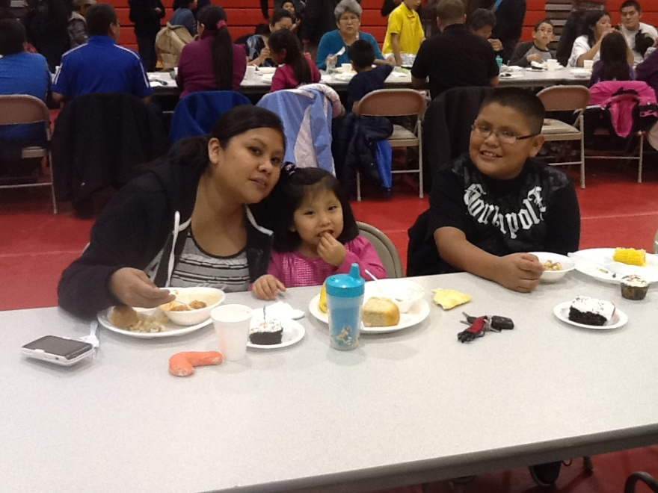
Culture & Language Indicators
  Physical appearance reflects culture
  LT plans ways to infuse tribal customs & values, models respect for them
  All students receive instruction in prevailing tribal language and use.
  As’kwali, Ku’na’a, Thank you!!!

