Slide 1
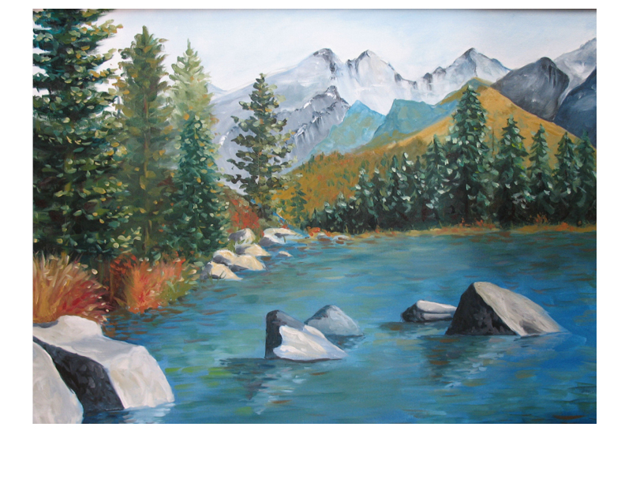
Mentor-Principals
January Webinar
Principal Leadership Academy

Slide 2
Agenda: Progress Reports
Welcome
Snapshot Progress Reports
  Each Principal gives a 3 minute report of PLA progress with:
    Rapid Improvement Leader Plan
    Leadership Team work with Native Star
    Project 1: Engaging People: Culture and Language
    Project 2: Common Core (or substitute topic)

Slide 3
Agenda: Looking Ahead
A Look Ahead to February (10 minutes)
  Continue implementation of Culture and Language Project; weekly log in Project Management Tool
  Continue implementation of Project 2 (Common Core or substitute topic); weekly log in Project Management Tool
  Site Visits: Who is scheduled for February? Schedule set in Project Management Tool?

Slide 4
Agenda: Managing Change
How well is your Leadership Team assuming its leadership role? (3 minutes each principal)
  Regular attendance of all members
  Working from agendas from Native Star
  Culture of Candor
  Implementing plans
  Communicating with teachers and others
  Progress with Leadership and Decision Making indicators

Slide 5
Agenda: Discussion and Reminders
Discussion of Principal reports (Managing Change) and common themes (10 minutes)
Reminder to enter reflections about this webinar in Project Management Tool
Confirm February webinar time and date

