Slide 1

Principal Leadership Academy
November 2012
Project Management System

Slide 2
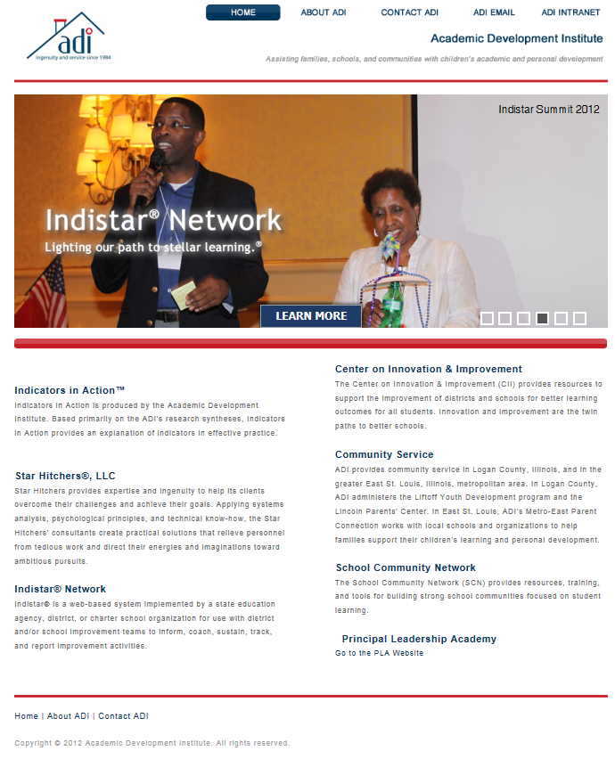
Finding the PLA Website
We aren’t dentists
A little like finding Waldo
Typing in the web address wasn’t working
NOW! You can find the link on the ADI homepage (we still aren’t the dentists)

Slide 3
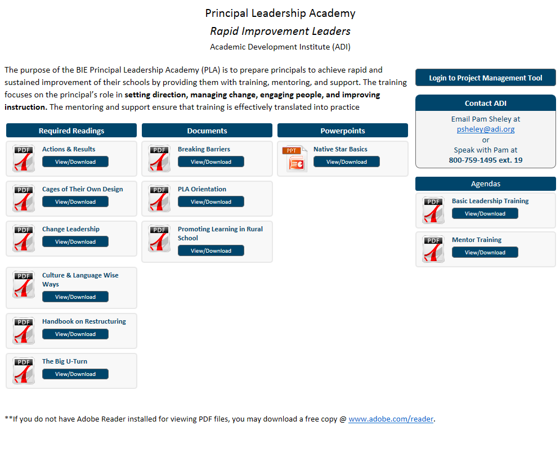
PLA Main Page
On the PLA Main Page, the required readings are posted as well as other useful documents, powerpoints used in all the trainings, and agendas for trainings. Also found on the Main Page is contact information for questions, a download for adobe reader, and the login to the PLA Work Space Management.

Slide 4
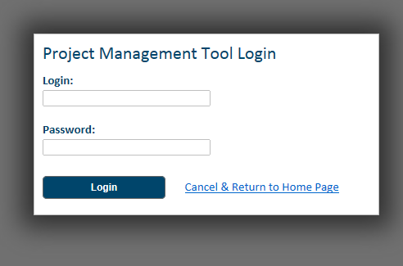
Logging In
You will be assigned one login and password
The login and password will allow you to enter the Work Space Management page

Slide 5
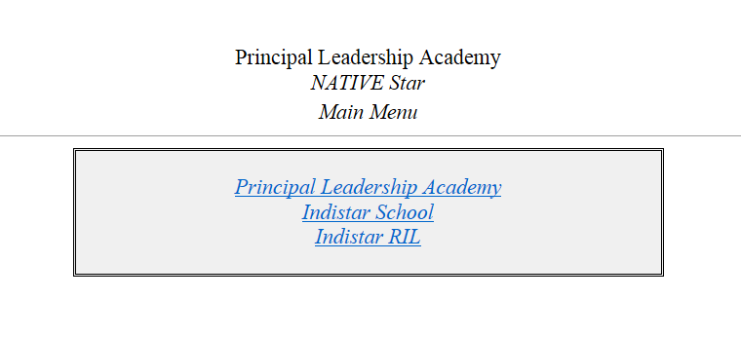
Work Space Management
We wanted to make this as convenient as possible for your busy schedules. From the one login, you will be able to access your work in Native Star, your work in the Rapid Improvement Leader indicators, and your work in the Project Management System. We’ll cover the Rapid Improvement Leader indicators in another session. In this session, we are entering the Project Management System.

Slide 6
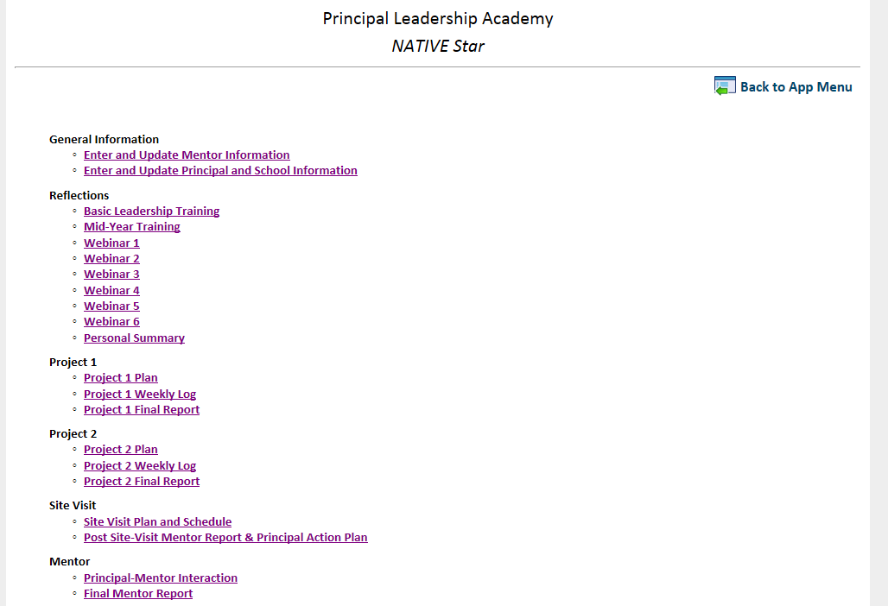
Main Menu
From the Main Menu page, the principal or mentor may navigate to any page within the system. On each page, a Return to Main Page link is provided.

Slide 7
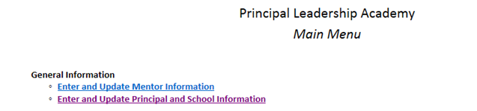
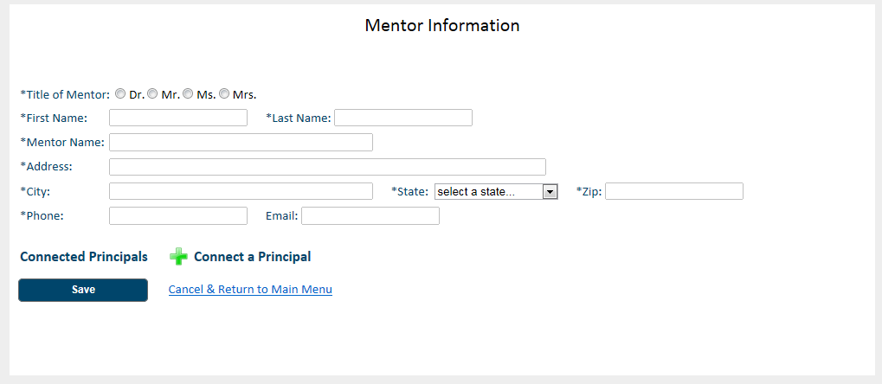
Mentor Information
Mentors will fill in his or her information the first time you log in. You may edit the information at any time. Please make sure to keep it updated and correct.

Slide 8
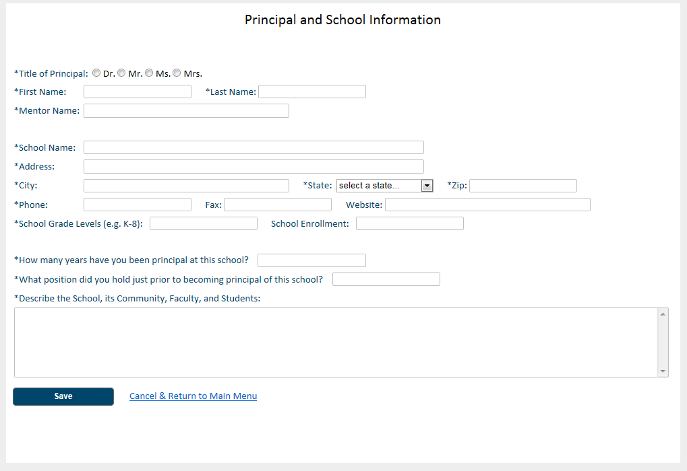
Principal and School Information
Basic information will be “pre-loaded” into the system. Principals will need to answer the extra questions at the bottom of the page. Information may be updated or edited at any time. Please make sure it is always correct.

Slide 9
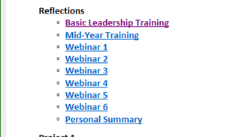
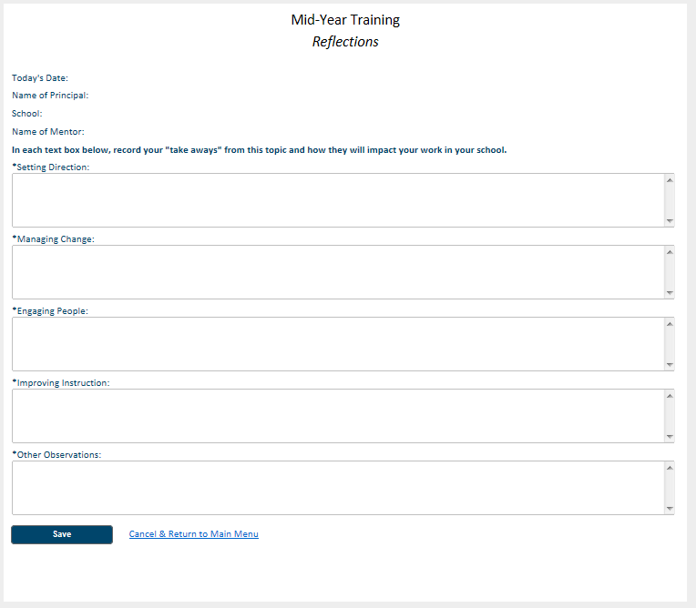
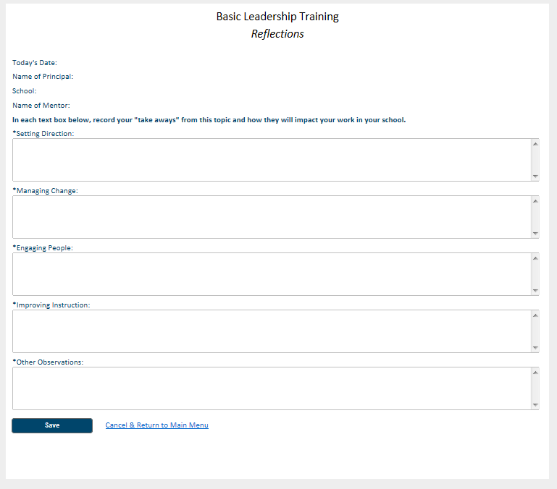
Reflections: Basic Leadership Training and Mid-Year Training
After each training, principals will be given the opportunity to reflect on what was learned and record those thoughts here.

Slide 10
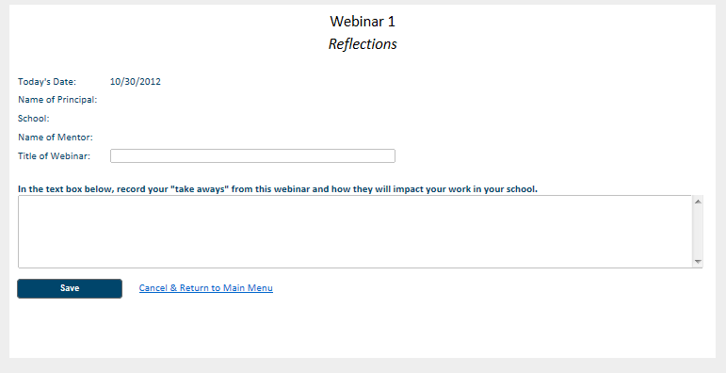
Reflections: Webinars
Likewise, after each webinar with the mentor, principals will be given the opportunity to reflect on what was learned and record those thoughts here.

Slide 11
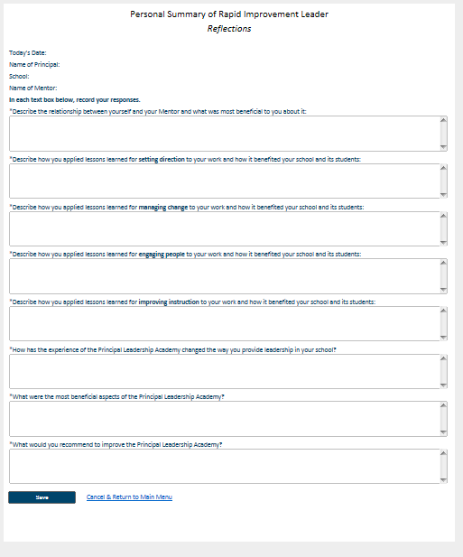
Reflections: Personal Summary
Before submitting final reports to the certification board, the principal enters reflections on the whole principal leadership academy process.

Slide 12
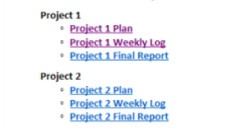
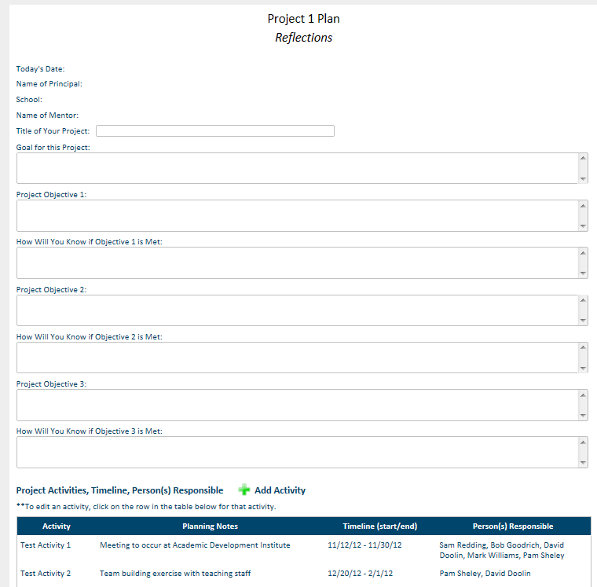
Project 1 (and 2) Plan
During Basic Training, principals and mentors will have a chance to begin planning the Project 1 of the required projects for the Principal Leadership Academy. Project Plan 1 and 2 provides a place to document the goal for each project, the objectives, how you know the objective has been met, activities to meet the objectives, a timeline for each activity, and a person responsible for each activity.

Slide 13
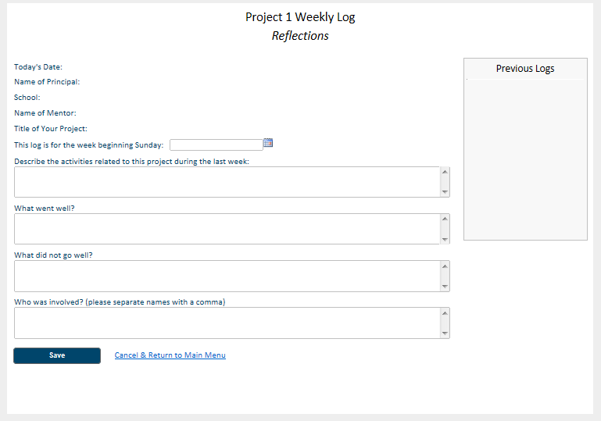
Project 1 (and 2) Weekly Log
Principals will record weekly the progress on each project. Once the screen is saved, a link will appear in the Previous Logs. The link will be the date of the week recorded. Prior logs may be edited.

Slide 14
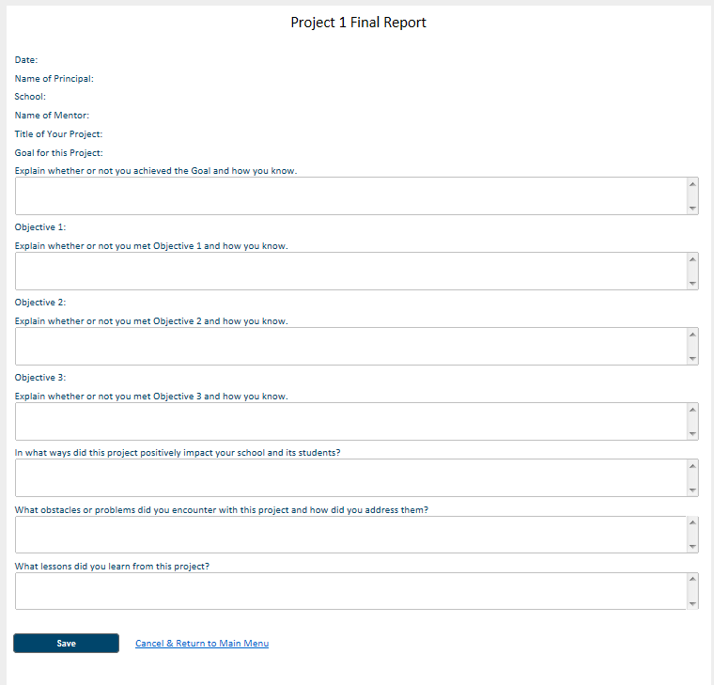
Project 1 (and 2) Final Report
Before submitting final reports to the certification board, the principal enters reflections on the implementation and success of Project 1 and Project 2.

Slide 15
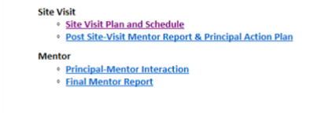
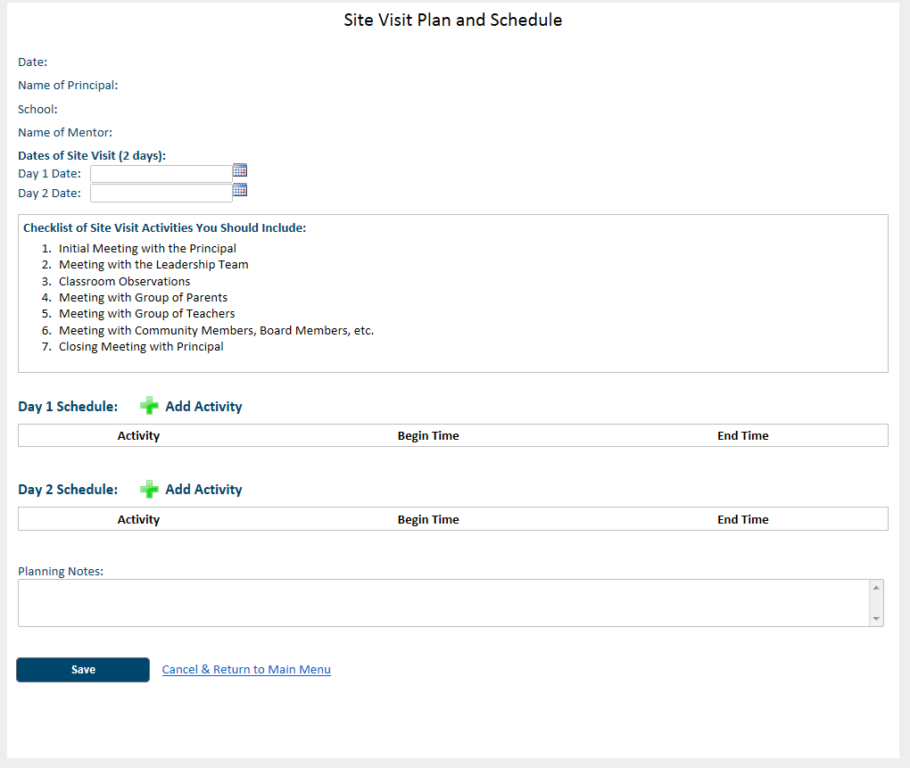
Site Visit Plan and Schedule
The principal will be responsible for planning and hosting a two-day site visit for the mentor. The activities which should be included are listed in the checklist. A place to assign a time for each activity is also provided.

Slide 16
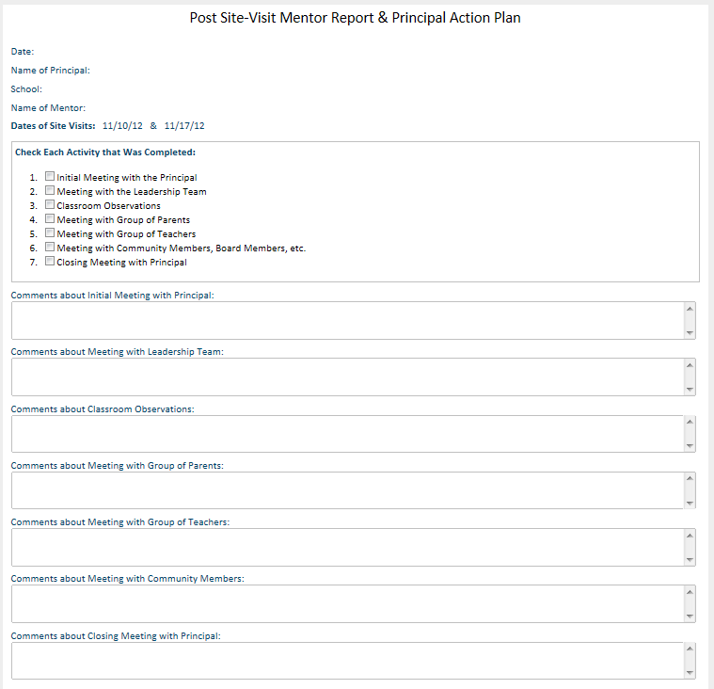
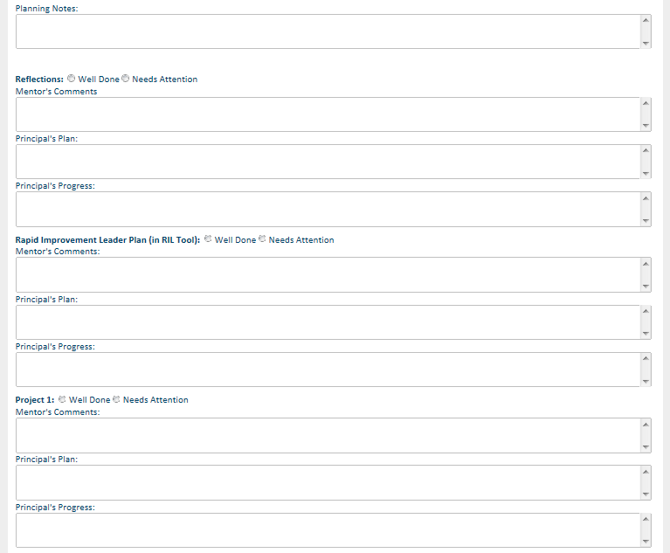
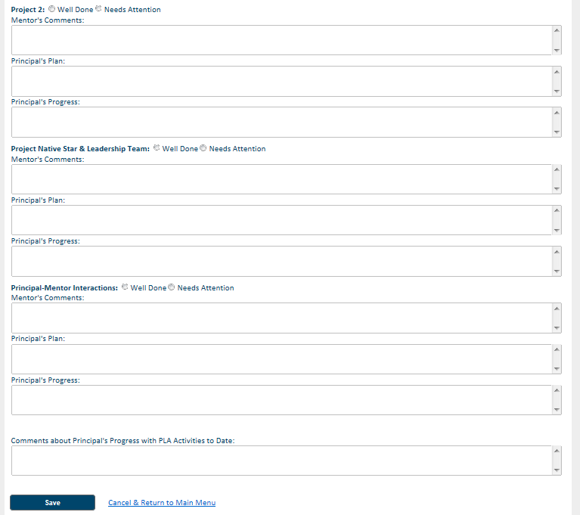
Post Site Visit Mentor Report &
Principal Action Plan
After the visit, the mentor will complete the Post Site Visit Report and create an action plan to be shared with the principal. The principal will use this same form to record progress on the action plan. (It’s a really long form.)

Slide 17
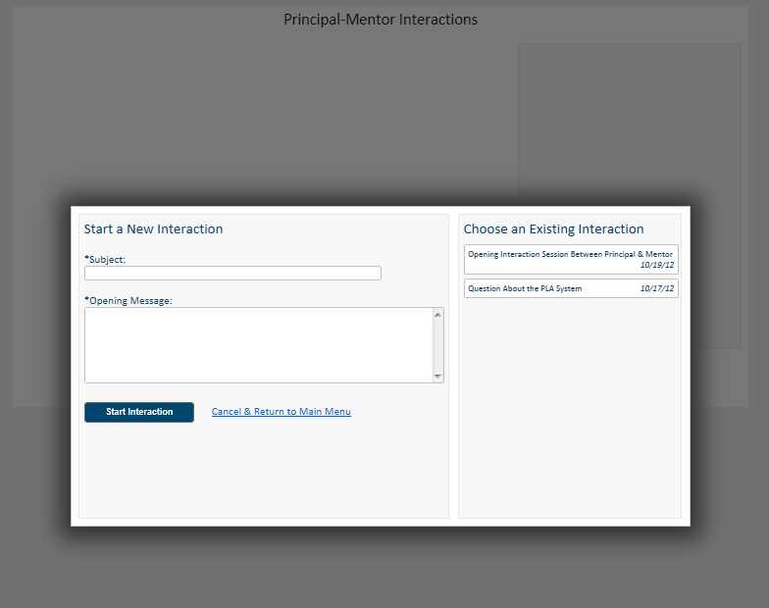
Principal-Mentor Interaction
The most important aspect of the Principal Leadership Academy will be the relationship that is formed between the principal and the mentor. In order to facilitate communication, the Principal-Mentor Interaction page was created to post comments, questions, and conversations. Either principal or mentor may initiate a “thread” and either may respond to a thread already started by selecting the subject link in the box to the right.

Slide 18
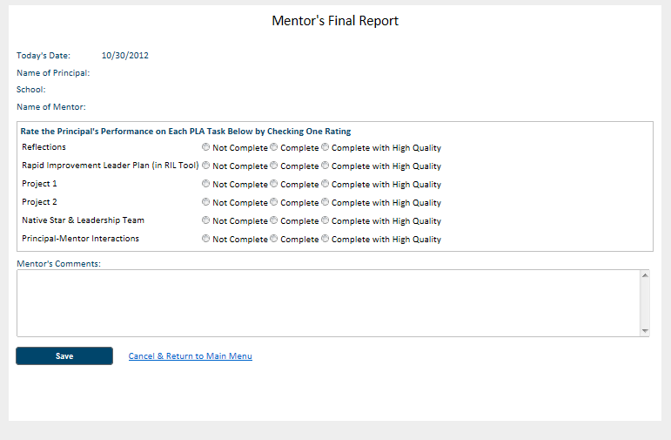
Mentor’s Final Report
Before any final reports are submitted to the Certification Board, the mentor will complete the final report. If any item on the final report is not complete, a principal cannot be recommended for Certification.

Slide 19
Questions?
If you have any questions, please contact:
Pam Sheley
217-732-6462 ext. 19
psheley@adi.org

