Slide 1
Rapid Improvement Leader
Rapid Improvement Leader Web System: Thinking About Your RIL Plan

Slide 2
Rapid Improvement Leader Indicators
Rapid Improvement leader will make an action plan so that everyone involved knows specifically what they need to do differently.
  This allows people to focus on changing what they do, rather than worrying about impending change.
Rapid Improvement leader will personally analyze data about the organization’s performance to identify high-priority problems that can be fixed quickly.
  Later, they establish organization routines that include ongoing data analysis.

Slide 3
Indicators
Rapid Improvement leader will make changes that deviate from organization’s norms and rules if necessary to gain visible wins.
  In a failing organization, existing norms and rules often contribute to failure. Targeted deviations to achieve early wins teach the organization that new practices can lead to success.
Rapid Improvement leader will implement an action plan in which change is mandatory for all staff, not optional.

Slide 4
Indicators
Rapid Improvement leader will replace or redeploy some staff as necessary based on careful examination of skills and readiness for change.
  Successful leaders typically do not replace all or most staff. But they often replace senior staff, particularly those who manage others. After the organization begins to show turnaround success, staff unwilling or unable to make changes that their colleagues have made leave or are removed by the leader.
Rapid Improvement leader will quickly discard tactics that don’t work and spend more resources and time on tactics that work.

Slide 5
Indicators
Rapid Improvement leader will report progress but keep the school’s focus on high priority goals.
  Leaders are not satisfied with partial success. When a goal is met, they are likely to raise the bar.
Rapid Improvement leader will motivate others inside and outside the school to contribute to success.
  Leaders communicate a clear picture of success and its benefits.

Slide 6
Indicators
Rapid Improvement leader will use various tactics to help staff empathize with those they serve and be motivated for change.
  Leaders help their staff put themselves in the shoes of those whom they serve. This helps staff feel the problems that the status quo is causing and feel motivated to change.
Rapid Improvement leader will work hard to gain the support of trusted influencers among staff and community.
  Leaders work with staff and community to build support for change.

Slide 7
Indicators
Rapid Improvement leader will silence critics with speedy success on “quick win” objectives.
  Early, visible winds are used not just for success in their own right, but to make it harder for others to oppose further change. This reduces leader time spent addressing “politics” and increases time spent managing for results.
Rapid Improvement leader will set up systems to measure and report interim results often.
  This enables the rapid discard of failed tactics and increase of successful tactics essential for fast results.

Slide 8
Indicators
Rapid Improvement leader will share results in open-air meetings to hold all staff accountable for results and to focus on solving problems.
  Sharing of results in open-air meetings allows leaders to hold staff who make key decisions accountable for results, creating discomfort for those who do not make needed changes and providing kudos to those who are achieving success. This shifts the focus of the organization’s meetings from power plays, blaming, and excuses to problem solving.

Slide 9
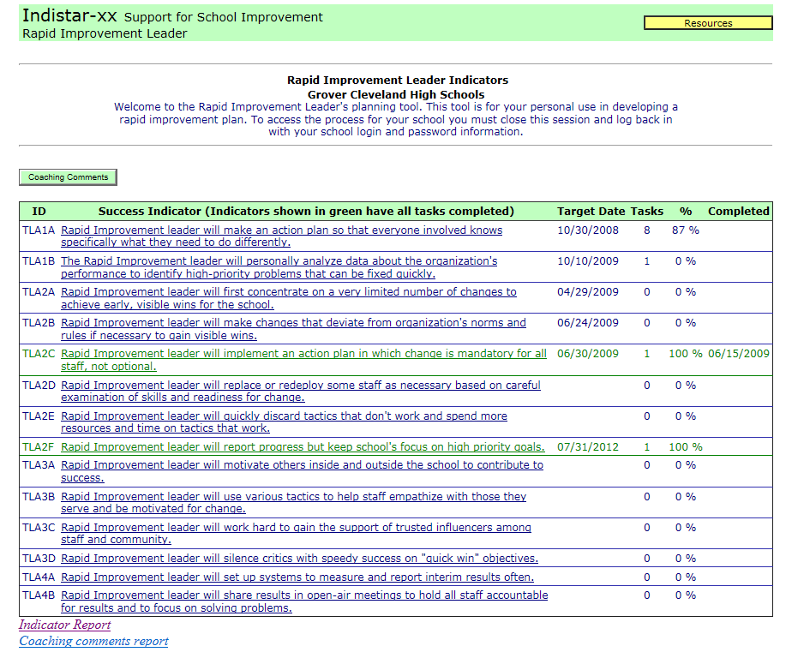
RIL Online System: Home Screen

Slide 10
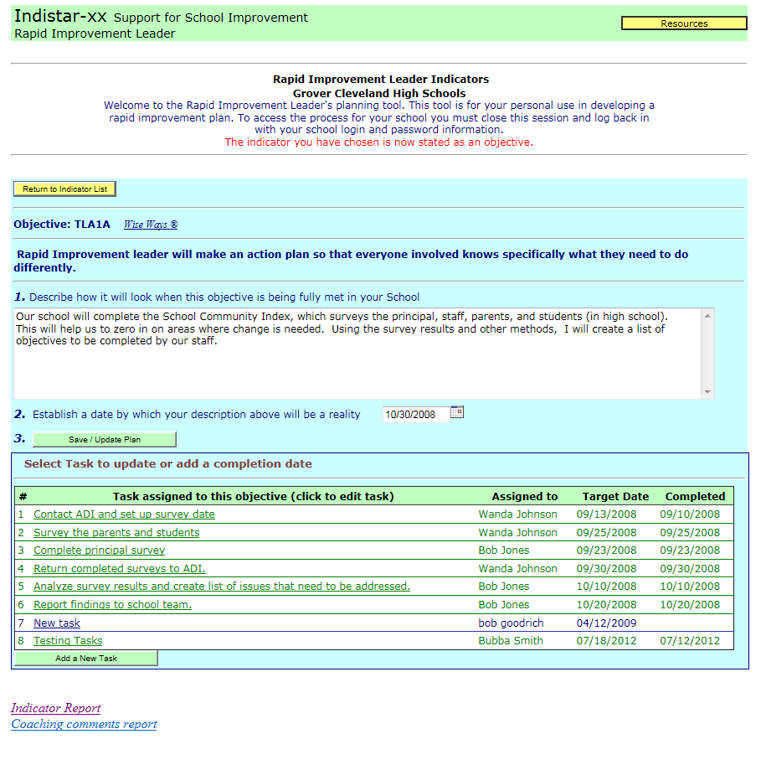
Planning an Indicator
1. Select an Indicator to plan from the Home Screen
2. State how the Objective will look when fully met in your school.
3. Establish a target date.
4. Add tasks that will get you from where you are now to where you want to be.

Slide 11
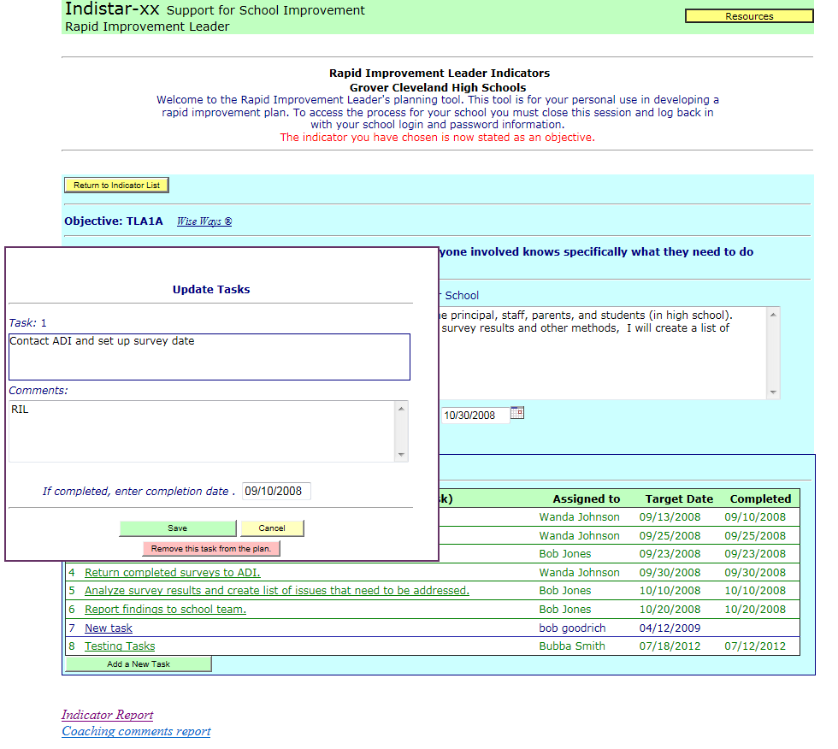
Monitoring Tasks
1. Select a task to monitor. Add comments on the progress. Enter a completion date when task is met.

Slide 12
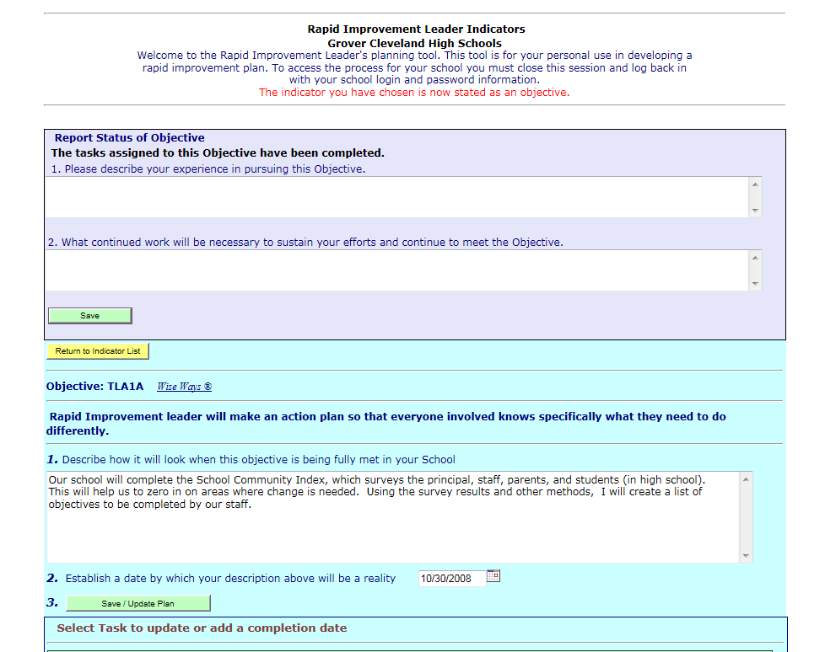
Objective Met
When all the tasks are complete, you will be asked to describe your experience and how you will sustain your efforts to continue to meet the objective.

Slide 13
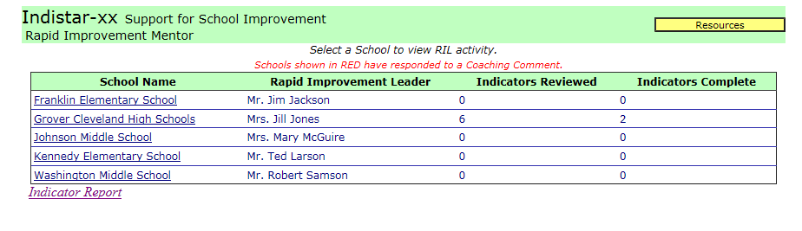
Coaching Comments: Mentor
When mentors log in, they will be able to choose the principal for whom they are adding coaching comments, as well as see if a principal has responded to a coaching comment.

Slide 14
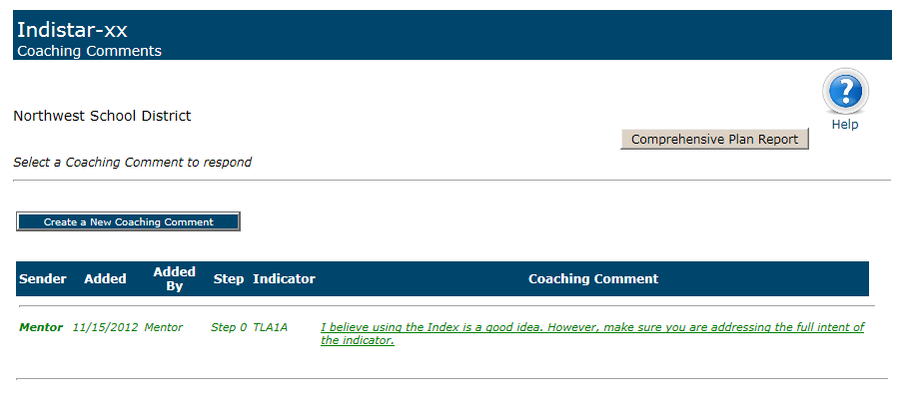
Adding a Coaching Comment
Mentors may create a new Coaching Comment or may choose a response from a school to add a comment.

Slide 15
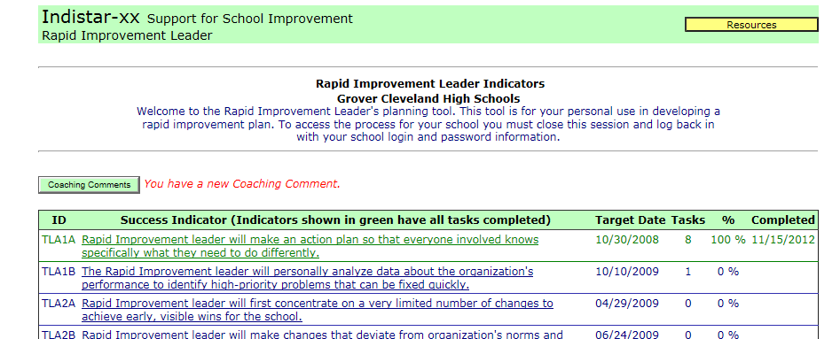
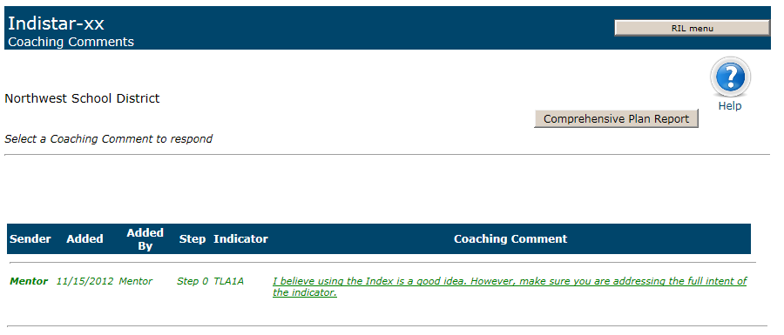
Coaching Comments: Principal
1. Principals will be notified of a coaching comment when they log into the RIL system.
2. Principals may respond to a coaching comment by selecting the comment.

Slide 16
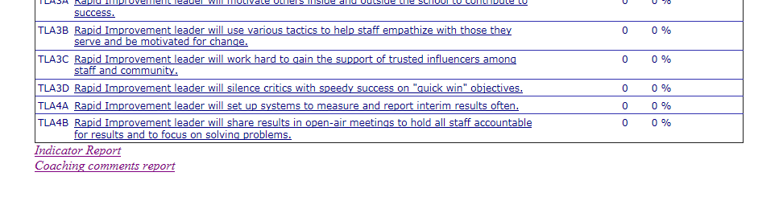
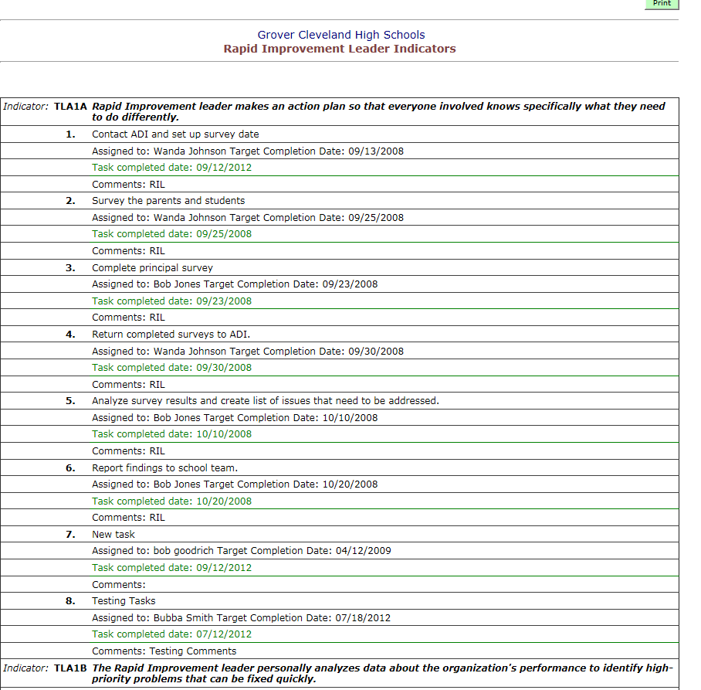
Reports for Mentor and Principal
Principals and Mentors may both view the Indicator Report which shows all the work of the principal on the objectives.

Slide 17
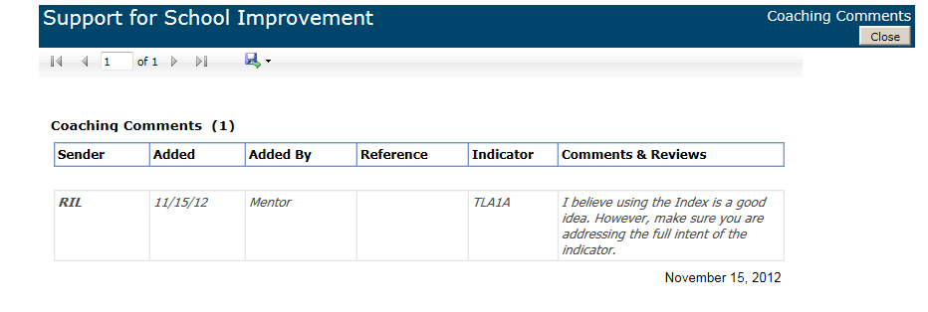
Reports for Principals and Mentors
The Coaching Comments report displays the ongoing interactions between the Mentor and the Principal.

Slide 18
Questions?
For technical assistance in the use of the RIL system, please contact:
Pam Sheley
217-732-6462 psheley@adi.org

