Slide 1

Honoring our
Heritage
San Felipe Pueblo Elementary School

Slide 2
Goal for Project
Indicator #14 To provide instruction that is relevant to the students of San Felipe Pueblo and Santo Domingo Pueblo and build upon recognizing that the students bring their identity, as Keres speakers, Keres thinkers, Keres living beings, with them every day to school. They do not leave their being as a Native Pueblo Keres speaking child at the door of the classroom as they would their backpacks, they live, breath, talk and learn in Keres AND in the English language.
Objective 1 - The objective is to let students demonstrate “Who they are as Native Pueblo Keres speakers” through writing, stories, song, dance, and plays by teachers creating a cultural unit of study.
Indicator #3 To reflect “What is means to be Keres….Katishya, Kewa” throughout the school thru paintings and drawings done by students.
Indicator #1 To bring awareness of the culture, customs, and values of San Felipe Pueblo to the non-Indian staff of San Felipe Pueblo Elementary School.

Slide 3
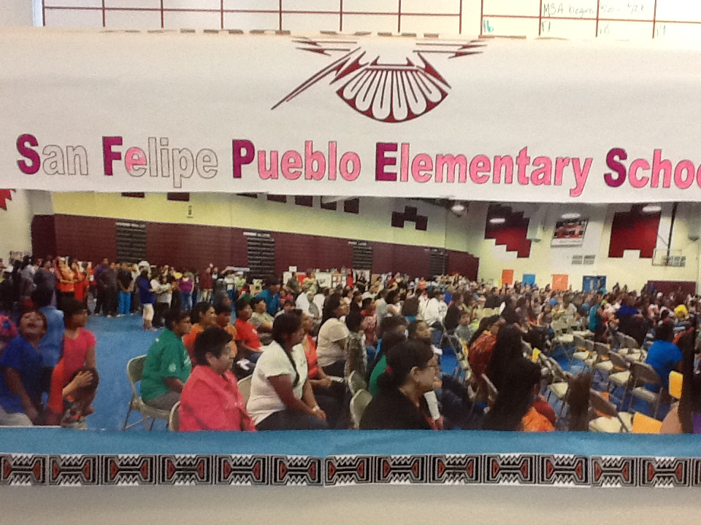
Honoring our Heritage Showcase
The showcase was a culmination of all the projects that students were involved in at their respective grades. Teachers submitted a lesson plan that stated the objective of their lessons for the month and they referenced NM CCSS for Language Arts and NM State Benchmarks for English Language Development and Modern, Classical, and Native Languages. The showcase was followed with a traditional feast.
The language and culture project brought PRIDE to SFPES and the knowledge that the NM CCSS could still be met utilizing a project based approach to instruction and lesson planning which is what occurred between staff and grade levels to implement the projects. The language and culture project also initiated conversations amongst all staff regarding this sensitive issue of language and culture and how it relates to the school environment. The language and culture project is a step towards further conversations and instilling PRIDE for being a Thunderbird.

