Slide 1
Taos Day School
PLA Culture Project

Slide 2
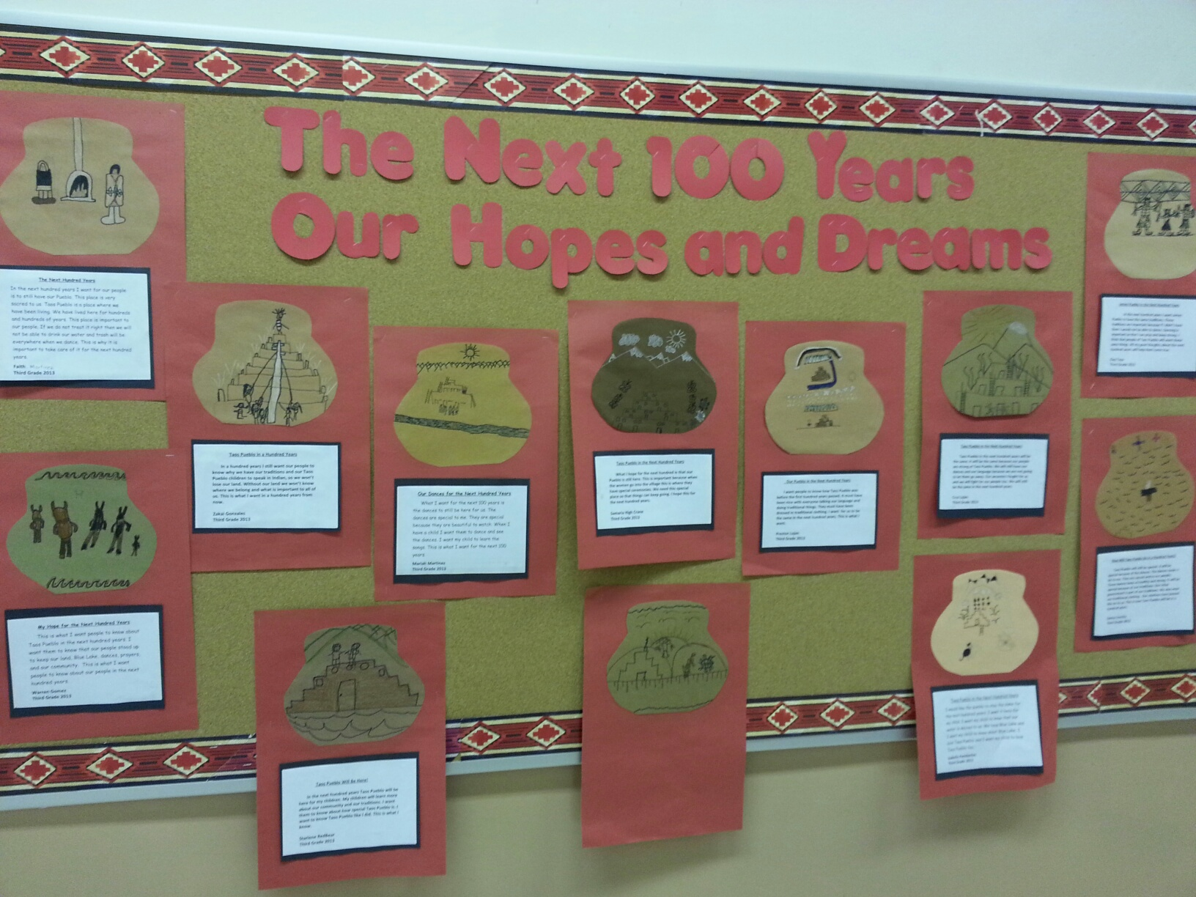

Slide 3
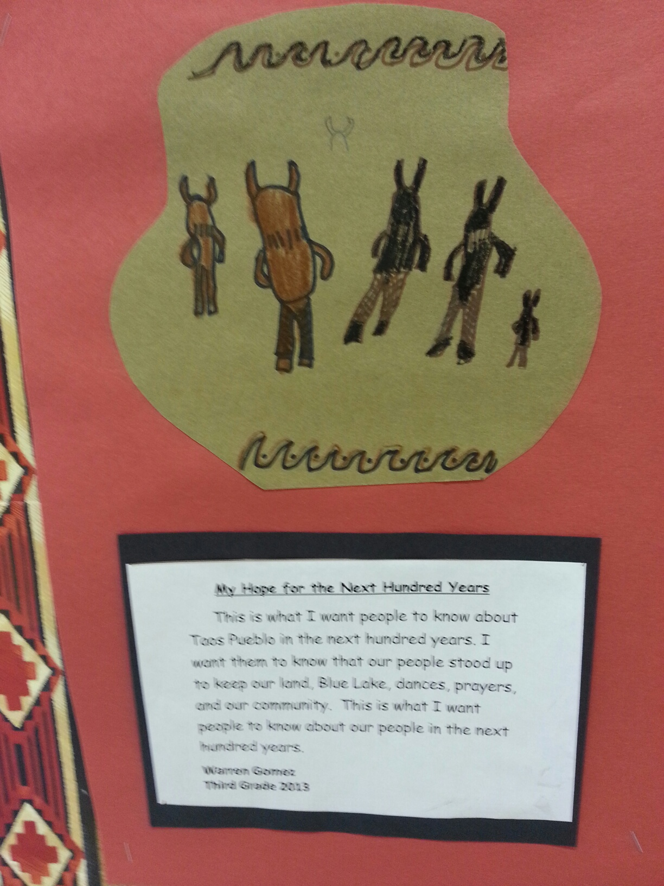

Slide 4
