Slide 1


Instructional Modes and Instructional Strategies
Personalized Learning Academy
Center on Innovations in Learning
Florida and the Islands Comprehensive Center
Virgin Islands Department of Education
2016-2017

Slide 2
Instructional Modes
Personalized Learning Academy

Slide 3
Well planned and delivered content
“The consistent delivery of lessons that include multiple checks for understanding may be the most powerful, cost-effective action we can take to ensure learning. Solid research demonstrates that students learn as much as four times as quickly from such lessons.”
Schmoker, M. (2010, Sept. 27). When pedagogic fads trump priorities. Education Week. Retrieved from http://www.edweek.org/ew/articles/2010/09/29/05schmoker.h30.html?r=1730712829

Slide 4
Creating a well designed lesson – Lesson Definition
Write the lesson title |  | For example: | Writing to Explain
Choose the standard to address |  | For example: | ELA-L. W. 3.2 Write informative/explanatory texts to examine a topic and convey ideas and information clearly.
Write the learner and behavior |  | For example | The students will be able to
Write the conditions for mastery of the objective |  | For example | When this…then that
Write the criteria for mastery |  | For example | Students will…when conditions are met

Slide 5
The Five Modes
Teacher-directed whole class instruction
Teacher-directed small group instruction
Student-directed small group instruction
Independent practice
Homework
Not every lesson will include all modes.

Slide 6

Teacher-directed whole class
Behavior Check
Review
Think (Stimulate Interest)
Know (Teach)
Show (Check for Understanding)

Slide 7
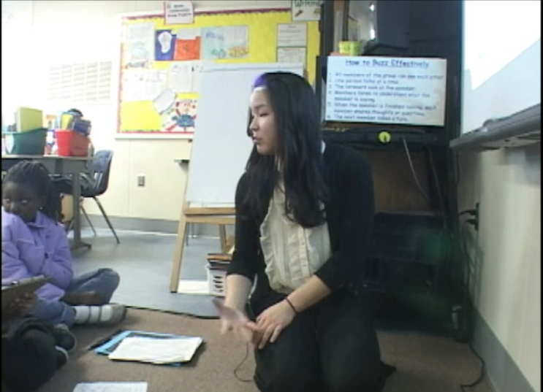
Teacher-directed small group
  Focus attention on particular requirements of homogeneous groups
  Groups are fluid
  Groups are short term
  Uses same procedures as whole-class instruction
Place your screenshot here
Notes:
Screen is a video to show explaining different modes.

Slide 8
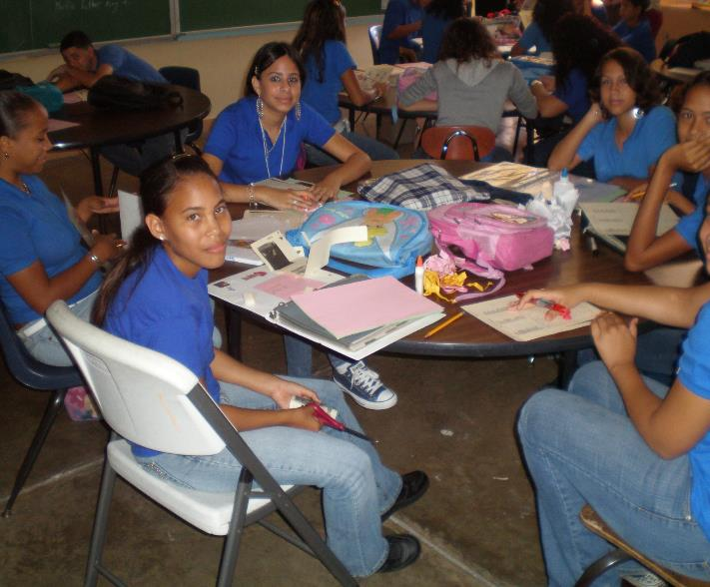
Student-directed small group
Groups are heterogeneous and fluid
Students develop personal responsibility for learning
Small groups provide opportunities for cooperative learning
Teacher structures the group by:
        Naming group leader
        Providing explicit instructions
        Guiding students to set group norms
        Setting goal for group to accomplish

Slide 9
Independent practice
Students complete their work at different rates
Assignments can be leveled
Students learn to manage their time
Computer-based programs are aligned to the standards
Activities have a purpose and are not just “busy work”

Slide 10

Homework
The home environment has an impact on student success. Homework can be a primary point of interface between school and home.
Parents need to understand what is expected of students and what their role is in supporting their student.

Slide 11
Learning Strategies
Personalized Learning Academy

Slide 12



Strategies Educators Should Use
3
Technology to Increase
Engagement & View Learning
(Kahoot)
Learning Pictures
(Student Graphs)
Active Student Responding
(CR, RC, GN)

Slide 13
Using a Tech Tool: Kahoot
Strategy 1
Tech Tools for Classroom Use: Kahoot
          Creating a Kahoot
          Using it to Evaluate Student Learning

Slide 14
Karen’s PG
LINK

Slide 15

Let’s Learn Kahoot!
Place your screenshot here

Slide 16
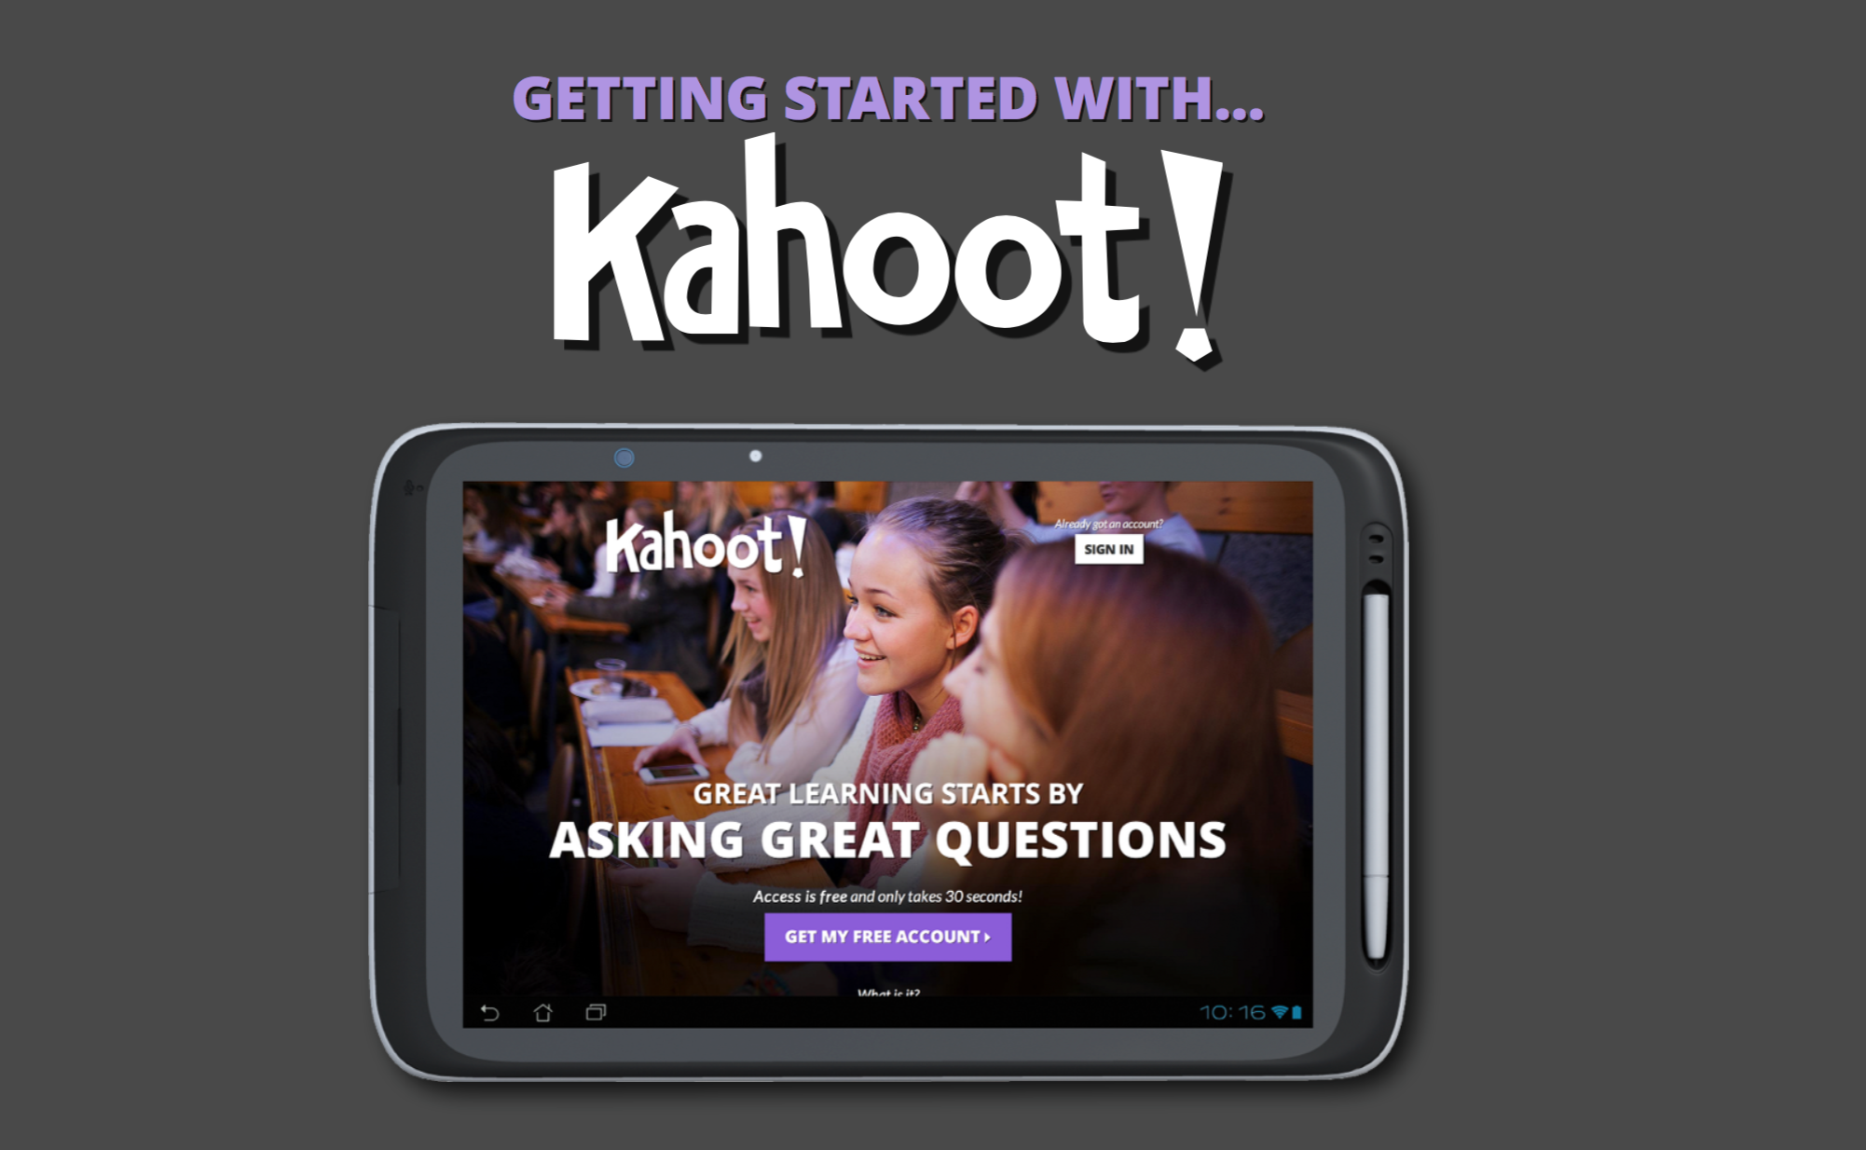
We’re going to create a Kahoot together now, and in the future you can always refer to this handy online guide.
Place your screenshot here
https://getkahoot.com/tutorials/Kahoot_Tutorials.pdf

Slide 17
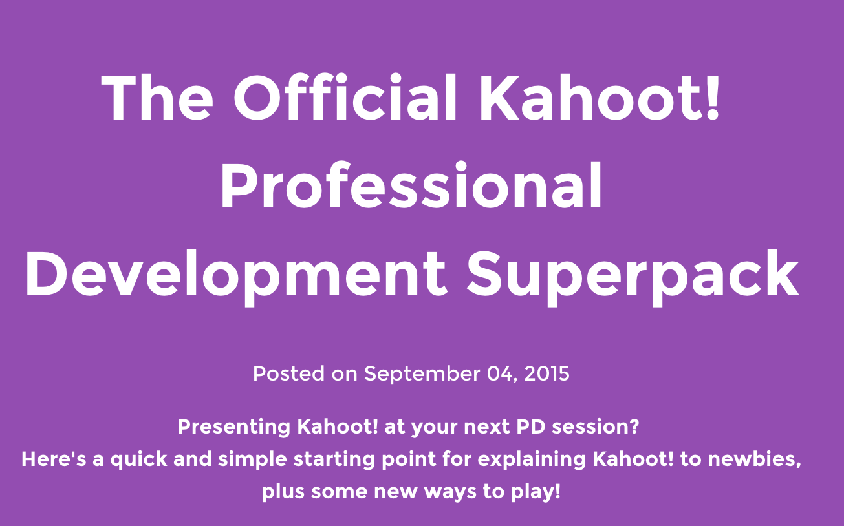
And get even more tips, tools, and ideas on this site.
Place your screenshot here
https://getkahoot.com/blog/the-official-kahoot-professional-development-superpack
Notes:
https://getkahoot.com/blog/the-official-kahoot-professional-development-superpack

Slide 18
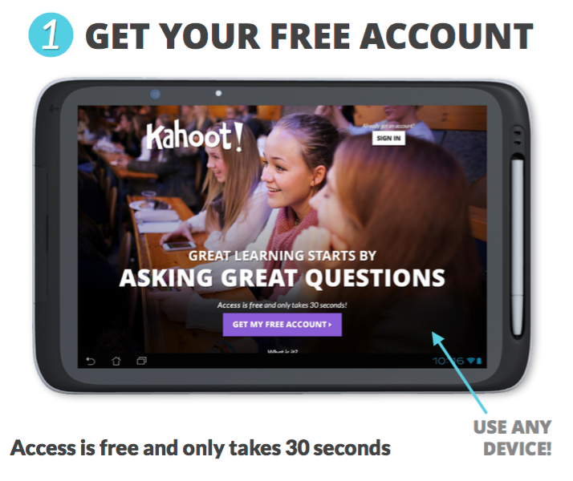
1 | Create an Account
Objectives
for student learning
Go to getkahoot.com
Answer a few simple questions to quickly create an account.
Notes:
ONE PERSON PER GROUP WILL DO THIS. OR ONE PER DEVICE.
Instrucitons: Go to getkahoot.com and press on the large purple ‘GET MY FREE ACCOUNT’ button.
Select: Your role: Choose ‘Teacher’ from this list.
School or university: Type the name of your institution.
Username: Type a username memorable to both you & other users who want to play your Kahoots.
Email: Type the email address you wish to use.
Password: Type a password that’s personal to you.
Press the purple ‘CREATE ACCOUNT’ button and you will get instant access (step 2), & receive a welcome email.

Slide 19
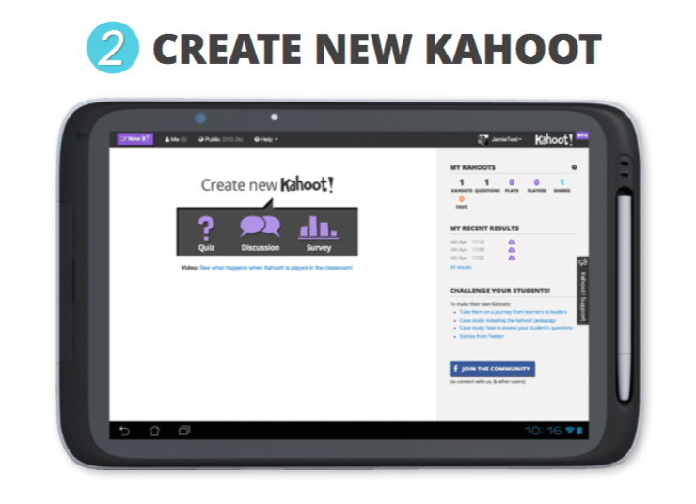
2 | Create a Quiz
Choose the Quiz Icon; Give the Quiz a Name
Add a brief description and hit Go!.
Notes:
Next Steps:
When you sign in, you’re presented with the 3 types of Kahoot you can make. Here we’ll focus on a quiz.
Press on the quiz icon, and you will be asked to give it a name. Type the name into the text field - give it a descriptive & catchy name to inform and motivate your students, as well as attract other users to play it in their teaching.
Press the purple ‘Go!’ button. You can now add your questions (step 3).
Note: If you’re browsing other sections of the website, you can get back to this screen by pressing the purple ‘New K!’ button in the top left.

Slide 20
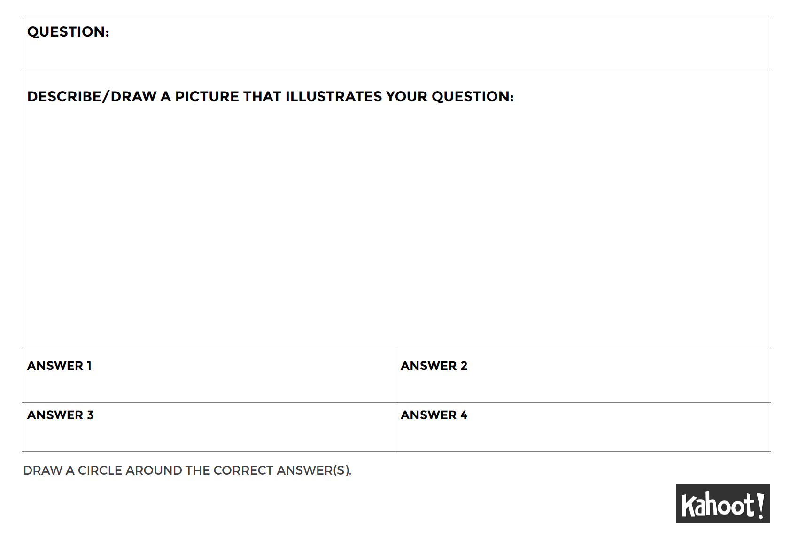
Write your questions
Each group member writes a question using the template.

Slide 21
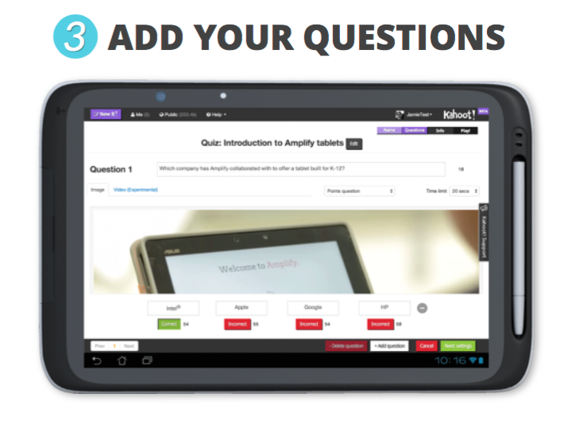
3 | Create at least 3 Questions
The “driver” will enter in the questions online.
Don’t worry about adding pictures or video today.
Type your first question & up to 4 answers
Make 1 answer correct;
Then Hit + Add Question to add another;
When you’re all done, click the green Next: Settings;
Complete the basic info and that’s it!
Notes:
Add 3 Questions Keep your quizzes short-
Enter your first question in the field at the top - you have
a 95 character limit so make it focused & snappy! Enter up to 4 answer options, and select the correct one(s) by pressing the red ‘Incorrect’ button to turn it into a green ‘Correct’ button. Choose a time limit between 5-120 secs.
Embed an image into your question by dragging one in from your desktop, or pressing the ‘Choose file’ button. If you’re using a tablet one straight from your camera.
Embed a YouTube video instead by pressing on the video tab & adding the video’s unique code - here’s a guide.
Add more questions by pressing ‘+ Add question’. Once you’ve added them all, press the green ‘Next: Re-order questions’ button to change their order and finally the green ‘Next: Settings’ button to add extra information about it (step 4).
Press the purple ‘Go!’ button. You can now add your questions (step 3).
Note: If you’re browsing other sections of the website, you can get back to this screen by pressing the purple ‘New K!’ button in the top left.

Slide 22

Let’s Play!
We’ll take turns and try a few of your Kahoots!
Notes:
JST to add.

Slide 23
Kahoot
User Guide
Place your screenshot here
https://getkahoot.com/tutorials/Kahoot_Tutorials.pdf

Slide 24
Kahoot
Professional
Development
Tools
Place your screenshot here
https://getkahoot.com/blog/the-official-kahoot-professional-development-superpack
Notes:
https://getkahoot.com/blog/the-official-kahoot-professional-development-superpack

Slide 25
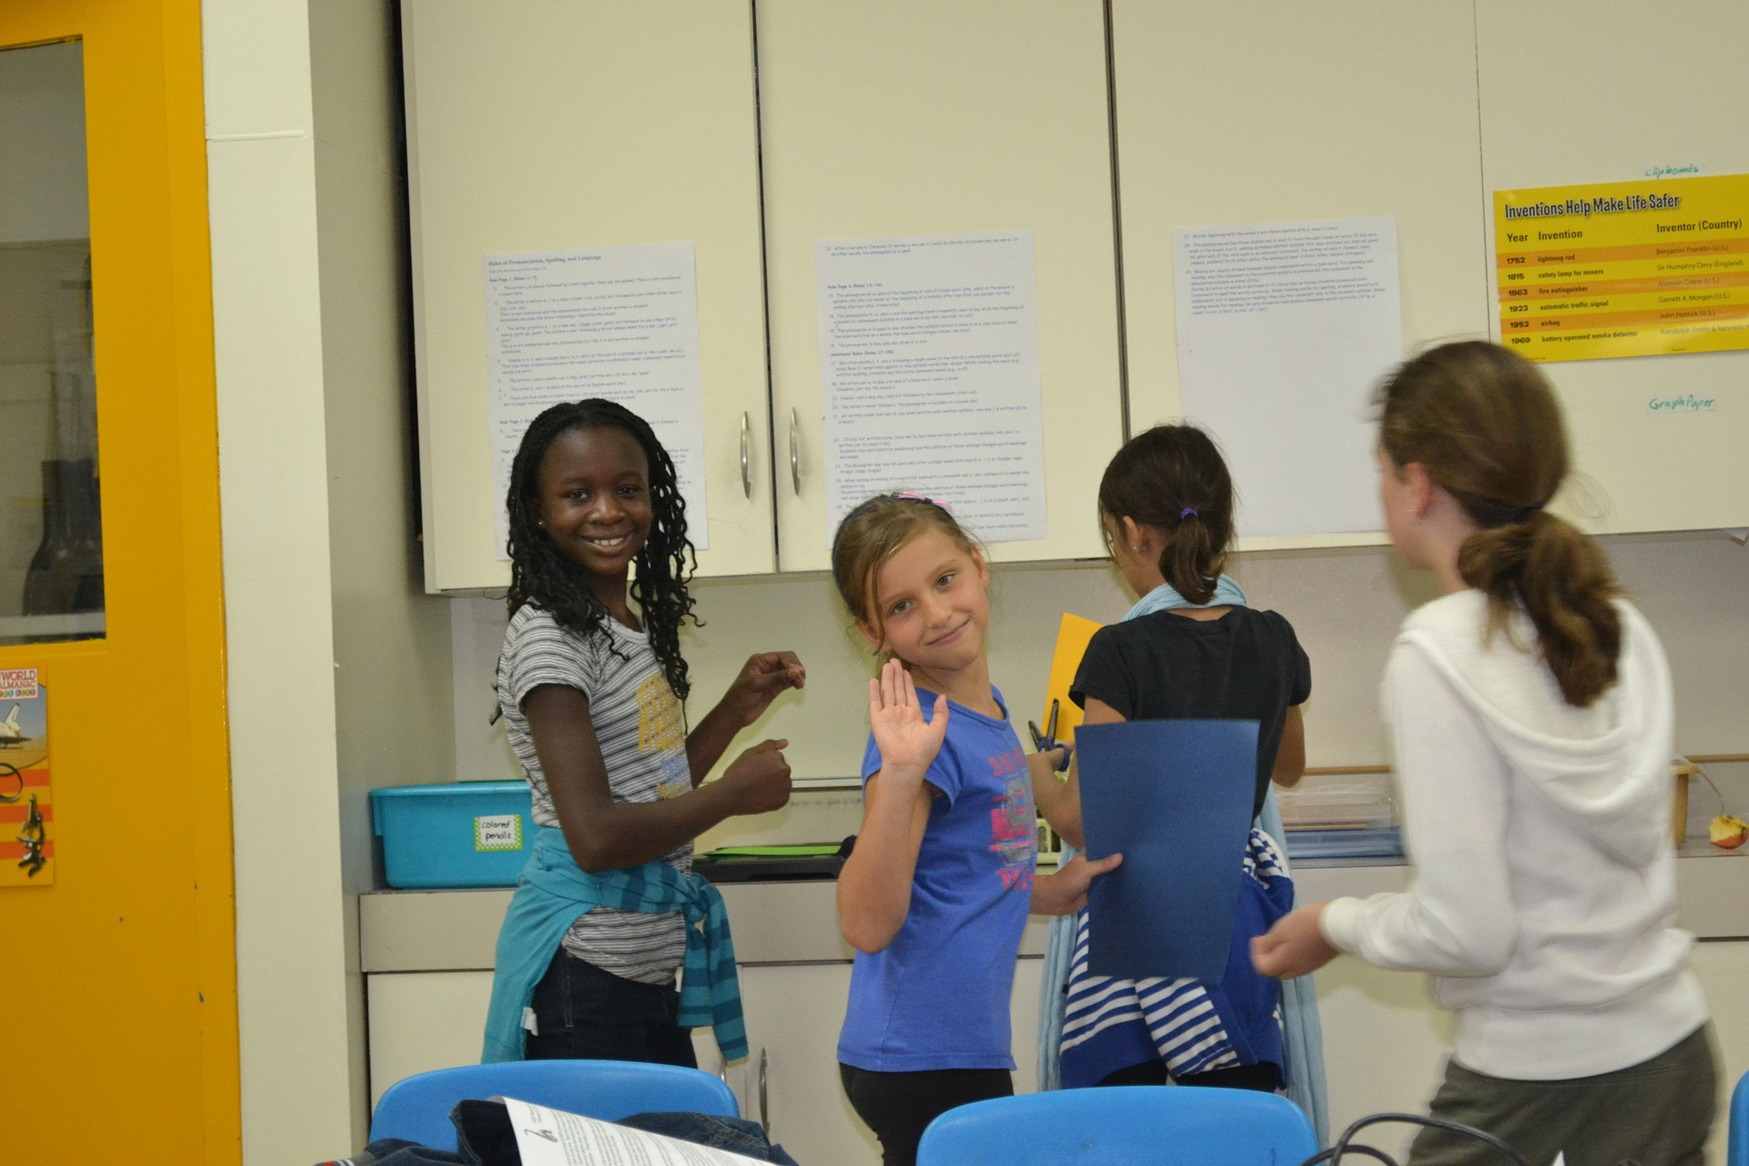
Using Student Learning Pictures: Strategy 2

Slide 26

Essential features
4
Assessments
are meaningful
and positive learning experience for students
Notes:
This may be the hardest part. Any good examples? What assessments have you felt good about? Why?

Slide 27

Essential features
5
Student progression toward mastery of each competency is mapped, allowing educators, students and parents to
track performance and needs in real time.
Notes:
Why is this important?
Where does this happen now?
This is one (of many) areas that digital technologies may be able to greatly help.

Slide 28

Essential features
6
Transparent, meaningful information
on the impact of instructional practices is provided to all stakeholders.
Notes:
This includes parents, families, the community, and where ever our learners will go in the future (college and or career).

Slide 29

Access Data in “My Results”
Technology can help measure and track learning.
Notes:
And we know that technology can help measure and track learning.

Slide 30
It all comes together in
Student Learning Pictures
Technology to Assist Personalized Learning
PL:
Student Ownership
Track Progress
Meaningful “Assessment”
Communication
Let’s see what this means.

Slide 31

What do you see?

Slide 32

Student Learning Pictures
(measurement, data, charts, & graphs)
help us see LEARNING amidst all that’s going on.
What do you see?

Slide 33
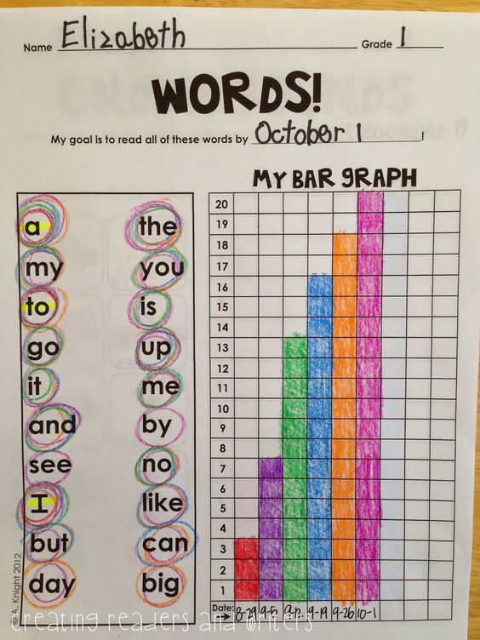
Putting it all together:
Objective/Competency:
Given a list of 20 Grade 1 sight words (a, the, my…), Elizabeth will read each of the 20 words accurately with no hesitation or mispronunciations across 3 consecutive days.
Instructional Mode: Teacher Directed Whole Group, using Choral Responding. Learners circle each correctly read word.
Added Personalization: Goal date, color choice, “ownership” of learning.
Personal Competencies: cognitive, metacognitive, motivational (and probably even social emotional)

Slide 34
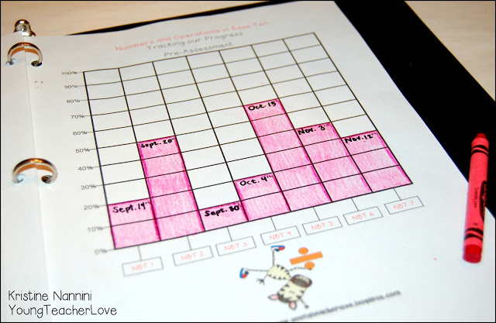

More Learning Picture Examples: By Students!
Courtesy of http://youngteacherlove.com/math-and-ela-student-data-tracking-binders-and-a-freebie/
Tips at http://youngteacherlove.com/using-data-binders-mid-year-intro-to/

Slide 35
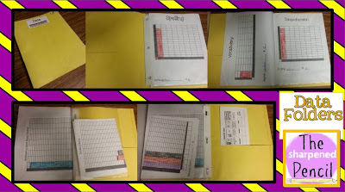
More Learning Picture Examples: By Students!
They love seeing their progress and the areas they need to work on. We always talk about how we can improve and what we can do differently in the future. It also helps us work on our graphing skills (how many more words did you read this time than last time, what week did you score the best, the worst, etc.)
It really helps them take ownership of their grades.... even as early as 2nd grade!
Notes:
They love seeing their progress and the areas they need to work on. We always talk about how we can improve and what we can do differently in the future. It also helps us work on our graphing skills (how many more words did you read this time than last time, what week did you score the best, the worst, etc.)
It really helps them take ownership of their grades.... even as early as 2nd grade!
http://the-sharpenedpencil.blogspot.com/2013/11/thank-ful-teachers-thursday.html?&cuid=307169e6b2a9247dc3309e703fe3683a

Slide 36
Research shows that when students track their own learning and data, they take ownership of their learning, have intrinsic motivation, and perform better in school.
Robert Marzano, 2010
Notes:
When students track their own progress on assessments using graphic displays, the gains are even higher. Over my many years of working with teachers, I have had the opportunity to examine the effects of such an approach. In 14 different studies, teachers had students in one class track their progress on assessments; in a second class, these teachers taught the same content for the same length of time without having students track their progress (see www.marzanoresearch.com/research/strategy20_trackingprogress.aspx). On average, the practice of having students track their own progress was associated with a 32 percentile point gain in their achievement.
http://www.marzanoresearch.com/research/strategy20_trackingprogress.aspx

Slide 37
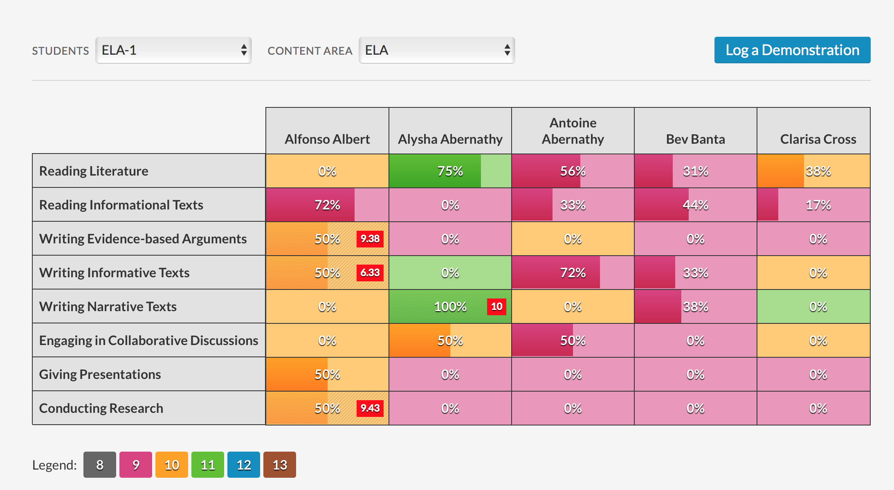
Notes:
http://cbl-demo.ny01.slatepowered.net/cbl/teacher-dashboard?students=section+ELA-1&content-area=ELA

Slide 38
Active Student Responding: Strategy 3
Research says these things reliably work:
Active Student Responding
(choral responding, guided notes, response cards)
Attention & Approval
Clear Learning Objectives
Data-based Decision Making
Feedback (Immediate)
Fluency
Good Behavior Game
Incidental Teaching
Modeling and Imitation
Token Economy
Notes:
Strategies are what we’re expecting at teacher practices to come out of the PLA
Active Student Responding choral responding guided notes response cards
Behavioral Momentum
Behavioral Objectives
Chaining backward, forward, total task
Contingent Attention & Approval
Contingency Contract/Behavior Contract
Data-based Decision Making
Differential Reinforcement
Errorless Learning
Exclusion
Feedback (Immediate)
Fluency
Functional Behavior Analysis/Assessment
General Case/Multiple Exemplar Training
Generalization Strategies
Group Contingencies (GBG) dependent independent interdependent
Incidental Teaching
Modeling and Imitation
Observational Learning
Planned Ignoring
Premack Principle
Public Posting
Priming, Prompting, and Fading
Reinforcement Schedules
Response Cost
Shaping
Stimulus Control Procedures
Stimulus Discrimination Procedures
Task Analysis
Time Delay
Timeout
Token Economy

Slide 39
The Importance of Teachers…
…the most important factor affecting student learning is the teacher…
What teachers do MATTERS
Notes:
Research well documents that the most important factor affecting student learning is the teacher. The clear, immediate and actionable implication of this finding is that perhaps more can be done to improve education by improving the effectiveness of teachers than by any other single factor. Effective teachers appear to be effective with students of all achievement levels, regardless of how diverse their classroom may be. The takeaway: What teachers do, matters. So let’s give them lots of good things to do, to support personalized learning and learner achievement.
Quote Source: Sanders, W. L., & Rivers, J. C. (1996). Cumulative and residual effects of teachers on future student academic achievement (Research Progress Report). Knoxville, TN: University of Tennessee Value-Added Research and Assessment Center.
Also found in: http://www.ascd.org/publications/books/104136/chapters/The-Power-of-an-Effective-Teacher-and-Why-We-Should-Assess-It.aspx#fn4

Slide 40

What’s the most common mode of instruction?
Image Source: www.flickr.com/photos/judybaxter/5476586/in/photostream/
Notes:
Ask the question, “So, what to teachers typically do?” Ask the group the onscreen question, “What’s the most common mode of instruction? Rephrase if necessary: How is must instruction provided? What teaching format is most common?
Answer on next slide.

Slide 41


Whole Group instruction challenges teachers to…
Mode of Instruction:
Teacher Directed Whole Group
maintain students' attention
provide each student with sufficient opportunities to respond
provide feedback for student responses
prevent and deal with disruptive behavior
monitor students' learning
Notes:
Answer: Teacher-directed, whole group instruction.
Group instruction challenges teachers to do all of the things listed here. Just maintaining students’ attention during a lesson is an achievement, and when we manage to do that we often accept it as evidence of a successful lesson. But it’s a mistake to assume that students are learning when they “pay attention.” There’s a lot more going on, and more teacher’s can do

Slide 42
How much learning time is available in a day?
Available Time
Allocated Time
Instructional Time
Time on Task
ASR
Opportunity to Respond
Active Student Responding
Notes:
Available, Allocated, and Instructional Time are calendar or clock based indicators of time, reported as days, hours, or courses. They do little to help us know how much a student is learning.
Academic Learning Time and Time on Task are also time based measures, often reported in minutes or percentages. But they are very rough, and still don’t give us a true indication of how much a student is learning.
Opportunity to respond is better, at least we know more information about instruction. But it’s still not enough. A teacher may hand out a 10 item quiz, but how many did the student actually do? There were 10 opportunities to respond, but maybe only 5, or 7, or 3 actual responses.
Active student response gets us the closest to actual student learning. With it we can increase engagement, response opportunities, and know “at the moment of teaching” who is responding and what they do or don’t know.
Source: ASR COMPARED WITH OTHER COMMONLY USED MEASURES OF INSTRUCTIONAL DELIVERY AND STUDENT PARTICIPATION. ADAPTED FROM HEWARD, 1994, P. 287

Slide 43
A solution? STRATEGY 2
Active
Student
Responding
Lessons in which students emit many relevant responses produce more learning than lessons of equal duration in which students make few responses.

Slide 44

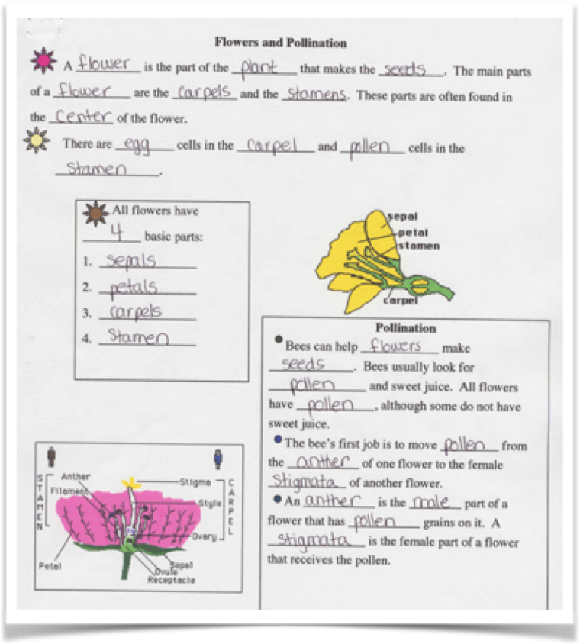
Active Student Responding
Choral Responding
Response Cards
Guided
Notes

Slide 45
ASR Strategy:
CHORAL RESPONDING
provides every student with an opportunity to actively respond to every question posed during instruction
Notes:
effective for providing multiple opportunities to deepen declarative knowledge
Unlike traditional one-student-at-a-time response modes (e.g., handraising), choral response provides every student with an opportunity to actively respond to every question posed during instruction.

Slide 46
Choral Responding
Is best used with any curriculum content, subject area, or age of learner, as long as:
each question, problem, or item presented has only one
correct answer;
each question can be answered with a brief oral response
(a single word or phrase, such as sight words or labeling diagrams); and
the material is suitable for a lively pace.
Notes:
When teachers present choral responding at a lively pace, their students . . emit more responses
respond with higher accuracy
engage in less off-task and disruptive behavior

Slide 47
Let’s Practice: I’ll model
Where there’s fire there may be . . .
smoke
A short funny story is called a . . .
joke
A well-know soft drink is a . . .
Coke
The white of an egg is called the . .
albumen

Slide 48
Let’s Practice: Your turn
Have your learners say the opposite of each word listed:
big
cheap
easy
fast
long
heavy
tight
hot
empty
old
wet
narrow

Slide 49
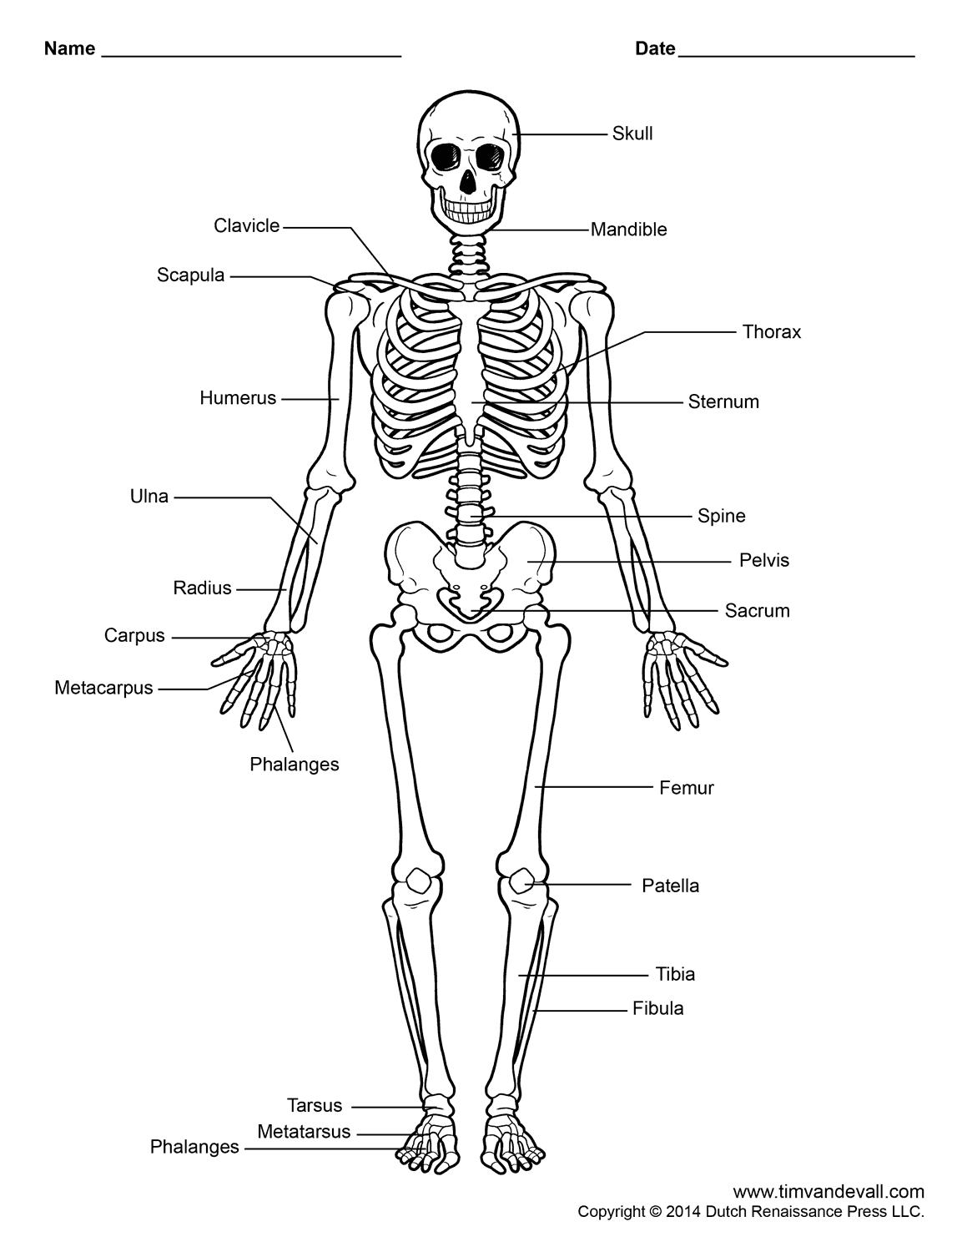
Let’s Practice: Your turn
Have your learners label the parts of this diagram:

Slide 50
Active Student Responding
Choral Responding
Response Cards
Guided
Notes

Slide 51
ASR Strategy:
RESPONSE CARDS
any sign which can be held up simultaneously
by all students in response to a question
Notes:
A response card is any sign which can be held up simultaneously by all students in response to a question
A potential advantage of RC over choral responding: easier for teacher to assess each student’s performance.

Slide 52
Response Cards
Can be used with any curriculum content, subject area, or age of learner. Best when…
students are choosing answers from multiple choices.
Learners are responding together however the teacher wants to see individual responses.
Review questions/concepts with mixed answers.

Slide 53
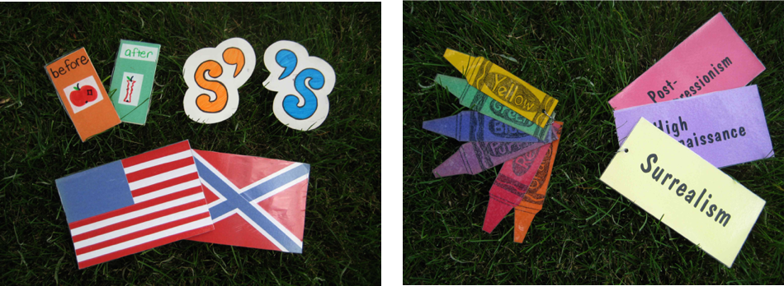
ASR Response Cards
How could these cards be used? What might some sample questions be?
Notes:
Before After:
‘s: It’s Geralds hat. All the teachers new plan; The team’s uniform;
American vs British spellings
Describe something, what color is it?
Kinds of paintings.

Slide 54
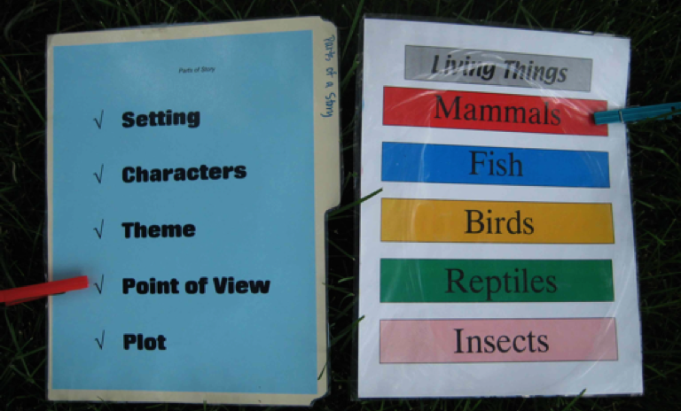
More Response Card Examples
Notes:
A potential advantage of RC over choral responding: easier for teacher to assess each student’s performance.

Slide 55

Let’s Practice
A
B
C
D

Slide 56
Active Student Responding
Choral Responding
Response Cards
Guided
Notes

Slide 57
ASR Strategy:
GUIDED NOTES
handouts that “guide” students through a lecture, presentation, or demonstration with background information and visual cues that indicate where to write key facts, points, and relationships
Notes:
A response card is any sign which can be held up simultaneously by all students in response to a question

Slide 58
Guided Notes
Can be used with any curriculum content, subject area, or age of learner, and…
to highlight/critically think about key concepts (advanced organizer, fill in the blanks, label diagrams, etc.),
follow along a lecture or video; and
is available for later study.

Slide 59
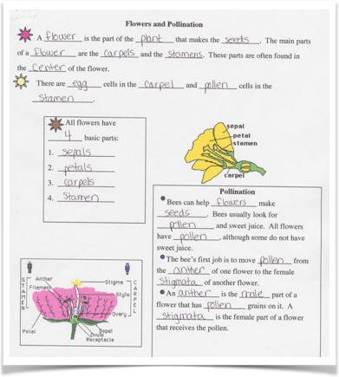
Guided Notes Example

Slide 60
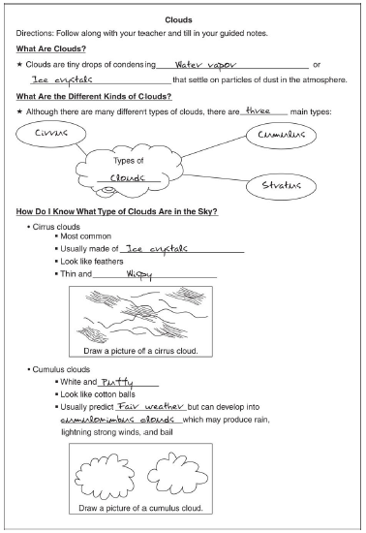
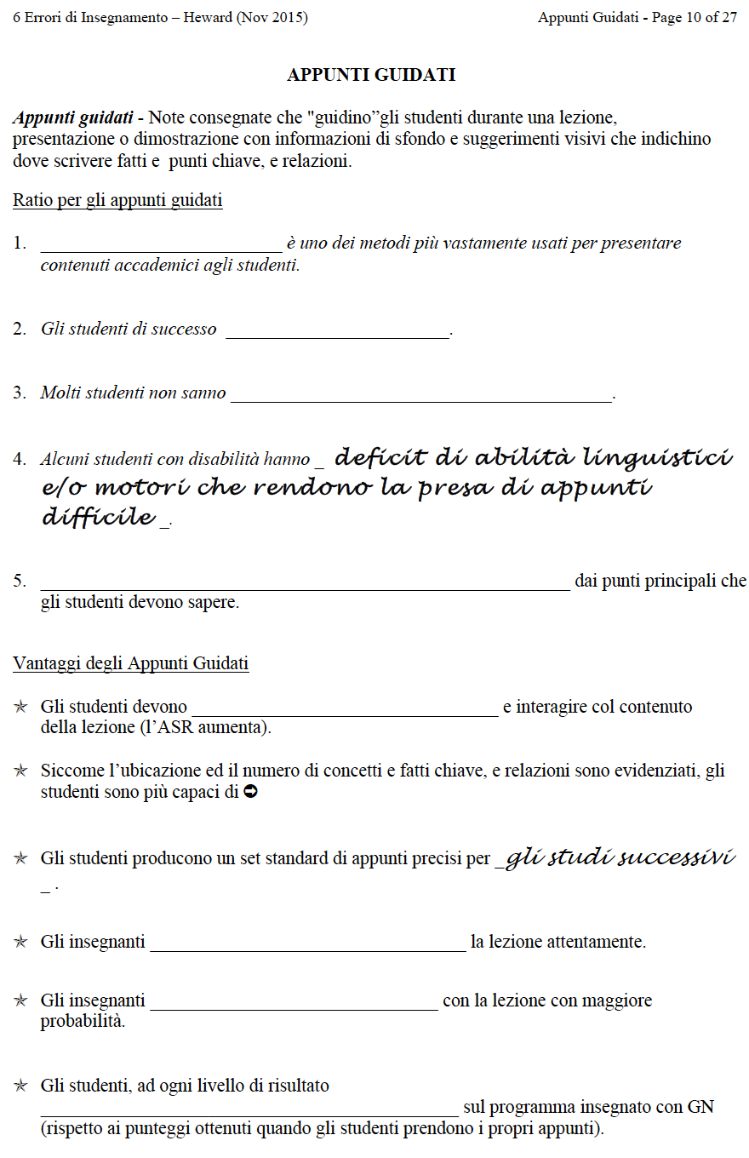
More Guided Notes Examples
Notes:
Courtesy: Moira Konrad, The Ohio State University

Slide 61
Let’s Practice:
I’ll model – Then your turn
Guided Notes Maker
https://www.interventioncentral.org/rti2/guided_notes

Slide 62
Guided Notes
May be used with any curriculum content, subject area, or age of learner. Suggestions include:
Using the blanks to highlight/stress important content, key words;
each question can be answered with a brief oral response
(a single word or phrase, such as sight words or labeling diagrams); and
the material is suitable for a lively pace.
Notes:
When teachers present choral responding at a lively pace, their students . . emit more responses
respond with higher accuracy
engage in less off-task and disruptive behavior

Slide 63
Active Student Responding
Choral Responding
Response Cards
Guided
Notes

Slide 64
Any questions?
more
Time for a break!
Notes:
15 minute break

