Slide 1


Lesson Design Studio
St. Thomas / St. John School District

Slide 2

Agenda or Where We Are Headed…
Review of Instructional Modes
Creating a Basic Lesson Design

Slide 3
Outcomes or Where We Will End Up
At the conclusion of this session, we will:
                Be able to define and describe Instructional Modes
                Know the elements of a Basic Lesson Design
                Be able to write an objective, condition, and criteria for mastery for a lesson
                Understand how to use Lesson Design Studio (online)

Slide 4
“Good lessons start with a clear, curriculum-based objective and assessment, followed by multiple cycles of instruction, guided practice, checks for understanding (the soul of a good lesson), and ongoing adjustments to instruction.”
Schmoker, M. (2010, Sept. 27). When pedagogic fads trump priorities. Education Week. Retrieved from http://www.edweek.org/ew/articles/2010/09/29/05schmoker.h30.html?r=1730712829

Slide 5
Well planned and delivered content
“The consistent delivery of lessons that include multiple checks for understanding may be the most powerful, cost-effective action we can take to ensure learning. Solid research demonstrates that students learn as much as four times as quickly from such lessons.”
Schmoker, M. (2010, Sept. 27). When pedagogic fads trump priorities. Education Week. Retrieved from http://www.edweek.org/ew/articles/2010/09/29/05schmoker.h30.html?r=1730712829

Slide 6
Instructional Modes
1
Where the rubber meets the road…

Slide 7
The Five Modes
Teacher-directed whole class instruction
Teacher-directed small group instruction
Student-directed small group instruction
Independent practice
Homework
Not every lesson will include all modes.

Slide 8

Teacher-directed whole class
Behavior Check
Review
Think (Stimulate Interest)
Know (Teach)
Show (Check for Understanding)

Slide 9
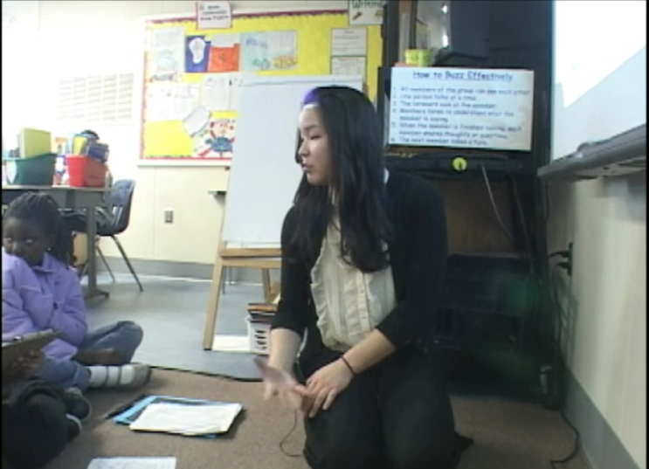
Teacher-directed small group
  Focus attention on particular requirements of homogeneous groups
  Groups are fluid
  Groups are short term
  Uses same procedures as whole-class instruction
Place your screenshot here
Notes:
Screen is a video to show explaining different modes.

Slide 10

Student-directed small group
Groups are heterogeneous and fluid
Students develop personal responsibility for learning
Small groups provide opportunities for cooperative learning
Teacher structures the group by:
        Naming group leader
        Providing explicit instructions
        Guiding students to set group norms
        Setting goal for group to accomplish

Slide 11

Independent practice
Students complete their work at different rates
Assignments can be leveled
Students learn to manage their time
Computer-based programs are aligned to the standards
Activities have a purpose and are not just “busy work”

Slide 12

Homework
The home environment has an impact on student success. Homework can be a primary point of interface between school and home.
Parents need to understand what is expected of students and what their role is in supporting their student.

Slide 13
Basic Lesson Design
2
Just the basics. . .

Slide 14
Creating a well designed lesson – Lesson Definition
Write the lesson title |  | For example: | Writing to Explain
Choose the standard to address |  | For example: | ELA-L. W. 3.2 Write informative/explanatory texts to examine a topic and convey ideas and information clearly.
Write the learner and behavior |  | For example | The students will be able to
Write the conditions for mastery of the objective |  | For example | When this…then that
Write the criteria for mastery |  | For example | Students will…when conditions are met

Slide 15
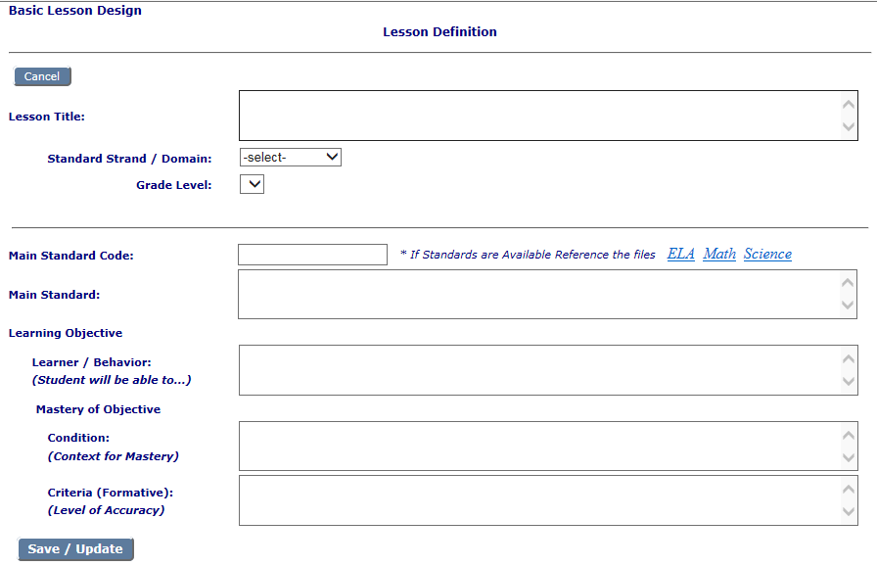
Lesson Design Studio

Slide 16

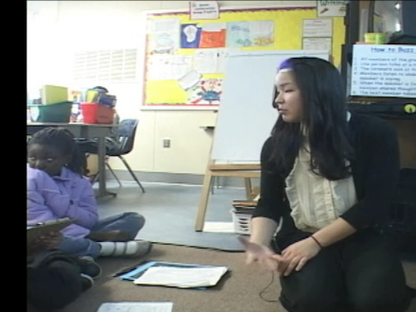



Choose the instructional mode(s)
1
2
3
4
5

Slide 17
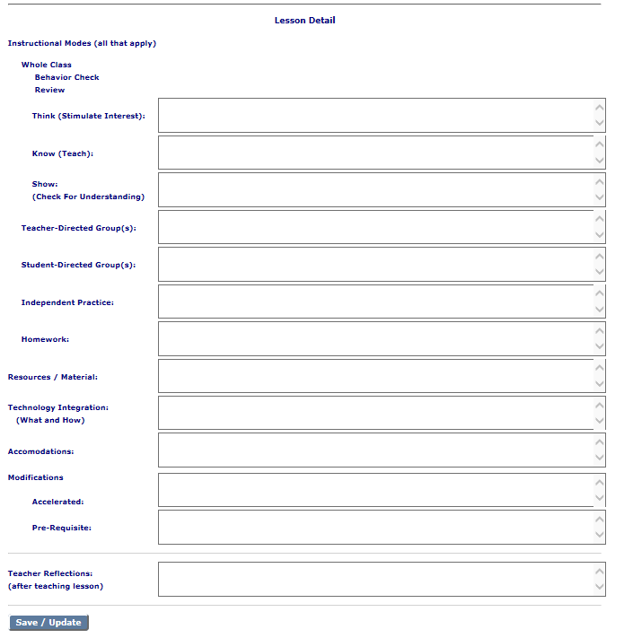
Lesson Detail

Slide 18
Let’s review some concepts
If using student-directed small group, independent work, computer-based work, or homework…
Are the instructions clear?
Are accommodations available?
Are materials ready and available?
Are activities leveled (target,
pre-requisite, accelerated)?
Are modifications needed?
Accelerated
Pre-requisite

Slide 19
Big 3 Strategies
3
Just the basics. . .

Slide 20

Kahoot!

Slide 21

Choral Response

Slide 22

Tracking Mastery

Slide 23
Live Demonstration

Slide 24
Live Demonstration
Test site for practice today: http://www.adi.org/Testeld/Menu.aspx
Live site url next week
Chrome is preferred browser

Slide 25
What We Accomplished
                We are able to define and describe Instructional Modes
                We know the elements of a Basic Lesson Design
                We are able to write an objective, condition, and criteria for mastery for a lesson
                We understand how to use the Lesson Design Studio

Slide 26
Next Steps
4
Now the fun begins…

Slide 27
Personalized Learning Trainers
By November 15, 2016:
    Introduce all teacher teams to Lesson Definition and Lesson Design Studio
                By December 15, 2016
                Introduce all teacher teams to Instructional Modes and Instructional Strategies
                Share Lesson Design Comment Sheet with all teacher teams
                By January 27, 2017
                Engage all teacher teams in group review and analysis of lessons using rubric and guidelines
Each Teacher in the Teams
By November 29, 2016
Create 5 Lesson Definitions in Lesson Design Studio (Lessons you will teach between January 7-21)
    By January 7, 2017
    add Lesson Detail to the 5 Lesson Definitions
    Include a Big 3 Strategy in each Lesson Detail
    Review and add comments using Lesson Design Comment Sheet to two lessons created by a team member
    By January 21, 2017
    Teach the 5 lessons and enter reflections in Lesson Design Studio
    By January 27, 2017
    Participate in group review and analysis of lessons using rubric and guidelines

