Slide 1


Enhanced Lesson Design
Janet Twyman and Mark Williams—Presenters

Slide 2
Enhanced Lesson Design
1
Now for the good stuff. . .

Slide 3
Now that you have a basic lesson designed, how do you enhance it?
Sharpening the student focus!

Slide 4
Big 3 Strategies
Amping up Student Engagement in Their Learning
Technology Integration (Kahoot is example)
Choral Response
Tracking Mastery
Where do they fit in a lesson design?

Slide 5
Learning Technology
Clear and relevant learning objectives
High rates of active meaningful responding
Clear, contingent, immediate feedback
Instruction that adapts
Mastery or fluency criteria
Measurement and reports with actionable data
Consideration of principals of UD

Slide 6

Kahoot!

Slide 7
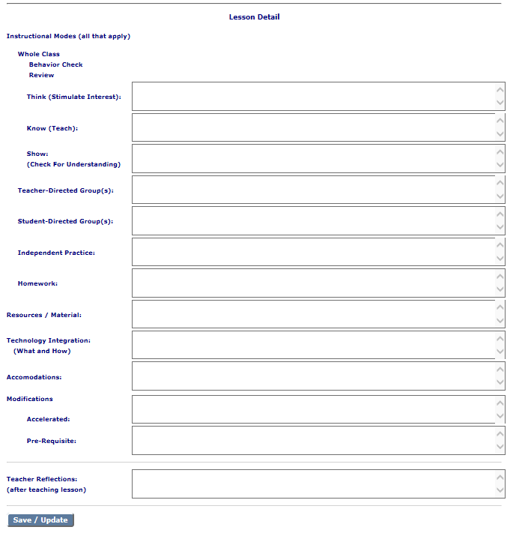
Back to Lesson Detail
Where does the strategy fit, and what do the teacher and students do?
Subject:
Lesson topic:
Grade level:

Slide 8

Choral Response

Slide 9
Back to Lesson Detail
Where does the strategy fit, and what do the teacher and students do?

Slide 10

Tracking Mastery

Slide 11
Back to Lesson Detail
Where does the strategy fit, and what do the teacher and students do?
Subject:
Lesson topic:
Grade level:

Slide 12
Strategies to Build Personal Competencies
Intentionally incorporate a personal competency (or two) in each lesson
Cognitive
Metacognitive
Motivational
Social/Emotional

Slide 13

Cognitive Competency Strategies
Review prior learning and connect it with new topics
Memorization/memorization techniques
Review and questioning to reinforce retained knowledge in memory
Vocabulary development
Teaching common facts that student will encounter
Rich reading
Writing assignments
Provide pathways of exploration and discovery
Also see infographic!

Slide 14
Back to Lesson Detail
Where does the strategy fit, and what do the teacher and students do?
Subject:
Lesson topic:
Grade level:

Slide 15

Metacognitive Competency Strategies
Thinking out loud
Pair students as problem solver and active listener
Teach active listening, note-taking, strategic reading, organization of content, access to resources, questioning, memorization (mnemonics), outlining, practice, analytical thinking, self-monitoring, and test preparation
Use self-checks and peer checks
Show how to chart/graph mastery
Include documentation of process in assignments
Teach procedures of logic, synthesis and evaluation
Teach techniques for divergent thinking
Also see infographic!

Slide 16
Back to Lesson Detail
Where does the strategy fit, and what do the teacher and students do?
Subject:
Lesson topic:
Grade level:

Slide 17

Motivational Competency Strategies
Promote growth mindset (success from effort and self-regulation)
Connect learning tasks to student’s personal aspirations
Differentiate assignments
Help students find satisfaction in mastery and learning
Stretch student’s interests in new topics
Celebrate mastery
Include parents in understanding their influence on their child’s mindset
Also see infographic!

Slide 18
Back to Lesson Detail
Where does the strategy fit, and what do the teacher and students do?
Subject:
Lesson topic:
Grade level:

Slide 19

Social/Emotional Competency Strategy
Teach and reinforce positive social skills and relationships
Establish classroom norms
Teach students to understand the consequences of their decisions and take responsibility for them
Be attentive to student’s emotional states/guide students in ability to manage emotions
Help students set constructive goals for learning and for social relationships
Model responsible behavior
Use cooperative learning methods
Encourage questioning, seeking help from others and offering help to others
Work with parents to promote and reinforce social/emotional skills at home
Also see infographic!

Slide 20
Back to Lesson Detail
Where does the strategy fit, and what do the teacher and students do?
Subject:
Lesson topic:
Grade level:

Slide 21
Wrap-Up Discussion of Enhanced Lesson Design

