Slide 1

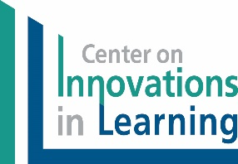
Introduction to Student-Focused Learning
Center on Innovations in Learning
2016

Slide 2
Born at West Point
Janet

Slide 3
Was state director of Career and Technical Education
Mark

Slide 4
Has an account at the Vatican bank
Mark

Slide 5
Owns and trains two wild Mustangs
Janet

Slide 6
Founded ed tech company - Headsprout
Janet

Slide 7
Recently renovated 125 year old kitchen
Mark

Slide 8
Professor of Pediatrics at UMass Med School
Janet

Slide 9
Was an early adopter of PLATO
Mark

Slide 10
Student-Focused Learning
1
What Is It?
Notes:
Introduction to this session: What is Personalized Learning? We personalize learning for every student, and in doing so we reach each student in different ways, fitting their needs and aspirations.

Slide 11

We have all been there…
You have had a student who you want desperately to reach, but nothing you do seems to be working. This student might be:
Struggling academically and not making progress,
Displaying negative behaviors that do not seem reflective of their true personality or that seem to be a cry for help or attention,
Likely advanced or gifted but not be demonstrating that in his/her schoolwork,
Reserved, quiet, and unresponsive to attention from you, or
More than one of the above.
This is a very frustrating experience for a teacher! This child could be one of your favorites, or he or she could be one that tests your patience the most. Either way, you want to do more.
Notes:
You have had a student who you want desperately to reach, but nothing you do seems to be working. This student might have:
Struggling academically and not making progress,
● Displaying negative behaviors that do not seem reflective of their true personality or
that seem to be a cry for help or attention,
● Likely advanced or gifted but not be demonstrating that in his/her schoolwork,
● Reserved, quiet, and unresponsive to attention from you, or
● More than one of the above.
This is a very frustrating experience for a teacher! This child could be one of your favorites, or he or she could be one that tests your patience the most. Either way, you want to do more

Slide 12
Think about that student now…
Notes:
● When did you know the student? (What grade, time of year, etc.)
● What was the nature of your relationship with that student? (Supportive, difficult,
nagging?)
● What behaviors did this student display that frustrated you?
● What behaviors did this student display that gave you hope for his or her growth?
● What was that student going through at the time?
● Describe the strategies or approaches you used to try to build this child as a learner:
How do you know if the strategies you used were successful?
Did you personalized learning for this student?
Talk with a table partner about your student. Any similarities?

Slide 13
Student-Focused Learning is “personalized” for the student
Personalization refers to:
a teacher’s relationships with students and their families
the use of multiple instructional modes to scaffold each student’s learning, and
enhancing the student’s personal competencies [cognitive, metacognitive, motivational, social/emotional].
varying the time, place, path, pace, practice, and trace of learning for each student,
enlisting the student in the creation of learning pathways, and
utilizing technology to enhance, support, manage, and document the learning process and access rich sources of information.
Twyman & Redding, 2015
Notes:
Here are 6 parts to a definition of personalized learning. Another way of saying it is that these are 6 ways to personalize learning.

Slide 14
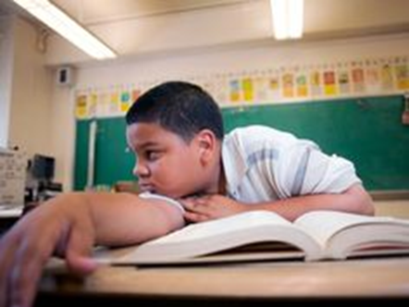
Influencing Jeffrey
Notes:
Let’s meet a student named Jeffrey. In your Guided Notes, you will find a short story about Jeffrey. Please take a few minutes to read the story. Then we will discuss it.
[Allow about 5 minutes to read or sense when they are finished.]

Slide 15

Jeffrey’s Story
What did Ms. Johnson see in Jeffrey?
What did she do to develop Jeffrey as a learner?
In what ways did she personalize learning for Jeffrey?
Notes:
From the group as a whole, discuss the three questions.

Slide 16
How is learning personalized?
Personalization refers to:
a teacher’s relationships with students and their families
the use of multiple instructional modes to scaffold each student’s learning, and
enhancing the student’s personal competencies [cognitive, metacognitive, motivational, social/emotional].
varies the time, place, path, pace, practice, and trace of learning for each student,
enlists the student in the creation of learning pathways, and
utilizes technology to enhance, support, manage, and document the learning process and access rich sources of information.
Twyman & Redding, 2015
Notes:
Let’s look again at the definition of personalized learning. How many of these ways to personalize learning did Ms. Johnson employ?

Slide 17

Relational Suasion
Relational Suasion - the teacher’s (or other respected adult’s) ability to influence a student’s learning and personal competencies by virtue of their personal knowledge of, and interaction with, the student and the student’s family.
Redding, S. (2014). Personal competencies in personalized learning. Philadelphia, PA: Temple University, Center on Innovations in Learning.
Notes:
Nothing matters more to a student’s learning than the teacher. The teacher’s relational suasion is key to the teacher’s ability to personalize learning.

Slide 18
Think of that special teacher…
Who focused on you?
Notes:
What strategies did that employ to personalize learning for you?

Slide 19

Student-Focused Learning
Three Big Buckets
Personal Competencies
Competency- Based Education
Learning Technologies
Notes:
There are three big buckets that hold all that Personalized Learning contains, all 6 parts of the definition. We will touch on each of them briefly now, and then we will go deeper into each of them.

Slide 20
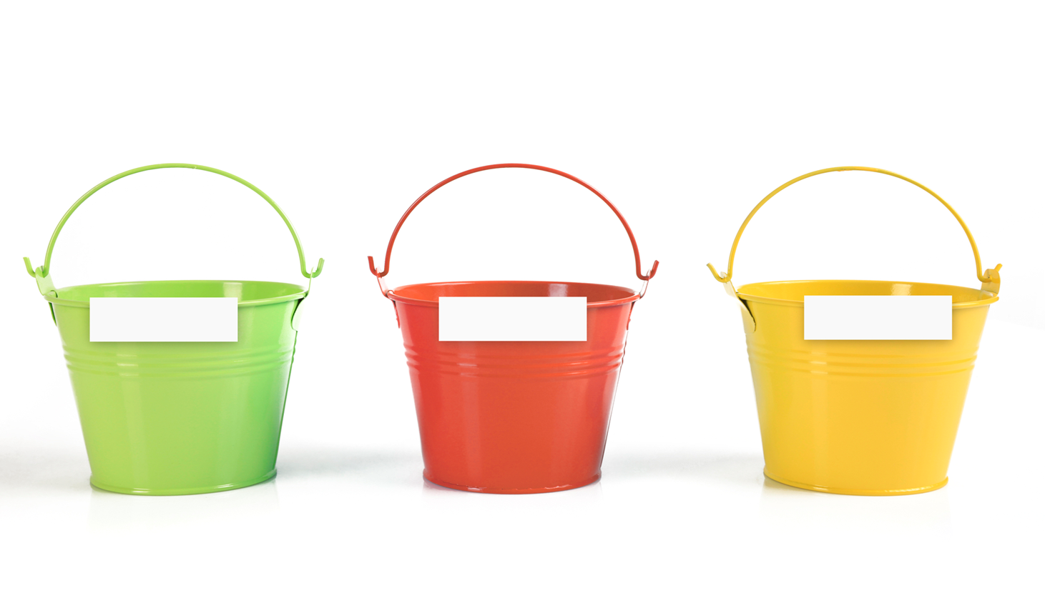
Personal Competencies
Personal Competencies
What I Know (Cognitive Competency)
How I Learn (Metacognitive Competency)
Why I Learn (Motivational Competency)
Who I Am (Social/Emotional Competency)
Personal Competencies
Notes:
The four Personal Competencies are listed here: Cognitive, Metacognitive, Motivational, and Social/Emotional.

Slide 21

Personal Competencies:
The roots of learning
Mastery
Knowledge and Skill
Personal Competencies
Cognitive
Metacognitive
Motivational
Social/Emotional
Notes:
.
The Personal Competencies are the roots of learning. They are below the surface. But the make learning happen, and the learning is shown as mastery of knowledge and skill.

Slide 22
Competency-Based Education
The essential component of a competency-based approach to student-focused learning is:
Achieving competency in an environment not bounded by time, place, path, pace, practice or trace.
Competency- Based Education
Notes:
Competency-based education is an aspect of personalized learning. For teachers, that means using strategies to vary time (when students learn), place (where students learn), path (how students get to their goals/meet competencies), pace (the rate at which students obtain their goals/meet competencies), practice (how students are taught, how they learn), and trace (how student learning/competencies met are observed, measured, or demonstrated/assessed).

Slide 23
CBE Aspects of Student-Focused Learning
Flexible credit schemes
  (a) dual enrollment and early college high schools, (b) credit recovery, and (c) multiple paths to graduation.
Service learning
Internships and job shadowing
Differentiated staffing: taking advantage of teachers’ different skills and interests
Acceleration and enrichment
Recognition of mastery with badges, certificates, and credits
Student learning plans (SLPs)
Study groups and research teams enable students to work together to design projects aimed toward a hypothesis or outcome. The students may be members of a class or the group may be assembled across the miles via the Internet.

Slide 24
Learning Technologies
  Student-focused learning is made practical by technology that:
    increases the range and possibilities of instructional content;
    organizes and helps individualize curricular content;
    facilitates differentiation;
    opens vast and diverse avenues of learning;
    provides ongoing measures, and ultimately confirms mastery, and
    assists with communication and shared awareness.
Learning Technologies
Notes:
Technology should support learning and instructional goals, not drive them.

Slide 25
What makes this definition unique?
…breaks from the traditional image of school learning- that is, a student sitting at a desk listening to a teacher or completing the same assignment as the other students- substituting a view of the teacher, aided by learning management software, pivoting from a succinct, interactive presentation of a new concept to walk among her students, encouraging them as they engage with activities they have helped plan and are preparing to continue on their laptops at home that evening. Varying the mode of instruction and the time, place, and pace of learning for each student, expanding the venue of learning beyond the classroom, and detaching expected outcomes from rigid timelines are hallmarks of personalized learning.”
(Redding, 2015)

Slide 26

Why Student-Focused Learning?
Student-focused learning is made practical by technology that:
organizes
curricular content,
facilitates differentiation,
opens vast and diverse avenues of learning,
provides ongoing checks of mastery,
and ultimately confirms mastery.
Center on Innovations in Learning
Notes:
Personalized learning is made practical by technology that organizes curricular content, facilitates
differentiation, opens vast and diverse avenues of learning, provides ongoing checks of
mastery, and ultimately confirms mastery.
Personalized learning encourages and confirms learning that takes place anytime, anywhere, and is thus a companion to competency based education.
Personalized learning steps beyond the mechanical individualization of learning by
incorporating the teacher’s deep understanding of each student’s interests, aspirations,
backgrounds, and behavioral idiosyncrasies.
Personalized learning mixes the targeting of learning to the individual student with opportunities to learn with a group, one-to-one,face-to-face, or across the miles.
Personalized learning is simply what is best for kids. Learning experiences are authentic and meaningful. They want to see the purpose and connect education to real life.
Personalized learning builds a culture of trust between the students and adults. It becomes okay to try, fail, and learn from that failure.
Personalized learning builds a stronger staff culture of transparency, collaboration, and alignment.
Personalized learning allows the teachers to be the experts. Teachers are empowered and provided with trust, time, and support.
Personalized learning elevates the profession of teaching. Teachers are able to step up as leaders in their classrooms, schools and districts. In many cases, teachers are even able to build substantial networks with teacher across the state and country pursuing similar work.
Personalized learning can provide an opportunity for grassroots spread. Teachers can lead by demonstrating passion, and other teachers see that passion and are able to be the agents of change in their own classroom at a pace at which they are comfortable.
Personalized learning is the best way to maximize all of the technology resources that many teachers have available to them. With one-to-one initiatives and large achievement gaps, personalized learning just makes sense.
Personalized learning restored many teachers’ faith in education and enthusiasm about their work. Many teachers felt unfulfilled in a traditional environment, feeling that they weren’t meeting their students’ needs and that there were constantly roadblocks in their way. (KnowledgeWorks)

Slide 27

Why Student-Focused Learning?
Student-focused learning encourages and confirms learning that takes place anytime, anywhere, and is thus a companion to competency based education.
Center on Innovations in Learning
Notes:
Personalized learning steps beyond the mechanical individualization of learning by
incorporating the teacher’s deep understanding of each student’s interests, aspirations,
backgrounds, and behavioral idiosyncrasies.
Personalized learning mixes the targeting of learning to the individual student with opportunities to learn with a group, one-to-one,face-to-face, or across the miles.
Personalized learning is simply what is best for kids. Learning experiences are authentic and meaningful. They want to see the purpose and connect education to real life.
Personalized learning builds a culture of trust between the students and adults. It becomes okay to try, fail, and learn from that failure.
Personalized learning builds a stronger staff culture of transparency, collaboration, and alignment.
Personalized learning allows the teachers to be the experts. Teachers are empowered and provided with trust, time, and support.
Personalized learning elevates the profession of teaching. Teachers are able to step up as leaders in their classrooms, schools and districts. In many cases, teachers are even able to build substantial networks with teacher across the state and country pursuing similar work.
Personalized learning can provide an opportunity for grassroots spread. Teachers can lead by demonstrating passion, and other teachers see that passion and are able to be the agents of change in their own classroom at a pace at which they are comfortable.
Personalized learning is the best way to maximize all of the technology resources that many teachers have available to them. With one-to-one initiatives and large achievement gaps, personalized learning just makes sense.
Personalized learning restored many teachers’ faith in education and enthusiasm about their work. Many teachers felt unfulfilled in a traditional environment, feeling that they weren’t meeting their students’ needs and that there were constantly roadblocks in their way. (KnowledgeWorks)

Slide 28

Why Student-Focused?
Student-focused learning steps beyond the mechanical individualization of learning by incorporating the teacher’s deep understanding of each student’s:
interests,
aspirations,
background, and
behavioral idiosyncrasies.
Center on Innovations in Learning
Notes:
Personalized learning is simply what is best for kids. Learning experiences are authentic and meaningful. They want to see the purpose and connect education to real life.
Personalized learning builds a culture of trust between the students and adults. It becomes okay to try, fail, and learn from that failure.
Personalized learning builds a stronger staff culture of transparency, collaboration, and alignment.
Personalized learning allows the teachers to be the experts. Teachers are empowered and provided with trust, time, and support.
Personalized learning elevates the profession of teaching. Teachers are able to step up as leaders in their classrooms, schools and districts. In many cases, teachers are even able to build substantial networks with teacher across the state and country pursuing similar work.
Personalized learning can provide an opportunity for grassroots spread. Teachers can lead by demonstrating passion, and other teachers see that passion and are able to be the agents of change in their own classroom at a pace at which they are comfortable.
Personalized learning is the best way to maximize all of the technology resources that many teachers have available to them. With one-to-one initiatives and large achievement gaps, personalized learning just makes sense.
Personalized learning restored many teachers’ faith in education and enthusiasm about their work. Many teachers felt unfulfilled in a traditional environment, feeling that they weren’t meeting their students’ needs and that there were constantly roadblocks in their way. (KnowledgeWorks)

Slide 29
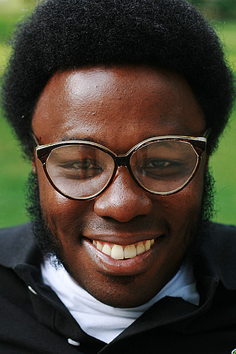
Why Student-Focused Learning?
Student-focused learning restored many teachers’ faith in education and enthusiasm about their work. Many teachers felt unfulfilled in a traditional environment, feeling that they weren’t meeting their students’ needs and that there were constantly roadblocks in their way.
KnowledgeWorks
Notes:
Personalized learning is the best way to maximize all of the technology resources that many teachers have available to them. With one-to-one initiatives and large achievement gaps, personalized learning just makes sense.

Slide 30
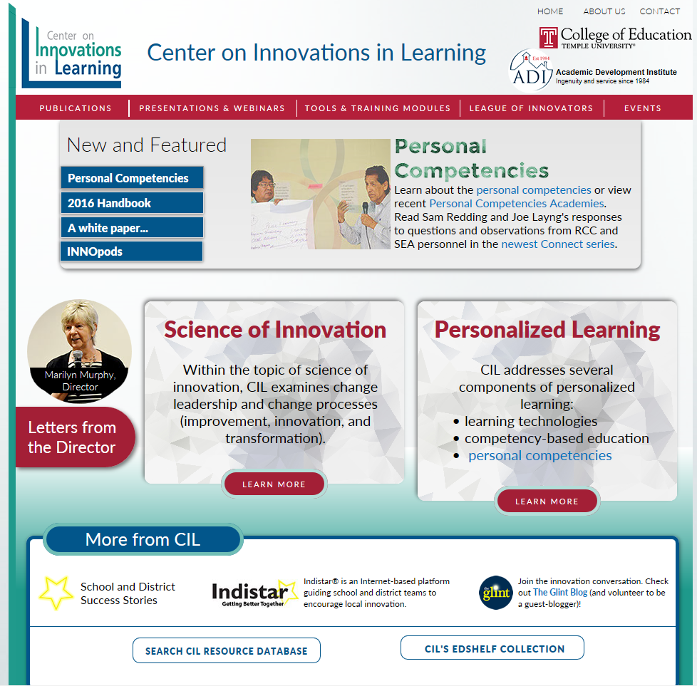
Resources for Personalized Learning
Arkansas’s ACSIP (Indistar) includes 21 indicators and Wise Ways from the Personalized Learning indicators on CIL website.
Go to www.centeril.org
Notes:
The Center on Innovations in Learning’s website is loaded with resources on Personalized Learning. Let’s look at some. Indicators in Tools. INNOpod. Handbook. Etc. Also Emily is creating a new section for this.

